Slide 1
"We're all a little mad here"
An Exhibition on Atypical Artists By Keely Shipe
Notes:
The title is a quote from Disney's "Alice in wonderland"! Visuals might change from canvas to a shifting background like you might see in the game Slay the Princess which might add more of a "swirling into the unknown" feeling.

Slide 2
Theme
Atypical, adjective, not representative of a type, group, or class. It is a common myth that artist become "mad" or mentally ill due to creativity or an artist must be mentally ill to be a creative genius. This is a harmful stereotype that limits viewers interpterion's. Either the artist is just mentally ill, or it is a product of their mental illness. In fact, there is no correlation between being mentally ill and a very successful, talented artist. Mear coincidence.

Slide 3
Theme
Deviations from the art norms and even common thought of the time often are diluted one phrase: "The artist was likely mentally ill." It is far more interesting to investigate the artist's upbringing, surroundings, or even their circumstances. With the artist chosen there are ample resources to learn about these artist, and I plan to use them to explore these artist. Each unique in their own ways, and the art that they have crafted.
"Meeting people unlike oneself does not enlarge one's outlook; it only confirms one's idea that one is unique." - Elizabeth Bowen

Slide 4
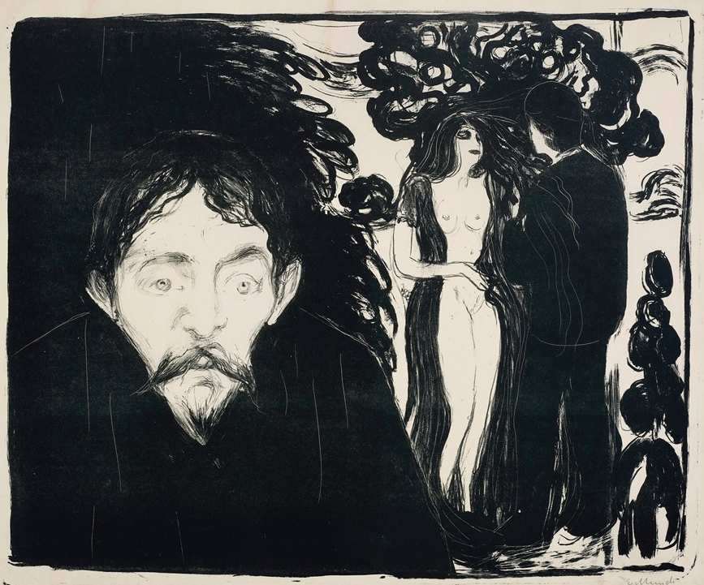
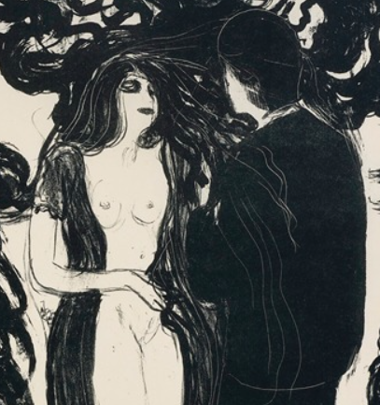
The Symbolist movement, Edvard Munch, Jealousy II, 1896
Notes:
https://artvee.com/dl/eifersucht-ii-jealousy-ii/
Jealousy II one of a series of works all under the title "Jealousy". Each of these works depict a nude woman and a man sharing a loving gaze and small touch while a man stares at the viewer with abstract ink scribbles behind him. Other works are painted, some being more works in ink, but this one speaks to me because of its overall look. This work has many variants, always of two suitors and one woman who is nude. The suitor of the foreground- Suitor A- has a livid expression with the overbearing black ink behind him taking up a large amount of the canvas. The pair in the background are obviously very absorbed with one another. In other iterations of this work the two in the background are depicted to be Adam and Eve, Eve a temptress who is always bare to the figure. A strange thing about this work is the figure in the foreground who I've purposefully forgone talking about. This is Stainislaw Przybyszewski, a close friend of Munch's. His likeness is captured with his recognizable beard. It is known that Munch had affections for his wife, and painted her in the year of their marriage. Is this Przybyszewski's jealousy of his wife and Munch's affections, or maybe this is a future that Munch wished he had with her? (“Edvard Munch Biography”) This artist fits within this category of atypical for his Bohemians’ values, and generally his unique expression of the human condition in his work. In his life, he saw both his mother at the age of five and sister at the age of thirteen die of tuberculosis. These events have been theorized to shape Munch as not only a person, but as a artist as well. After all, Munch himself barely survived as a child from tuberculosis. His father held "dogmatic, fervent religious beliefs" which he rebelled against as he was raised, clearly effecting the young man as well. Munch is said to be one of the most effective artist who expressed the human experience and the human psyche in his time, making waves with his pieces "The Scream" and "The Sickly Child" which both have much more information on their own. (“Edvard Munch Biography”) While Munch is one of the most renowned artist who sits in the Mad artist myth, there is no denying that it had some influence on his work. Despite this, his portrayal of these feelings and overwhelming emotions within his art set him apart from other artist within the symbolism movement. Edvard Munch receives the atypical stamp of approval!

Slide 5
The Symbolist movement, Edvard Munch, Jealousy II, 1896
Jealousy is a series of works made by Munch each depicting the same scene. A nude woman and man in modern dress sharing a romantic embrace. And a second, assumed to be another suitor, staring at the viewer.
Notes:
https://artvee.com/dl/eifersucht-ii-jealousy-ii/
Jealousy II one of a series of works all under the title "Jealousy". Each of these works depict a nude woman and a man sharing a loving gaze and small touch while a man stares at the viewer with abstract ink scribbles behind him. Other works are painted, some being more works in ink, but this one speaks to me because of its overall look. This work has many variants, always of two suitors and one woman who is nude. The suitor of the foreground- Suitor A- has a livid expression with the overbearing black ink behind him taking up a large amount of the canvas. The pair in the background are obviously very absorbed with one another. In other iterations of this work the two in the background are depicted to be Adam and Eve, Eve a temptress who is always bare to the figure. A strange thing about this work is the figure in the foreground who I've purposefully forgone talking about. This is Stainislaw Przybyszewski, a close friend of Munch's. His likeness is captured with his recognizable beard. It is known that Munch had affections for his wife, and painted her in the year of their marriage. Is this Przybyszewski's jealousy of his wife and Munch's affections, or maybe this is a future that Munch wished he had with her? (“Edvard Munch Biography”) This artist fits within this category of atypical for his Bohemians’ values, and generally his unique expression of the human condition in his work. In his life, he saw both his mother at the age of five and sister at the age of thirteen die of tuberculosis. These events have been theorized to shape Munch as not only a person, but as a artist as well. After all, Munch himself barely survived as a child from tuberculosis. His father held "dogmatic, fervent religious beliefs" which he rebelled against as he was raised, clearly effecting the young man as well. Munch is said to be one of the most effective artist who expressed the human experience and the human psyche in his time, making waves with his pieces "The Scream" and "The Sickly Child" which both have much more information on their own. (“Edvard Munch Biography”) While Munch is one of the most renowned artist who sits in the Mad artist myth, there is no denying that it had some influence on his work. Despite this, his portrayal of these feelings and overwhelming emotions within his art set him apart from other artist within the symbolism movement. Edvard Munch receives the atypical stamp of approval!

Slide 6
The Symbolist movement, Edvard Munch, Jealousy II, 1896
Notice the second suitor's livid expression and the mass that is behind him. The suitor in the foreground is a real person, a close friend of Munch, Stainislaw Przybyszewski. His likeness is captured with his recognizable beard and prominent nose. ​ ​
Notes:
https://artvee.com/dl/eifersucht-ii-jealousy-ii/
Jealousy II one of a series of works all under the title "Jealousy". Each of these works depict a nude woman and a man sharing a loving gaze and small touch while a man stares at the viewer with abstract ink scribbles behind him. Other works are painted, some being more works in ink, but this one speaks to me because of its overall look. This work has many variants, always of two suitors and one woman who is nude. The suitor of the foreground- Suitor A- has a livid expression with the overbearing black ink behind him taking up a large amount of the canvas. The pair in the background are obviously very absorbed with one another. In other iterations of this work the two in the background are depicted to be Adam and Eve, Eve a temptress who is always bare to the figure. A strange thing about this work is the figure in the foreground who I've purposefully forgone talking about. This is Stainislaw Przybyszewski, a close friend of Munch's. His likeness is captured with his recognizable beard. It is known that Munch had affections for his wife, and painted her in the year of their marriage. Is this Przybyszewski's jealousy of his wife and Munch's affections, or maybe this is a future that Munch wished he had with her? (“Edvard Munch Biography”) This artist fits within this category of atypical for his Bohemians’ values, and generally his unique expression of the human condition in his work. In his life, he saw both his mother at the age of five and sister at the age of thirteen die of tuberculosis. These events have been theorized to shape Munch as not only a person, but as a artist as well. After all, Munch himself barely survived as a child from tuberculosis. His father held "dogmatic, fervent religious beliefs" which he rebelled against as he was raised, clearly effecting the young man as well. Munch is said to be one of the most effective artist who expressed the human experience and the human psyche in his time, making waves with his pieces "The Scream" and "The Sickly Child" which both have much more information on their own. (“Edvard Munch Biography”) While Munch is one of the most renowned artist who sits in the Mad artist myth, there is no denying that it had some influence on his work. Despite this, his portrayal of these feelings and overwhelming emotions within his art set him apart from other artist within the symbolism movement. Edvard Munch receives the atypical stamp of approval!

Slide 7
The Symbolist movement, Edvard Munch, Jealousy II, 1896
An interesting detail of this work is that the two lovers in the background are Adam and Eve. The garment that is strown around her is typically red and behind her is the tree with apples. Eve is the temptress here leading Adam to sin much like many retellings and interpretations of the story.
Notes:
https://artvee.com/dl/eifersucht-ii-jealousy-ii/
Jealousy II one of a series of works all under the title "Jealousy". Each of these works depict a nude woman and a man sharing a loving gaze and small touch while a man stares at the viewer with abstract ink scribbles behind him. Other works are painted, some being more works in ink, but this one speaks to me because of its overall look. This work has many variants, always of two suitors and one woman who is nude. The suitor of the foreground- Suitor A- has a livid expression with the overbearing black ink behind him taking up a large amount of the canvas. The pair in the background are obviously very absorbed with one another. In other iterations of this work the two in the background are depicted to be Adam and Eve, Eve a temptress who is always bare to the figure. A strange thing about this work is the figure in the foreground who I've purposefully forgone talking about. This is Stainislaw Przybyszewski, a close friend of Munch's. His likeness is captured with his recognizable beard. It is known that Munch had affections for his wife, and painted her in the year of their marriage. Is this Przybyszewski's jealousy of his wife and Munch's affections, or maybe this is a future that Munch wished he had with her? (“Edvard Munch Biography”) This artist fits within this category of atypical for his Bohemians’ values, and generally his unique expression of the human condition in his work. In his life, he saw both his mother at the age of five and sister at the age of thirteen die of tuberculosis. These events have been theorized to shape Munch as not only a person, but as a artist as well. After all, Munch himself barely survived as a child from tuberculosis. His father held "dogmatic, fervent religious beliefs" which he rebelled against as he was raised, clearly effecting the young man as well. Munch is said to be one of the most effective artist who expressed the human experience and the human psyche in his time, making waves with his pieces "The Scream" and "The Sickly Child" which both have much more information on their own. (“Edvard Munch Biography”) While Munch is one of the most renowned artist who sits in the Mad artist myth, there is no denying that it had some influence on his work. Despite this, his portrayal of these feelings and overwhelming emotions within his art set him apart from other artist within the symbolism movement. Edvard Munch receives the atypical stamp of approval!

Slide 8
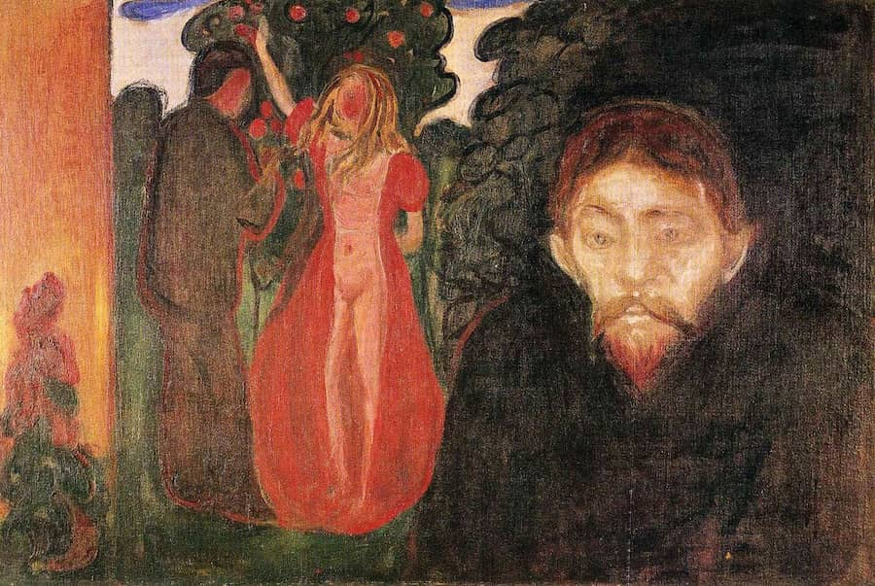
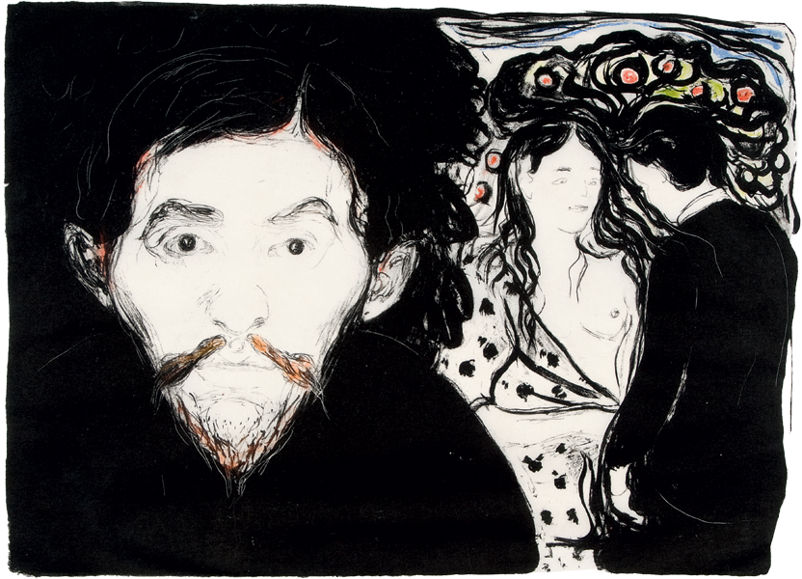
Other iterations of Edward Munch's Jealousy
Notes:
https://www.edvardmunch.org/jealousy.jsp#google_vignette and https://galleryintell.com/edvard-munch-screams/phoca_thumb_l_13_1896_jealousy_832_600/

Slide 9
The Symbolist movement, Edvard Munch, Jealousy II, 1896
Munch is known for having a troubled upbringing and a father with mental illness and his own anxieties that are depicted in his most famous work "The Scream."
Considering his upbringing and tragedies that he experienced, maybe his relationship with the women in his life has influenced his art? ​
Notes:
https://artvee.com/dl/eifersucht-ii-jealousy-ii/
Jealousy II one of a series of works all under the title "Jealousy". Each of these works depict a nude woman and a man sharing a loving gaze and small touch while a man stares at the viewer with abstract ink scribbles behind him. Other works are painted, some being more works in ink, but this one speaks to me because of its overall look. This work has many variants, always of two suitors and one woman who is nude. The suitor of the foreground- Suitor A- has a livid expression with the overbearing black ink behind him taking up a large amount of the canvas. The pair in the background are obviously very absorbed with one another. In other iterations of this work the two in the background are depicted to be Adam and Eve, Eve a temptress who is always bare to the figure. A strange thing about this work is the figure in the foreground who I've purposefully forgone talking about. This is Stainislaw Przybyszewski, a close friend of Munch's. His likeness is captured with his recognizable beard. It is known that Munch had affections for his wife, and painted her in the year of their marriage. Is this Przybyszewski's jealousy of his wife and Munch's affections, or maybe this is a future that Munch wished he had with her? (“Edvard Munch Biography”) This artist fits within this category of atypical for his Bohemians’ values, and generally his unique expression of the human condition in his work. In his life, he saw both his mother at the age of five and sister at the age of thirteen die of tuberculosis. These events have been theorized to shape Munch as not only a person, but as a artist as well. After all, Munch himself barely survived as a child from tuberculosis. His father held "dogmatic, fervent religious beliefs" which he rebelled against as he was raised, clearly effecting the young man as well. Munch is said to be one of the most effective artist who expressed the human experience and the human psyche in his time, making waves with his pieces "The Scream" and "The Sickly Child" which both have much more information on their own. (“Edvard Munch Biography”) While Munch is one of the most renowned artist who sits in the Mad artist myth, there is no denying that it had some influence on his work. Despite this, his portrayal of these feelings and overwhelming emotions within his art set him apart from other artist within the symbolism movement. Edvard Munch receives the atypical stamp of approval!

Slide 10
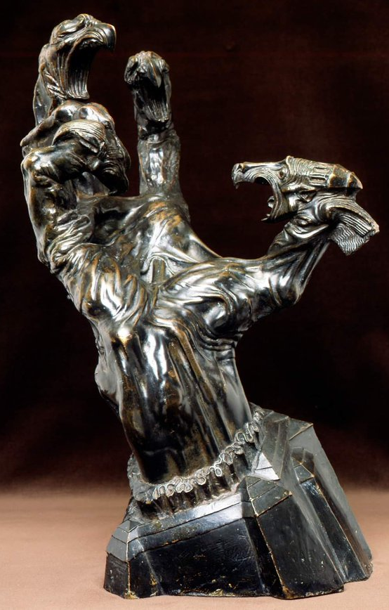
Postmodernism, Stanislav Szukalski, Struggle, 1917
Notes:
Twitter
This artwork is one of Szukalski's works that still exist today, however context and really any sources about the guy are difficult to find. This may be because of the bombing of Warsaw where most of his work was destroyed, but some remained such as the artwork titled "Struggle". "Szukalski has said that 'without the thumbs, we would not make tools and without tools, we would not make civilizations.'" This piece can be interpreted as the struggle between the brilliant and the ordinary. Each of the heads of eagles are attacking the brilliant thumb, the creator and tool for so much. In Szukalski's case, this happened to be the scientific world VS his pseudoscience beliefs. He formed the belief of Zermatism, the belief that everyone was apes who broke into two groups. The beautiful, talented, and good: and the ugly, deformed, and bad people. These beliefs were beyond the norms of the time, and more far fetched than many other theories! (The Collector). (This will be worked upon, it is 12am and I've been working for so long, forgive me :sob: just look at the others)

Slide 11
Postmodernism, Stanislav Szukalski, Struggle, 1917
Stanislav Szukalski is a Polish artist known for his creation of Zermatism. The pseudoscientific belief that humans began as two types of apes: The beautiful and pure, and the communist, nazis.
Even for his time this was not the common thought which can loop back to the artwork "Struggle".
Notes:
Twitter
This artwork is one of Szukalski's works that still exist today, however context and really any sources about the guy are difficult to find. This may be because of the bombing of Warsaw where most of his work was destroyed, but some remained such as the artwork titled "Struggle". "Szukalski has said that 'without the thumbs, we would not make tools and without tools, we would not make civilizations.'" This piece can be interpreted as the struggle between the brilliant and the ordinary. Each of the heads of eagles are attacking the brilliant thumb, the creator and tool for so much. In Szukalski's case, this happened to be the scientific world VS his pseudoscience beliefs. He formed the belief of Zermatism, the belief that everyone was apes who broke into two groups. The beautiful, talented, and good: and the ugly, deformed, and bad people. These beliefs were beyond the norms of the time, and more far fetched than many other theories! (The Collector). (This will be worked upon, it is 12am and I've been working for so long, forgive me :sob: just look at the others)

Slide 12
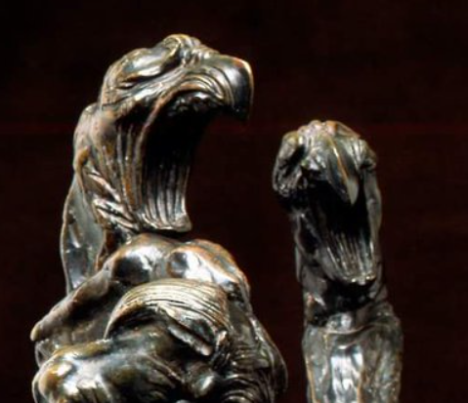
Postmodernism, Stanislav Szukalski, Struggle, 1917
“Without the thumbs, we would not make tools and without tools, we would not make civilizations.” -Szukalski
The thumb of this work represents the idea of the creators, or even the artist himself. The fingers are the common people who oppose creation and change.
Notes:
Twitter
This artwork is one of Szukalski's works that still exist today, however context and really any sources about the guy are difficult to find. This may be because of the bombing of Warsaw where most of his work was destroyed, but some remained such as the artwork titled "Struggle". "Szukalski has said that 'without the thumbs, we would not make tools and without tools, we would not make civilizations.'" This piece can be interpreted as the struggle between the brilliant and the ordinary. Each of the heads of eagles are attacking the brilliant thumb, the creator and tool for so much. In Szukalski's case, this happened to be the scientific world VS his pseudoscience beliefs. He formed the belief of Zermatism, the belief that everyone was apes who broke into two groups. The beautiful, talented, and good: and the ugly, deformed, and bad people. These beliefs were beyond the norms of the time, and more far fetched than many other theories! (The Collector). (This will be worked upon, it is 12am and I've been working for so long, forgive me :sob: just look at the others)

Slide 13
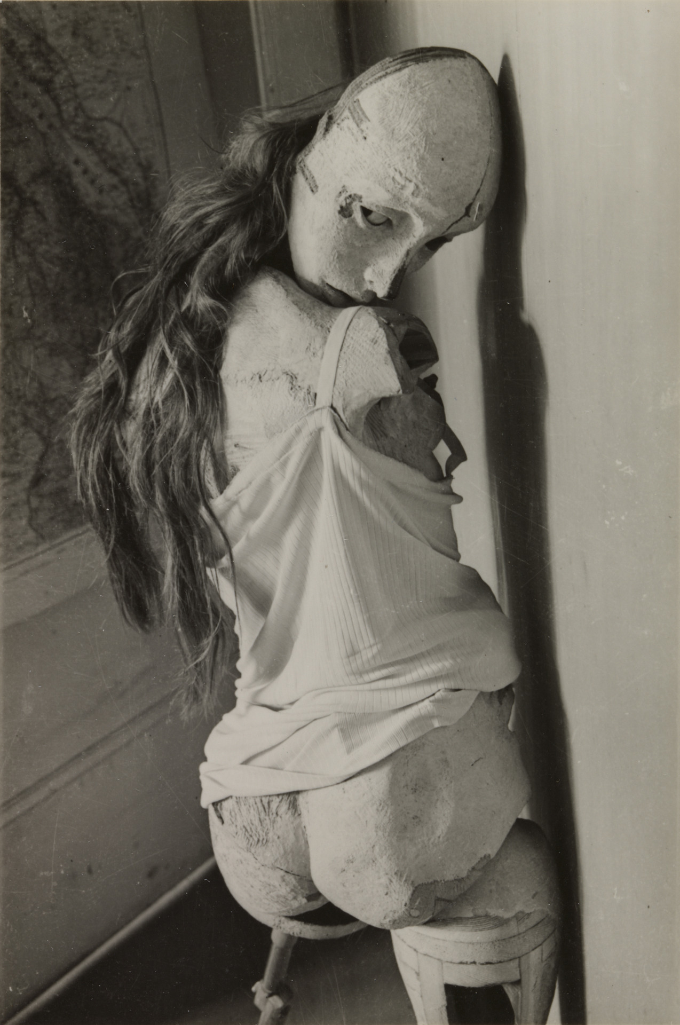
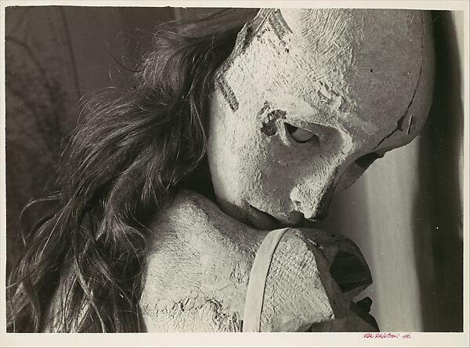
Surrealism, Hans Bellmer, The Doll, 1934
Notes:
https://www.metmuseum.org/art/collection/search/265312
Hans Bellmer, for lack of better phrasing, was weird. This is Bellmer's first doll, large and paper machete posed to be facing away from the viewer in this black and white photograph. The inherit look of distress and fear in the posture evokes strong emotions from any viewer, however those thoughts were not this doll's intended use. The series of photographs have content of female masturbation, and sexual depictions of this doll. The objectification of women in this piece is appalling for modern viewers, but in it's time this photo was suppose to be sexy, coy, and generally appealing for the male gaze. "So powerful and convincing are the effects of Bellmer’s manipulations that (male) commentators on this work have often readily embraced the fiction of the doll as temptress." (Taylor, 31) Missing limbs and the shying away from whoever this doll is looking in a modern context is disgusting, not to mention this work is depicting a schoolgirl… (Webb, 1) blames the doll’s very inertness for his own libidinous daydreams: 'Her passivity invites our attentions, whether kind or cruel, to rumple her beribbonned hair, to make up her lips, to mark her with love-bites, to paint bruises on her knees, and to splash with mud her long, pink, schoolgirl’s legs.'" (Taylor, 31) Disgusting. >:[ I have so very many thoughts about this piece. Clearly the fiction that Bellmer lived in with his dolls in his home to do whatever to them is not usual, and generally disgusting. No person in their right mind would think this to be just, correct, or normal for any person to think even about the visage of a human. This gratification of the fetishes the artist held, and by extent a fraction of his viewers, are not right. The passivity of the doll, or any women, does not mean it wants you to have sex with it. In fact it likely means the opposite. This was typical of his works to use these dolls and manipulate them into positions that were sexual and made to look sexual. This is a very odd artist for his time when surrealism typically did not medle in pedophilla and fetishes which grants this artist the "atypical" title.

Slide 14
Surrealism, Hans Bellmer, The Doll, 1934
Hans Bellmer is not a trained artist. Hans Bellmer made "The Doll", "La Poupée", and other untitled works. Each were a collection of photographs of dolls made by Bellmer. These photographs' content are normally overly sexual displaying an aftermath of abuse, most notably in the second doll made in 1935.
Notes:
https://www.metmuseum.org/art/collection/search/265312
Hans Bellmer, for lack of better phrasing, was weird. This is Bellmer's first doll, large and paper machete posed to be facing away from the viewer in this black and white photograph. The inherit look of distress and fear in the posture evokes strong emotions from any viewer, however those thoughts were not this doll's intended use. The series of photographs have content of female masturbation, and sexual depictions of this doll. The objectification of women in this piece is appalling for modern viewers, but in it's time this photo was suppose to be sexy, coy, and generally appealing for the male gaze. "So powerful and convincing are the effects of Bellmer’s manipulations that (male) commentators on this work have often readily embraced the fiction of the doll as temptress." (Taylor, 31) Missing limbs and the shying away from whoever this doll is looking in a modern context is disgusting, not to mention this work is depicting a "schoolgirl"! "… (Webb, 1) blames the doll’s very inertness for his own libidinous daydreams: 'Her passivity invites our attentions, whether kind or cruel, to rumple her beribbonned hair, to make up her lips, to mark her with love-bites, to paint bruises on her knees, and to splash with mud her long, pink, schoolgirl’s legs.'" (Taylor, 31) Disgusting. >:[ I have so very many thoughts about this piece. Clearly the fiction that Bellmer lived in with his dolls in his home to do whatever to them is not usual, and generally disgusting. No person in their right mind would think this to be just, correct, or normal for any person to think even about the visage of a human. This gratification of the fetishes the artist held, and by extent a fraction of his viewers, are not right. The passivity of the doll, or any women, does not mean it wants you to have sex with it. In fact it likely means the opposite. This was typical of his works to use these dolls and manipulate them into positions that were sexual and made to look sexual. This is a very odd artist for his time when surrealism typically did not medle in pedophilla and fetishes which grants this artist the "atypical" title.

Slide 15
Surrealism, Hans Bellmer, The Doll, 1934
Hans Bellmer had a troubled childhood, being abused by his father and this reflecting into the second doll that he made.
Truly the fetishizing of abuse in the form of sadomasochism is seen in all the works. All the Dolls are missing limbs, anatomically incorrect, and otherwise appear tortured.
Notes:
https://www.metmuseum.org/art/collection/search/265312
Hans Bellmer, for lack of better phrasing, was weird. This is Bellmer's first doll, large and paper machete posed to be facing away from the viewer in this black and white photograph. The inherit look of distress and fear in the posture evokes strong emotions from any viewer, however those thoughts were not this doll's intended use. The series of photographs have content of female masturbation, and sexual depictions of this doll. The objectification of women in this piece is appalling for modern viewers, but in it's time this photo was suppose to be sexy, coy, and generally appealing for the male gaze. "So powerful and convincing are the effects of Bellmer’s manipulations that (male) commentators on this work have often readily embraced the fiction of the doll as temptress." (Taylor, 31) Missing limbs and the shying away from whoever this doll is looking in a modern context is disgusting, not to mention this work is depicting a "schoolgirl"! "… (Webb, 1) blames the doll’s very inertness for his own libidinous daydreams: 'Her passivity invites our attentions, whether kind or cruel, to rumple her beribbonned hair, to make up her lips, to mark her with love-bites, to paint bruises on her knees, and to splash with mud her long, pink, schoolgirl’s legs.'" (Taylor, 31) Disgusting. >:[ I have so very many thoughts about this piece. Clearly the fiction that Bellmer lived in with his dolls in his home to do whatever to them is not usual, and generally disgusting. No person in their right mind would think this to be just, correct, or normal for any person to think even about the visage of a human. This gratification of the fetishes the artist held, and by extent a fraction of his viewers, are not right. The passivity of the doll, or any women, does not mean it wants you to have sex with it. In fact it likely means the opposite. This was typical of his works to use these dolls and manipulate them into positions that were sexual and made to look sexual. This is a very odd artist for his time when surrealism typically did not medle in pedophilla and fetishes which grants this artist the "atypical" title.

Slide 16
Surrealism, Hans Bellmer, The Doll, 1934
This work here is supposed to be a temptress, coy and sexy looking over her shoulder to invite the viewer to think sexually of her. In the context of a modern viewer this artwork says the opposite. The doll looks scared and weak than anything. Powerless and making herself smaller as a safety mechanism. And even worse: Bellmer intended for her to be a schoolgirl.
Notes:
https://www.metmuseum.org/art/collection/search/265312
Hans Bellmer, for lack of better phrasing, was weird. This is Bellmer's first doll, large and paper machete posed to be facing away from the viewer in this black and white photograph. The inherit look of distress and fear in the posture evokes strong emotions from any viewer, however those thoughts were not this doll's intended use. The series of photographs have content of female masturbation, and sexual depictions of this doll. The objectification of women in this piece is appalling for modern viewers, but in it's time this photo was suppose to be sexy, coy, and generally appealing for the male gaze. "So powerful and convincing are the effects of Bellmer’s manipulations that (male) commentators on this work have often readily embraced the fiction of the doll as temptress." (Taylor, 31) Missing limbs and the shying away from whoever this doll is looking in a modern context is disgusting, not to mention this work is depicting a "schoolgirl"! "… (Webb, 1) blames the doll’s very inertness for his own libidinous daydreams: 'Her passivity invites our attentions, whether kind or cruel, to rumple her beribbonned hair, to make up her lips, to mark her with love-bites, to paint bruises on her knees, and to splash with mud her long, pink, schoolgirl’s legs.'" (Taylor, 31) Disgusting. >:[ I have so very many thoughts about this piece. Clearly the fiction that Bellmer lived in with his dolls in his home to do whatever to them is not usual, and generally disgusting. No person in their right mind would think this to be just, correct, or normal for any person to think even about the visage of a human. This gratification of the fetishes the artist held, and by extent a fraction of his viewers, are not right. The passivity of the doll, or any women, does not mean it wants you to have sex with it. In fact it likely means the opposite. This was typical of his works to use these dolls and manipulate them into positions that were sexual and made to look sexual. This is a very odd artist for his time when surrealism typically did not medle in pedophilla and fetishes which grants this artist the "atypical" title.

Slide 17
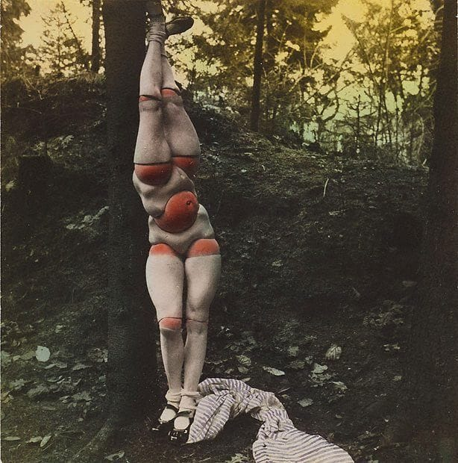
Hans Bellmer other works
Plate from La Poupée
Untitled, 1935
Untitled. 1935
Notes:
https://www.moma.org/artists/452#works and https://arthur.io/art/hans-bellmer/untitled-2 I hate this guy

Slide 18
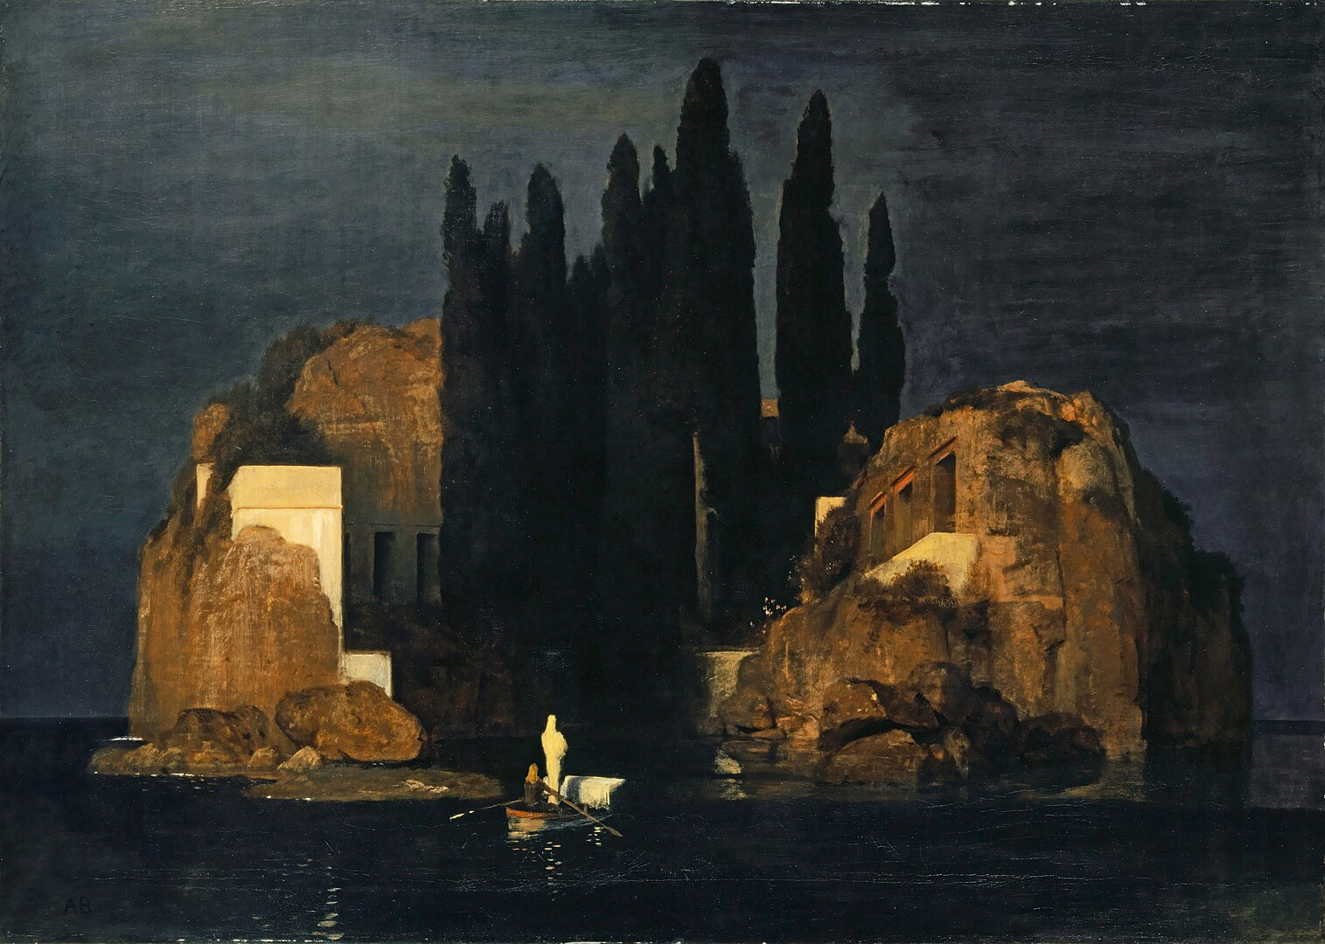
The Symbolist movement, Arnold Böcklin, Isle of the Dead: "Basel" version, 1880
Notes:
Wikipedia
Looking at this painting there is a lot to digest about it. The isles before the white figure sailing into the unknown with an oarsman, shadowy area that is "The Isle of Death". This boat is generally considered and understood to be a coffin, with doorways and structures cut into the rocks of the isle. Before getting more into the painting I would like to turn out attention to Böcklin, the artist. He was remarked as an artist with great memory, even he himself noted how important memory was to his works. "It is often much better not to paint studies’, he told his apprentice Rudolf Schick, ‘but to try to practice one’s memory and...observe everything’." (Frank, 1) This of course was not the only thing that made his work remarkable. "Although Böcklin’s greatness was often related to his powerful memory and creative imagination, it could also be linked to his power of attention, which had been considered a mark of genius since at least the eighteenth century." (Frank, 5) A feature that not many artist are acclaimed for, though he did not like to be considered as such a popular artist. He immersed himself if the technical skills of painters in the renaissance. Böcklin was also known for his depictions of mythology in a non traditional sense. This piece is particularly ambiguous, no clear myth is at play. Is this the ferryman who lead souls to their afterlife, Charon? This is a depiction of a real island, which is not typical for myths of the Styx and Hades. ("The Art Story")
This work's first three versions were called "A Quiet Place" (Wow like that one movie!), then changed it after he was commissioned for a third version. Famously, one of these paintings ended up in the hands of one of Böcklin's admirers.... Adolf Hitler, if you've ever heard of that guy. Bocklin has not done much to explain the theme of the work himself but only suggested that it was reminiscent of a dream. This work found it's way into many German homes and with it's themes of the beauty of nature and honoring of death it is clear as to why it was so popular. One of his most popular and recognizable pieces with such a mysterious and ethereal sense to it grants Böcklin the Atypical category.

Slide 19
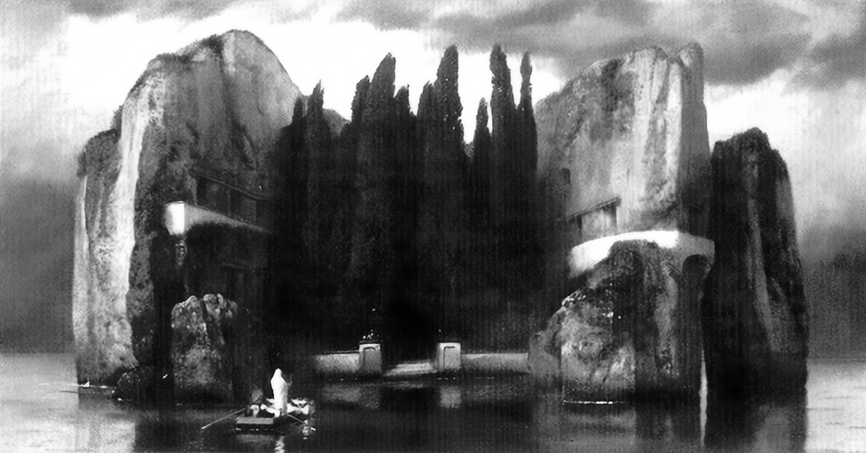
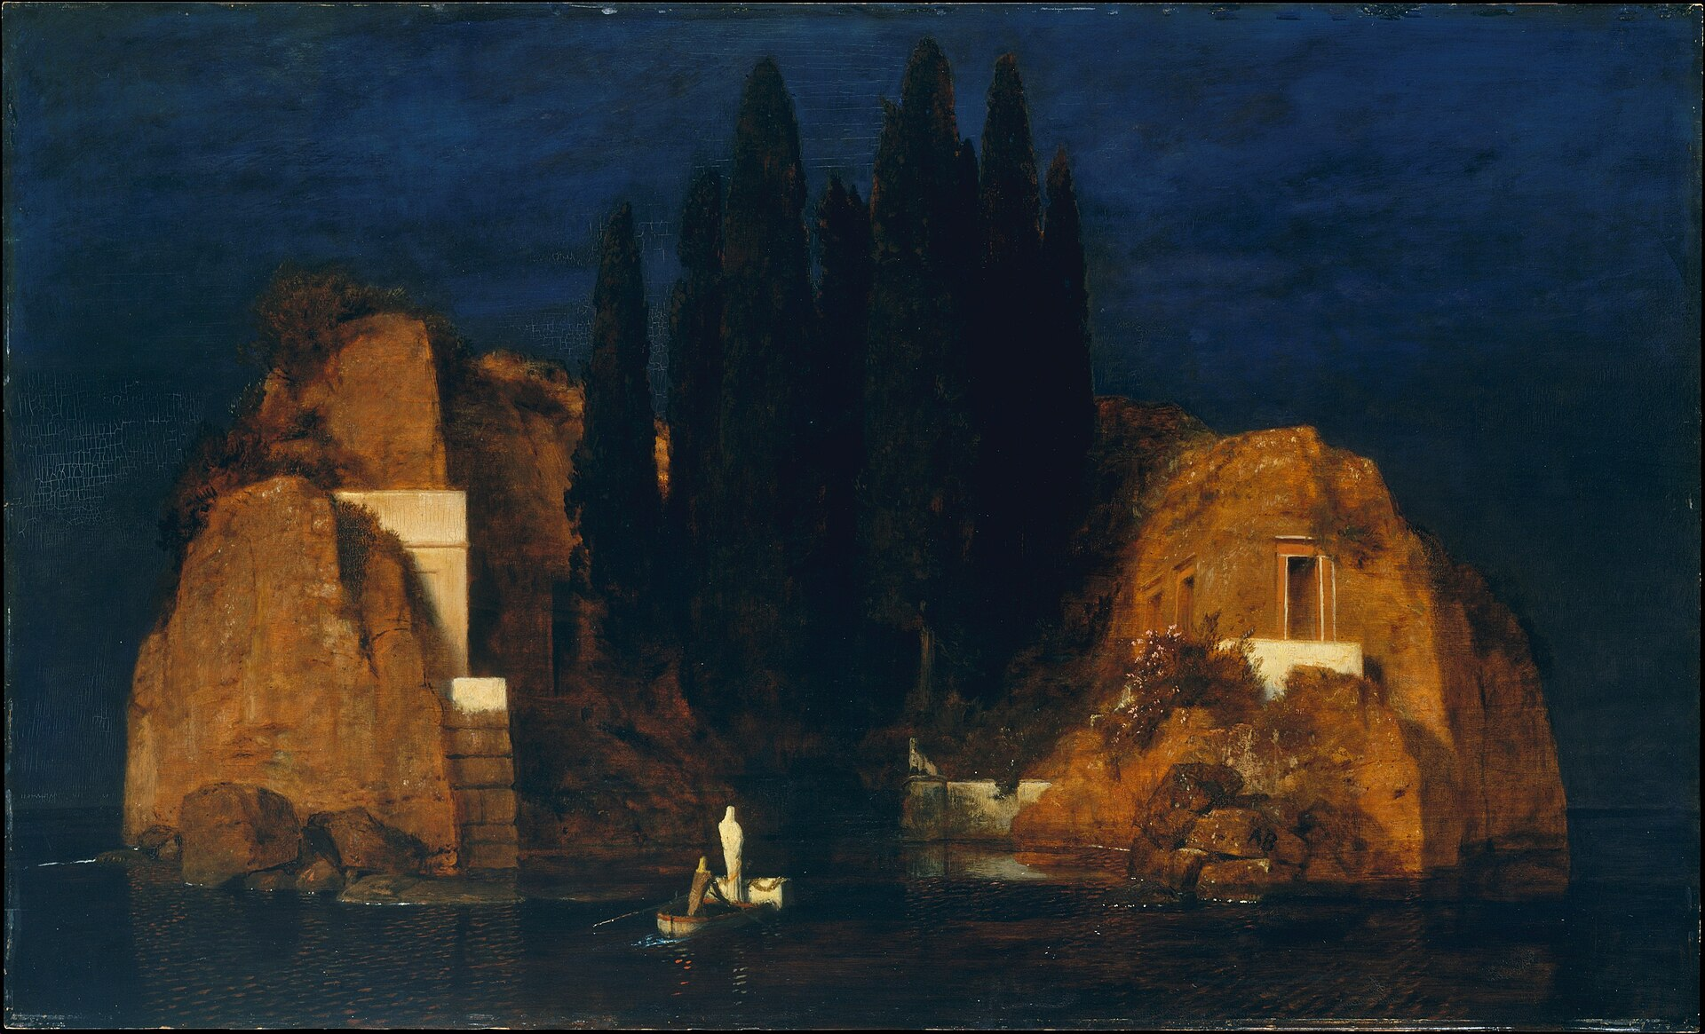
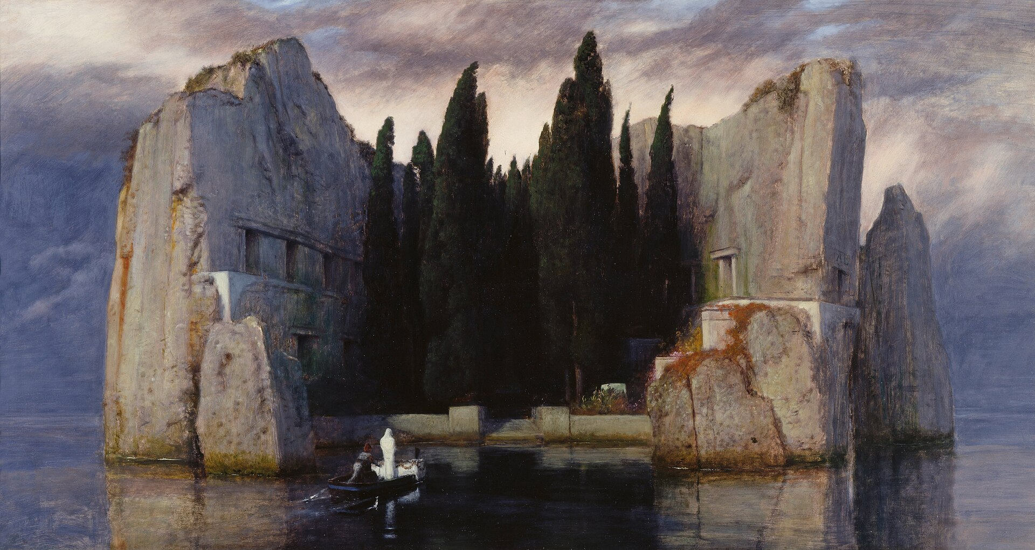
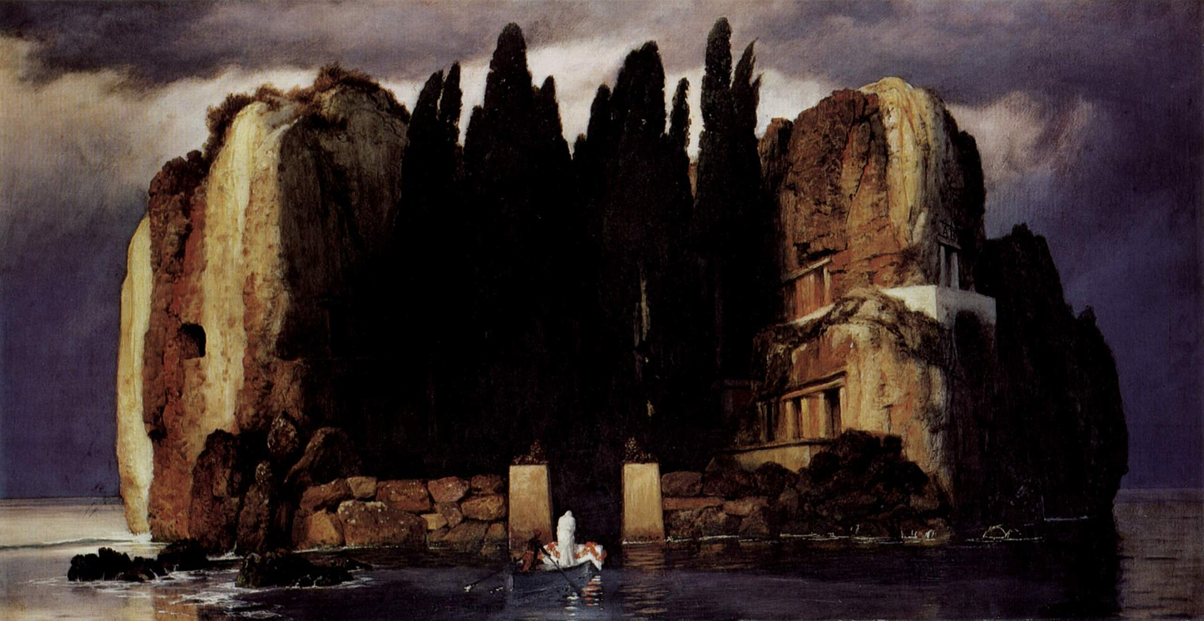
The Symbolist movement, Arnold Böcklin, Isle of the Dead, 1880-1886
Notes:
Wikipedia
Looking at this painting there is a lot to digest about it. The isles before the white figure sailing into the unknown with an oarsman, shadowy area that is "The Isle of Death". This boat is generally considered and understood to be a coffin, with doorways and structures cut into the rocks of the isle. Before getting more into the painting I would like to turn out attention to Böcklin, the artist. He was remarked as an artist with great memory, even he himself noted how important memory was to his works. "It is often much better not to paint studies’, he told his apprentice Rudolf Schick, ‘but to try to practice one’s memory and...observe everything’." (Frank, 1) This of course was not the only thing that made his work remarkable. "Although Böcklin’s greatness was often related to his powerful memory and creative imagination, it could also be linked to his power of attention, which had been considered a mark of genius since at least the eighteenth century." (Frank, 5) A feature that not many artist are acclaimed for, though he did not like to be considered as such a popular artist. He immersed himself if the technical skills of painters in the renaissance. Böcklin was also known for his depictions of mythology in a non traditional sense. This piece is particularly ambiguous, no clear myth is at play. Is this the ferryman who lead souls to their afterlife, Charon? This is a depiction of a real island, which is not typical for myths of the Styx and Hades. ("The Art Story")
This work's first three versions were called "A Quiet Place" (Wow like that one movie!), then changed it after he was commissioned for a third version. Famously, one of these paintings ended up in the hands of one of Böcklin's admirers.... Adolf Hitler, if you've ever heard of that guy. Bocklin has not done much to explain the theme of the work himself but only suggested that it was reminiscent of a dream. This work found it's way into many German homes and with it's themes of the beauty of nature and honoring of death it is clear as to why it was so popular. One of his most popular and recognizable pieces with such a mysterious and ethereal sense to it grants Böcklin the Atypical category.

Slide 20
The Symbolist movement, Arnold Böcklin, Isle of the Dead: "Basel" version, 1880
Böcklin is a Symbolist artist who was regarded by many to have an excellent memory.
"It is often much better not to paint studies’, he told his apprentice Rudolf Schick, ‘but to try to practice one’s memory and...observe everything’.
Notes:
Wikipedia
Looking at this painting there is a lot to digest about it. The isles before the white figure sailing into the unknown with an oarsman, shadowy area that is "The Isle of Death". This boat is generally considered and understood to be a coffin, with doorways and structures cut into the rocks of the isle. Before getting more into the painting I would like to turn out attention to Böcklin, the artist. He was remarked as an artist with great memory, even he himself noted how important memory was to his works. "It is often much better not to paint studies’, he told his apprentice Rudolf Schick, ‘but to try to practice one’s memory and...observe everything’." (Frank, 69) This of course was not the only thing that made his work remarkable. "Although Böcklin’s greatness was often related to his powerful memory and creative imagination, it could also be linked to his power of attention, which had been considered a mark of genius since at least the eighteenth century." (Frank, 73) A feature that not many artist are acclaimed for, though he did not like to be considered as such a popular artist. He immersed himself if the technical skills of painters in the renaissance. Böcklin was also known for his depictions of mythology in a non traditional sense. This piece is particularly ambiguous, no clear myth is at play. Is this the ferryman who lead souls to their afterlife, Charon? This is a depiction of a real island, which is not typical for myths of the Styx and Hades. ("The Art Story")
This work's first three versions were called "A Quiet Place" (Wow like that one movie!), then changed it after he was commissioned for a third version. Famously, one of these paintings ended up in the hands of one of Böcklin's admirers.... Adolf Hitler, if you've ever heard of that guy. Bocklin has not done much to explain the theme of the work himself but only suggested that it was reminiscent of a dream. This work found it's way into many German homes and with it's themes of the beauty of nature and honoring of death it is clear as to why it was so popular. One of his most popular and recognizable pieces with such a mysterious and ethereal sense to it grants Böcklin the Atypical category.

Slide 21
The Symbolist movement, Arnold Böcklin, Isle of the Dead: "Basel" version, 1880
It is theorized that this is a depiction of Charon, the boatman on the Styx who leads souls to their afterlife... Though it is not clear enough to tell 100%. It maybe another, similar myth found in Roman mythology. Another odd thing about this work is that it is a depiction of a real island which is not typical in myths of the Styx.
Notes:
Wikipedia
Looking at this painting there is a lot to digest about it. The isles before the white figure sailing into the unknown with an oarsman, shadowy area that is "The Isle of Death". This boat is generally considered and understood to be a coffin, with doorways and structures cut into the rocks of the isle. Before getting more into the painting I would like to turn out attention to Böcklin, the artist. He was remarked as an artist with great memory, even he himself noted how important memory was to his works. "It is often much better not to paint studies’, he told his apprentice Rudolf Schick, ‘but to try to practice one’s memory and...observe everything’." (Frank, 69) This of course was not the only thing that made his work remarkable. "Although Böcklin’s greatness was often related to his powerful memory and creative imagination, it could also be linked to his power of attention, which had been considered a mark of genius since at least the eighteenth century." (Frank, 73) A feature that not many artist are acclaimed for, though he did not like to be considered as such a popular artist. He immersed himself if the technical skills of painters in the renaissance. Böcklin was also known for his depictions of mythology in a non traditional sense. This piece is particularly ambiguous, no clear myth is at play. Is this the ferryman who lead souls to their afterlife, Charon? This is a depiction of a real island, which is not typical for myths of the Styx and Hades. ("The Art Story")
This work's first three versions were called "A Quiet Place" (Wow like that one movie!), then changed it after he was commissioned for a third version. Famously, one of these paintings ended up in the hands of one of Böcklin's admirers.... Adolf Hitler, if you've ever heard of that guy. Bocklin has not done much to explain the theme of the work himself but only suggested that it was reminiscent of a dream. This work found it's way into many German homes and with it's themes of the beauty of nature and honoring of death it is clear as to why it was so popular. One of his most popular and recognizable pieces with such a mysterious and ethereal sense to it grants Böcklin the Atypical category.

Slide 22
The Symbolist movement, Arnold Böcklin, Isle of the Dead: "Basel" version, 1880
Böcklin did not like being considered a popular artist in his time, though his pieces ended up in many German homes. He used technical skills of painters in the renaissance, showing in many of his works. His works were beloved by many, this one that he was even commissioned to make a third version.
Notes:
Wikipedia
Looking at this painting there is a lot to digest about it. The isles before the white figure sailing into the unknown with an oarsman, shadowy area that is "The Isle of Death". This boat is generally considered and understood to be a coffin, with doorways and structures cut into the rocks of the isle. Before getting more into the painting I would like to turn out attention to Böcklin, the artist. He was remarked as an artist with great memory, even he himself noted how important memory was to his works. "It is often much better not to paint studies’, he told his apprentice Rudolf Schick, ‘but to try to practice one’s memory and...observe everything’." (Frank, 69) This of course was not the only thing that made his work remarkable. "Although Böcklin’s greatness was often related to his powerful memory and creative imagination, it could also be linked to his power of attention, which had been considered a mark of genius since at least the eighteenth century." (Frank, 73) A feature that not many artist are acclaimed for, though he did not like to be considered as such a popular artist. He immersed himself if the technical skills of painters in the renaissance. Böcklin was also known for his depictions of mythology in a non traditional sense. This piece is particularly ambiguous, no clear myth is at play. Is this the ferryman who lead souls to their afterlife, Charon? This is a depiction of a real island, which is not typical for myths of the Styx and Hades. ("The Art Story")
This work's first three versions were called "A Quiet Place" (Wow like that one movie!), then changed it after he was commissioned for a third version. Famously, one of these paintings ended up in the hands of one of Böcklin's admirers.... Adolf Hitler, if you've ever heard of that guy. Bocklin has not done much to explain the theme of the work himself but only suggested that it was reminiscent of a dream. This work found it's way into many German homes and with it's themes of the beauty of nature and honoring of death it is clear as to why it was so popular. One of his most popular and recognizable pieces with such a mysterious and ethereal sense to it grants Böcklin the Atypical category.

Slide 23
The Symbolist movement, Arnold Böcklin, Isle of the Dead: "Basel" version, 1880
Böcklin honors death and holds the beauty of nature supreme in this piece. While he never elaborated on the theme, he said it was reminisce of a dream which describes the work fairly accurately. An ambiguous work of a ferryman sailing a robed women to the Isle of the dead. A serene, beautiful place.
Notes:
Wikipedia
Looking at this painting there is a lot to digest about it. The isles before the white figure sailing into the unknown with an oarsman, shadowy area that is "The Isle of Death". This boat is generally considered and understood to be a coffin, with doorways and structures cut into the rocks of the isle. Before getting more into the painting I would like to turn out attention to Böcklin, the artist. He was remarked as an artist with great memory, even he himself noted how important memory was to his works. "It is often much better not to paint studies’, he told his apprentice Rudolf Schick, ‘but to try to practice one’s memory and...observe everything’." (Frank, 69) This of course was not the only thing that made his work remarkable. "Although Böcklin’s greatness was often related to his powerful memory and creative imagination, it could also be linked to his power of attention, which had been considered a mark of genius since at least the eighteenth century." (Frank, 73) A feature that not many artist are acclaimed for, though he did not like to be considered as such a popular artist. He immersed himself if the technical skills of painters in the renaissance. Böcklin was also known for his depictions of mythology in a non traditional sense. This piece is particularly ambiguous, no clear myth is at play. Is this the ferryman who lead souls to their afterlife, Charon? This is a depiction of a real island, which is not typical for myths of the Styx and Hades. ("The Art Story")
This work's first three versions were called "A Quiet Place" (Wow like that one movie!), then changed it after he was commissioned for a third version. Famously, one of these paintings ended up in the hands of one of Böcklin's admirers.... Adolf Hitler, if you've ever heard of that guy. Bocklin has not done much to explain the theme of the work himself but only suggested that it was reminiscent of a dream. This work found it's way into many German homes and with it's themes of the beauty of nature and honoring of death it is clear as to why it was so popular. One of his most popular and recognizable pieces with such a mysterious and ethereal sense to it grants Böcklin the Atypical category.

Slide 24
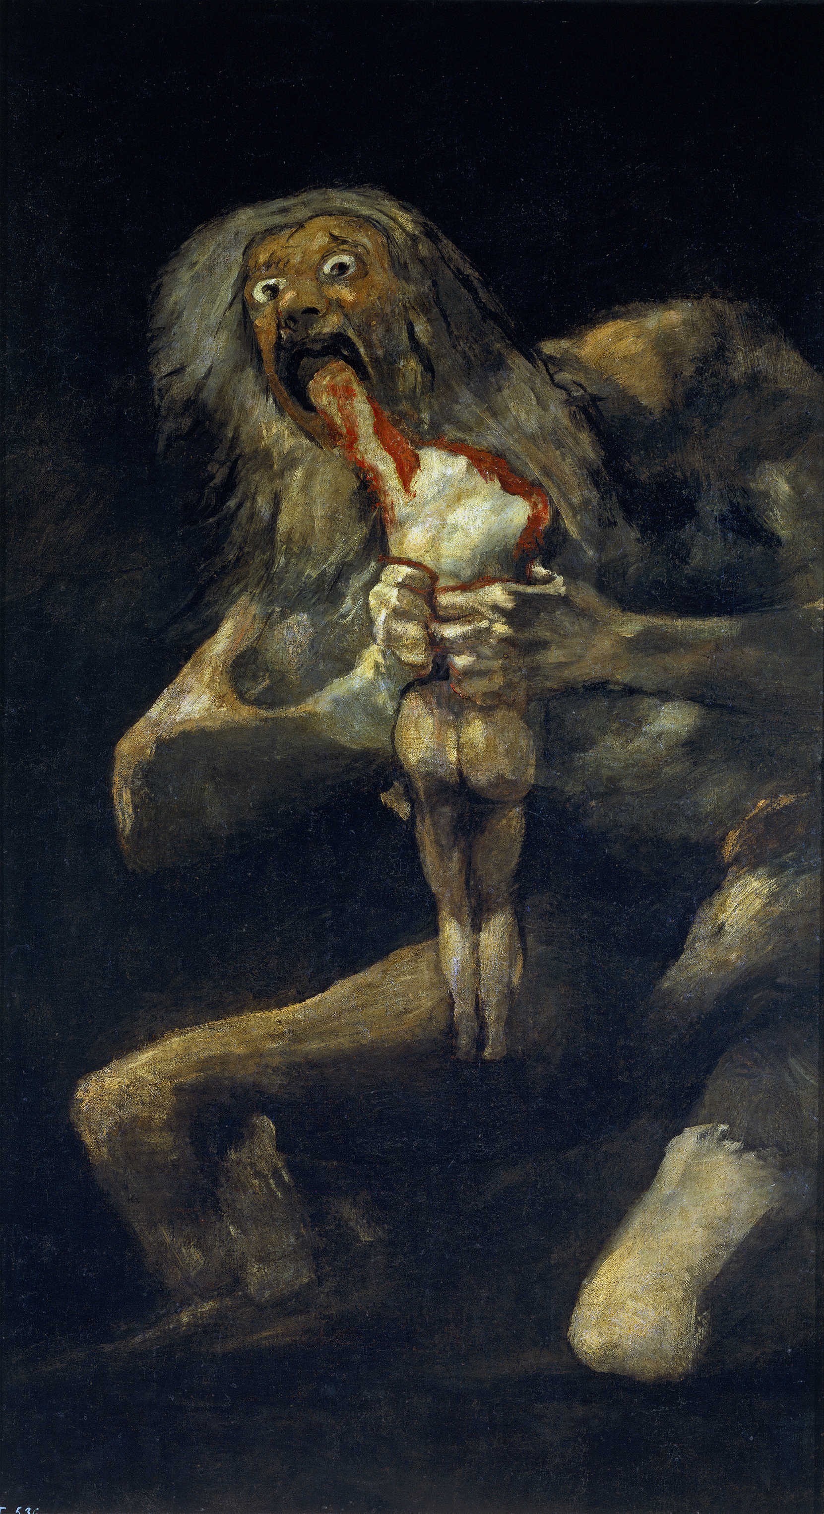
Romantism, Francisco Goya, Saturn devouring one of his sons, 1820-23
Notes:
Wikipedia When anyone looks at the painting to see the titan kneeling and devouring one of the sons that he had with the abnormal proportions and bulging eyes... It inspires fear out of anyone that looks at it. Some words that come to mind are evil, wicked, a monster. Along with it's size it makes one feel small and insignificant, like Saturn could devour you too. (Morgan, 39) Unlike the other beautiful portraits of Francisco de Goya in the romanticism period, these stand out to be odd, and horrific. The fear of humanity and the realization that time devours all, but if this giant represents time then why does he have disproportionate arms and legs to his torso? If this titan existed he would not be supported by his legs nor arms. Was time itself brought to it's knees with his terrible act? (Morgan, 41) The more that one can learn about Goya the more one can learn about this work in particular. It is no secret that these, and the other "Black Paintings" were not suppose to be public. These paintings were revealed after the death of Goya painted on walls of Goya's home in Madrid. (Bender). This house was bought by Goya after his wife died and the Napoleonic wars raged on, while this is important information it is not the most vital piece of information. "Goya and his wife, Josefa, had numerous children - between five and twenty: the exact number is unknown. Only one boy, Javier, survived beyond childhood. In Goya's letters to Martin Zapater, his friend from their school days in Saragossa, he often comments on Josefa's pregnancies, her illnesses, her many miscarriages." (Morgan, 40) Within his solitude it is clear that he reflected upon this, perhaps even wallowed in this part of his life. Has this inspired the cannibalistic god? The sadness of lost sons and daughters, however this is not the only theory. "
Shortly before he began the Black Paintings, Goya survived a near fatal illness... Did Goya, sick, deaf, in his seventies, paint his lonely terror of his own mortality through his Saturn?" (Morgan, 40) All the questions and meanings behind this work remain a mystery only to be left to speculation. For this I give Goya the Atypical stamp of approval.

Slide 25
Romantism, Francisco Goya, Saturn devouring one of his sons, 1820-23
Believe it or not Goya's works are not typically like the wide eyed titan of time before you. Goya's works normally consist of masterful portraits, and lovely scenic work. Soft hues that were typical of the time, however the Black Paintings were a stark contrast to this. In Madrid Goya was alone and growing deaf within his home, making these chalk renditions on his walls.
Notes:
Wikipedia When anyone looks at the painting to see the titan kneeling and devouring one of the sons that he had with the abnormal proportions and bulging eyes... It inspires fear out of anyone that looks at it. Some words that come to mind are evil, wicked, a monster. Along with it's size it makes one feel small and insignificant, like Saturn could devour you too. (Morgan, 39) Unlike the other beautiful portraits of Francisco de Goya in the romanticism period, these stand out to be odd, and horrific. The fear of humanity and the realization that time devours all, but if this giant represents time then why does he have disproportionate arms and legs to his torso? If this titan existed he would not be supported by his legs nor arms. Was time itself brought to it's knees with his terrible act? (Morgan, 41) The more that one can learn about Goya the more one can learn about this work in particular. It is no secret that these, and the other "Black Paintings" were not suppose to be public. These paintings were revealed after the death of Goya painted on walls of Goya's home in Madrid. (Bender). This house was bought by Goya after his wife died and the Napoleonic wars raged on, while this is important information it is not the most vital piece of information. "Goya and his wife, Josefa, had numerous children - between five and twenty: the exact number is unknown. Only one boy, Javier, survived beyond childhood. In Goya's letters to Martin Zapater, his friend from their school days in Saragossa, he often comments on Josefa's pregnancies, her illnesses, her many miscarriages." (Morgan, 40) Within his solitude it is clear that he reflected upon this, perhaps even wallowed in this part of his life. Has this inspired the cannibalistic god? The sadness of lost sons and daughters, however this is not the only theory. "
Shortly before he began the Black Paintings, Goya survived a near fatal illness... Did Goya, sick, deaf, in his seventies, paint his lonely terror of his own mortality through his Saturn?" (Morgan, 40) All the questions and meanings behind this work remain a mystery only to be left to speculation. For this I give Goya the Atypical stamp of approval.

Slide 26
Romantism, Francisco Goya, Saturn devouring one of his sons, 1820-23
The Black Paintings were made to be private, not to be displayed to the world. Deeply personal art that reflects some of his own life.
Goya and his wife had many children, yet only one survived past childhood. His wife suffered many miscarriages and was very ill. In his quiet home in Madrid did he wallow in this part of his life? Did he mourn the loss of his children and his wife, blaming such a concept like time?
Notes:
Wikipedia When anyone looks at the painting to see the titan kneeling and devouring one of the sons that he had with the abnormal proportions and bulging eyes... It inspires fear out of anyone that looks at it. Some words that come to mind are evil, wicked, a monster. Along with it's size it makes one feel small and insignificant, like Saturn could devour you too. (Morgan, 39) Unlike the other beautiful portraits of Francisco de Goya in the romanticism period, these stand out to be odd, and horrific. The fear of humanity and the realization that time devours all, but if this giant represents time then why does he have disproportionate arms and legs to his torso? If this titan existed he would not be supported by his legs nor arms. Was time itself brought to it's knees with his terrible act? (Morgan, 41) The more that one can learn about Goya the more one can learn about this work in particular. It is no secret that these, and the other "Black Paintings" were not suppose to be public. These paintings were revealed after the death of Goya painted on walls of Goya's home in Madrid. (Bender). This house was bought by Goya after his wife died and the Napoleonic wars raged on, while this is important information it is not the most vital piece of information. "Goya and his wife, Josefa, had numerous children - between five and twenty: the exact number is unknown. Only one boy, Javier, survived beyond childhood. In Goya's letters to Martin Zapater, his friend from their school days in Saragossa, he often comments on Josefa's pregnancies, her illnesses, her many miscarriages." (Morgan, 40) Within his solitude it is clear that he reflected upon this, perhaps even wallowed in this part of his life. Has this inspired the cannibalistic god? The sadness of lost sons and daughters, however this is not the only theory. "
Shortly before he began the Black Paintings, Goya survived a near fatal illness... Did Goya, sick, deaf, in his seventies, paint his lonely terror of his own mortality through his Saturn?" (Morgan, 40) All the questions and meanings behind this work remain a mystery only to be left to speculation. For this I give Goya the Atypical stamp of approval.

Slide 27
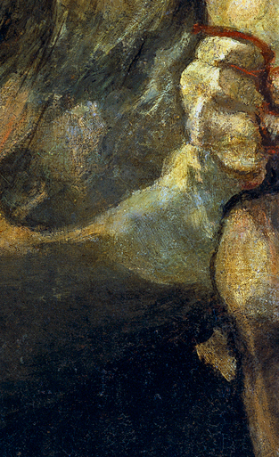
Romantism, Francisco Goya, Saturn devouring one of his sons, 1820-23
Saturn is the Titan of time within Roman mythology, a savage titan who ate his children because one of them was prophesied to kill him. He ate 5 of the 6 and was murdered by the 6th, Jupiter. Here he depicted to be devouring his second as indicated by the bone within his left hand.
Notes:
Wikipedia When anyone looks at the painting to see the titan kneeling and devouring one of the sons that he had with the abnormal proportions and bulging eyes... It inspires fear out of anyone that looks at it. Some words that come to mind are evil, wicked, a monster. Along with it's size it makes one feel small and insignificant, like Saturn could devour you too. (Morgan, 39) Unlike the other beautiful portraits of Francisco de Goya in the romanticism period, these stand out to be odd, and horrific. The fear of humanity and the realization that time devours all, but if this giant represents time then why does he have disproportionate arms and legs to his torso? If this titan existed he would not be supported by his legs nor arms. Was time itself brought to it's knees with his terrible act? (Morgan, 41) The more that one can learn about Goya the more one can learn about this work in particular. It is no secret that these, and the other "Black Paintings" were not suppose to be public. These paintings were revealed after the death of Goya painted on walls of Goya's home in Madrid. (Bender). This house was bought by Goya after his wife died and the Napoleonic wars raged on, while this is important information it is not the most vital piece of information. "Goya and his wife, Josefa, had numerous children - between five and twenty: the exact number is unknown. Only one boy, Javier, survived beyond childhood. In Goya's letters to Martin Zapater, his friend from their school days in Saragossa, he often comments on Josefa's pregnancies, her illnesses, her many miscarriages." (Morgan, 40) Within his solitude it is clear that he reflected upon this, perhaps even wallowed in this part of his life. Has this inspired the cannibalistic god? The sadness of lost sons and daughters, however this is not the only theory. "
Shortly before he began the Black Paintings, Goya survived a near fatal illness... Did Goya, sick, deaf, in his seventies, paint his lonely terror of his own mortality through his Saturn?" (Morgan, 40) All the questions and meanings behind this work remain a mystery only to be left to speculation. For this I give Goya the Atypical stamp of approval.

Slide 28
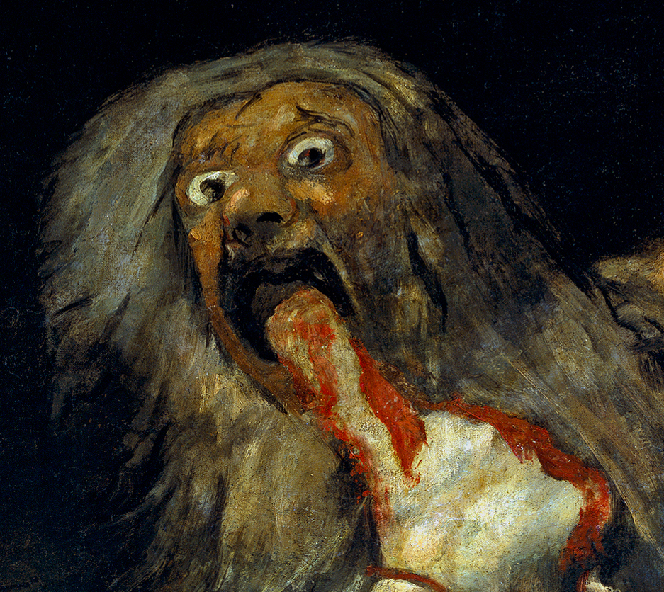
Romantism, Francisco Goya, Saturn devouring one of his sons, 1820-23
Saturn's bulging eyes staring at the viewer in the horror of what he must do in order to preserve himself are striking to say the least. And note the portions with a huge torso and arms paired with small legs, was time brought to his knees by the slaughtering of 5 of his own children?
Many theorize that this painting reflects his mourning of the children he lost within his life, and how he himself feared their mortality and his own. Even if the god of time did everything he could, death was still his fate.
Notes:
Wikipedia When anyone looks at the painting to see the titan kneeling and devouring one of the sons that he had with the abnormal proportions and bulging eyes... It inspires fear out of anyone that looks at it. Some words that come to mind are evil, wicked, a monster. Along with it's size it makes one feel small and insignificant, like Saturn could devour you too. (Morgan, 39) Unlike the other beautiful portraits of Francisco de Goya in the romanticism period, these stand out to be odd, and horrific. The fear of humanity and the realization that time devours all, but if this giant represents time then why does he have disproportionate arms and legs to his torso? If this titan existed he would not be supported by his legs nor arms. Was time itself brought to it's knees with his terrible act? (Morgan, 41) The more that one can learn about Goya the more one can learn about this work in particular. It is no secret that these, and the other "Black Paintings" were not suppose to be public. These paintings were revealed after the death of Goya painted on walls of Goya's home in Madrid. (Bender). This house was bought by Goya after his wife died and the Napoleonic wars raged on, while this is important information it is not the most vital piece of information. "Goya and his wife, Josefa, had numerous children - between five and twenty: the exact number is unknown. Only one boy, Javier, survived beyond childhood. In Goya's letters to Martin Zapater, his friend from their school days in Saragossa, he often comments on Josefa's pregnancies, her illnesses, her many miscarriages." (Morgan, 40) Within his solitude it is clear that he reflected upon this, perhaps even wallowed in this part of his life. Has this inspired the cannibalistic god? The sadness of lost sons and daughters, however this is not the only theory. "
Shortly before he began the Black Paintings, Goya survived a near fatal illness... Did Goya, sick, deaf, in his seventies, paint his lonely terror of his own mortality through his Saturn?" (Morgan, 40) All the questions and meanings behind this work remain a mystery only to be left to speculation. For this I give Goya the Atypical stamp of approval.

Slide 29
FIN
Notes:
Saturn, Ruben and Saturn Devouring one of his Sons, Goya It is said that Goya was inspired by this piece particularly, Saturn by Ruben. The giant devouring one of his own sons with the moody background and three stars overhead. Both artworks are in a way comedic and in all ways morbid. To compare, Ruben's Saturn is less monstrous literally. Looking at the titan he is biting into his son with more grace. No sympathy is present but with the comparison to Goya's it seems like it is. Saturn grasp onto his staff and sits, getting the job done. His son screams in agony all the same. Goya's on the other hand is a wide-eyed monster that bears only some resemblance to a human. The blood of his son drips onto his hands and the son's head is not present. He can struggle no longer. As dead as he is, Saturn keeps feasting. With the way he looks, you very well may be next.

Slide 30
Works Cited
“Stanislav Szukalski: Polish Art through the Eyes of a Mad Genius.” TheCollector, 1 Mar. 2021, www.thecollector.com/stanislav-szukalski-genius-polish-art/.
Bender, Dr Rebecca. “Francisco de Goya: The Enigma of the Black Paintings.” Rebecca M. Bender, PhD, 5 Nov. 2015, rebeccambender.com/2015/11/04/goya-black-paintings/.
Morgan, Jay Scott. “The Mystery of Goya’s ‘Saturn.’” New England Review (1990-), vol. 22, no. 3, July 2001, pp. 39–43. EBSCOhost, research.ebsco.com/linkprocessor/plink?id=7a60dd23-4cc4-310f-8974-67846fadb3b7. Accessed 31 Oct. 2024.
“Eifersucht II (Jealousy II) by Edvard Munch - Artvee.” Artvee, 2024, artvee.com/dl/eifersucht-ii-jealousy-ii/.
“Jealousy, 1895 by Edvard Munch.” Www.edvardmunch.org, www.edvardmunch.org/jealousy.jsp. Accessed 31 Oct. 2024
“Isle of the Dead | Floating inside the Inner World.” Hypercritic, hypercritic.org/collection/arnold-bocklin-isle-of-the-dead-floating-inside-the-inner-world-1880-1901. Accessed 31 Oct. 2024

Slide 31
Works Cited
Frank, Mitchell B. “‘He Painted Everything, so to Say, from His Head’: Arnold Böcklin’s Great Memory and Artistic Practice in Wilhelmine Germany.” Oxford Art Journal, vol. 39, no. 1, Jan. 2016, pp. 67–86. EBSCOhost, research.ebsco.com/linkprocessor/plink?id=d77759fe-47dd-3584-a1e4-63f63dfb8d47.
Sue Taylor. Hans Bellmer : The Anatomy of Anxiety. The MIT Press, 2000. EBSCOhost, research.ebsco.com/linkprocessor/plink?id=9467c5cc-836f-3824-a37a-7ed37074e0e9. Accessed 31 Oct. 2024. Co, Art History. “Jealousy: Edvard Munch.” Art History Co, 26 Jan. 2020, arthistory.co/jealousy-edvard-munch/.
kitsmediatech. The Myth of the Mad Genius - inside Outsider Art. www.outsiderart.me/the-myth-of-the-mad-genius/. Accessed 3 Nov. 2024 “Edvard Munch Biography.” Diego Rivera, 2011, www.edvardmunch.org/biography.jsp.
“Arnold Böcklin Paintings, Bio, Ideas.” The Art Story, www.theartstory.org/artist/bocklin-arnold/. Accessed 31 Oct. 2024

