Slide 1
Hygiene for Health
By Denise Woodruff, LPN
Nicole Bishop, LPN

Slide 2
Hygiene for Health
No one likes to be sick. Here are some ways to stay healthy at college.
Good hand washing
Keep your environment clean
Maintain regular schedule
Plenty of rest
Eat healthy
Drink plenty of fluids
Good hygiene habits
How do I do these things? There are many easy answers. The following slides are a few examples.

Slide 3
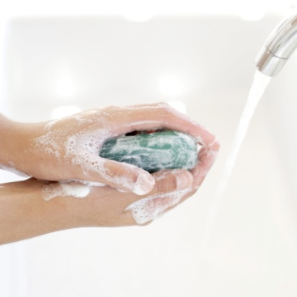
Good Hand Washing
Soap & Water – cheap and effective. Create a good lather and rub for 20 seconds. Use lots of soap. It kills the germs!
If no soap is available, use hand sanitizer instead that has an alcohol base.
Think about how many people touch the same surfaces as you do each day. Doorknobs, telephones, desks, computer equipment, etc... There are about 12,000 – 13,000 people enrolled at VSU.
Think about what you touched and what you could be exposed to if you do not wash your hands, especially before eating.
Hand washing can help keep germs away that cause colds, flu, pink eye, infectious diarrhea, meningitis, etc..

Slide 4


Good Hygiene Habits
Shower, bathe regularly, wash etc. This helps keeps the skin free of germs and bacteria that can cause skin infections.
Brush teeth twice daily. Promotes a healthy digestive system.
Try not to touch your face, eyes, nose and mouth. If you do re-wash your hands.

Slide 5

Maintain Regular Schedule
Sleep works !!! Recharge your batteries
Get more from classes – More alert
Help keep the Immune System on track
Feel better
Helps with appetite, digestion and mental stability

Slide 6


Eat Healthy and Drink Water
Water, water, water. The body is 70% water
Hydration keeps the skin clear, bladder free of infection, flushes waste (germs) from the body
Healthy foods – Healthy body
Helps with energy levels, improved mental alertness
Helps build up the immune system

Slide 7

Studies show that of 6,076 men and women in six different cities and telephone interviews 92% said they washed their hand after using the restroom but only 77% were seen doing so. Women wash their hands more than men. Think about this when touching common surfaces, shaking hands, handling money and then NOT washing your hands.

Slide 8

Anything and everything you can do to give yourself a head start against getting sick is a HUGE Payoff !!!!

Slide 9
Source
Manning, A. & Thomas, K. (2007) Men wash hands less than women. USA Today. www.usatoday.com/news/health.

