Slide 1
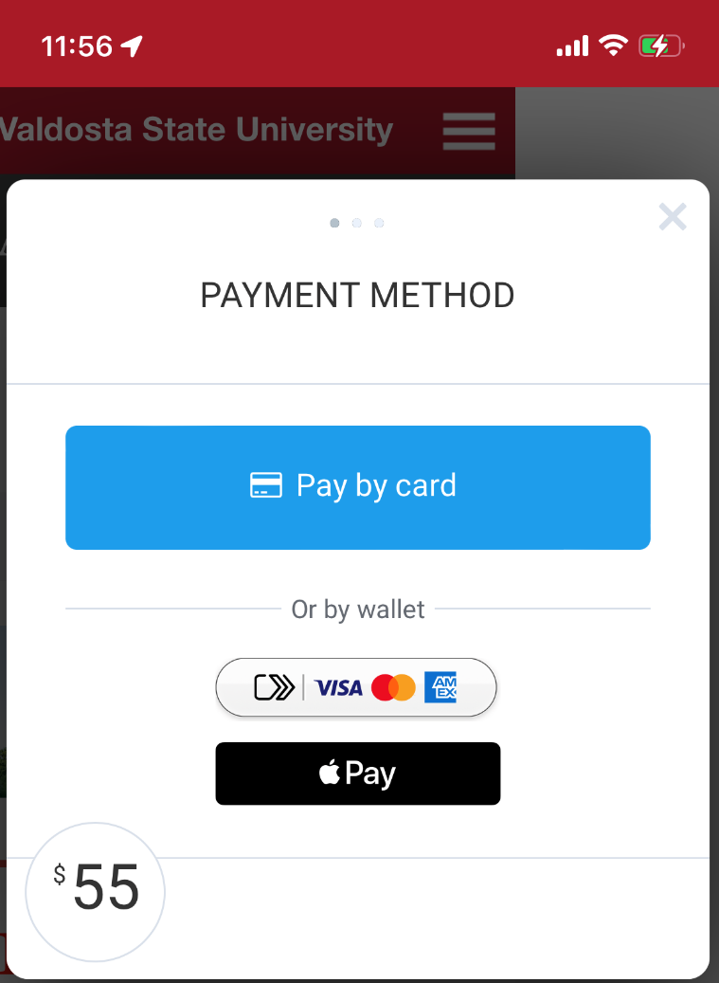
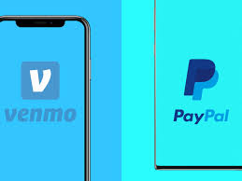
Mobile Payments mobile swipes, Venmo, Apple Pay

Slide 2
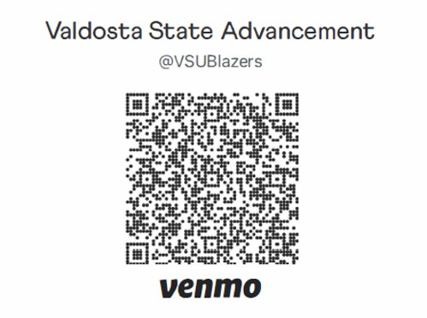
Venmo @VSUBlazers DOnors need a venmo account to give No Equipment necessary to initiate transaction

Slide 3
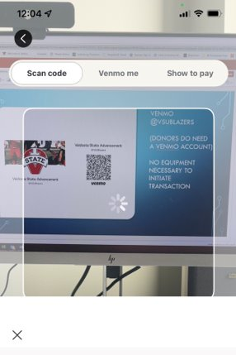
How does venmo Payment work? Display QR Code on Foundation device From Donor's Venmo, Hit Scan

Slide 4
THE QR CODE then LINKS donor's VENMO TO THE @VSUBLAZERS VENMO
Select the “Pay”
Donor will enter $XX.00
Very Important – Enter 5 digit fund number and a brief description of transaction
90005 Bingo Tickets

Slide 5
NetCommunity WebPage https://community.valdostastate.org/ Integrates with Raiser’s Edge and ability to link to constituent record Checkout includes credit card, direct debit (routing number), Google Pay and Apple Pay Why? Other methods cannot record specific event details such as attendance, meal preference, shirt size, guest names, or link the gift to the constituent record All events should have a registration page for event tracking purposes and should be submitted at least two weeks prior to the event
Methods of Payment for Event Registrations

Slide 6
Quick Methods of Payment for Events (Tickets/Other Revenue)
Preferred
Venmo
Include Fund ID and Description in comments (no emoji's)
Only Name and total amount is available in reports
MobilePay/Apple Pay (swipe/tap/insert)
Include Name, Email, and Comment
Cash
Must use receipt book to record transactions incase refund is requested.
Outcome
No contact information is collected from the transaction which prevents linking to constituents records; therefore, no data is collected other than total amount/transactions collected

Slide 7
Methods of Payment for Donations
Preferred
NetCommunity Pages
Integrates with Raiser’s Edge and ability to link to constituent record
Checkout includes credit card, direct debit (routing number), Google Pay and Apple Pay
Other methods
MobilePay/Apple Pay (swipe/tap/insert) (include all contact and billing information)
Does not integrate with Raiser’s Edge and cannot be linked to constituent record if the contact information is not collected during the swipe
Give Campus Pages
Does not integrate with Raiser’s Edge, but can be linked to constituent record. Used for crowdfunding purposes with set goal.
Venmo
Does not integrate with Raiser’s Edge and does not include contact information for linking gift to constituent record

Slide 8
MobilePay Swipe Instructions For immediate assistance, refer to Help in the menu
Make sure the Wi-Fi is off and cellular is on (PCI compliance is cellular mode only)
Make sure Bluetooth is turned on (the swipe is Bluetooth)
Open MobilePay Terminal app
Enter Username and Password (Ask Aimee to reset pw in Merchant Services if needed)
Click done and click Login
Under Payment, Click Get started
Turn on swipe
To pair, select swipe id (Serial Number on back of swipe)
Click Settings
Account configuration: VSUF MobilePay
Skip Email subject lines (leave payments and refund acknowledgements blank)
Default comment should include event description and fund id/fund name
Enter Default input amount
Choose payment amount
Click collect payment
Name on card and email are required for all transactions
For donations all contact and billing information is required
Click continue
You are now Ready for payment
Swipe/insert/tap the card or use Apple Pay

Slide 9
Summary
For event registrations, use NetCommunity
For card not present donations, use NetCommunity or Give Campus general donation pages
For card present donations, use MobilePay/Swipe (ApplePay), Venmo,

Slide 10
Venmo Fees and sales tax
Fee’s: 1.9% +%0.10 per transaction
Sales Tax: per locality

