Slide 1
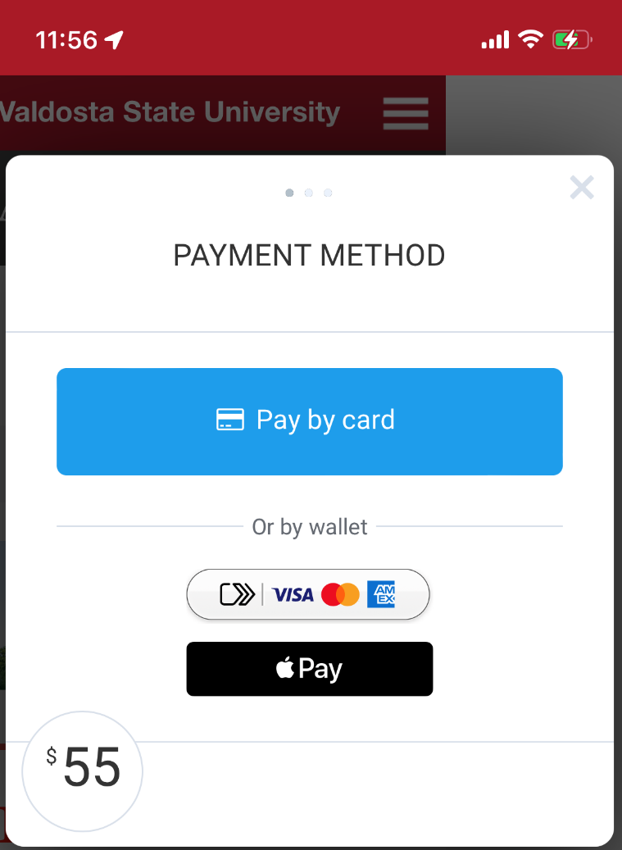
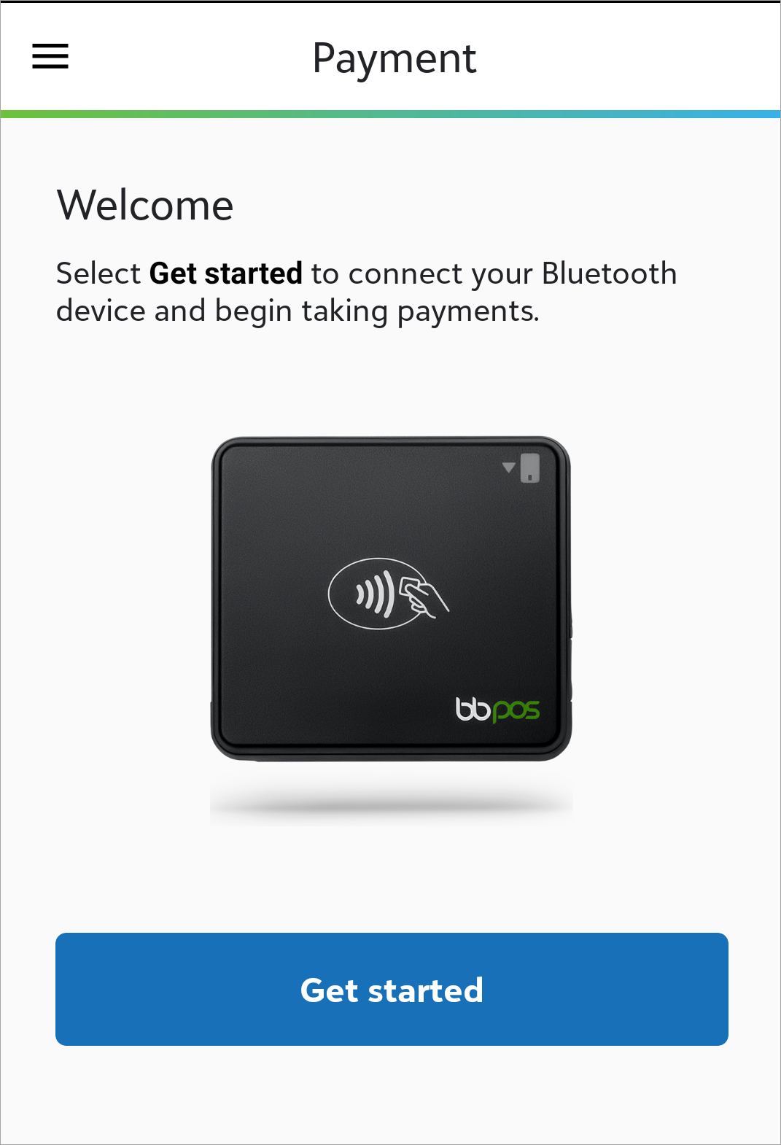
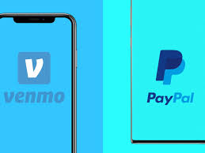
Mobile Payments ApplePay, Venmo, Paypal and mobile swipes

Slide 2
Where to find our forms, policies and procedures
**2 Weeks
HTTPS://WWW.VALDOSTA.EDU/ADMINISTRATION/ADVANCEMENT/VSU-FOUNDATION/POLICIES--PROCEDURES.PHP
https://forms.office.com/r/AgnccAqskD

Slide 3
Preferred Methods of payment NetCommunity Page Integrates with Raiser’s Edge and ability to link to constituent record Checkout includes credit card, direct debit (routing number), Google Pay and Apple Pay Why? Other methods cannot record specific event details such as attendance, meal preference, shirt size, guest names, or link the gift to the constituent record All events should have a registration page for event tracking purposes and should be submitted at least two weeks prior to the event
Event Registrations

Slide 4
Quick Methods of Payment for Events (Tickets/Other Revenue)
Preferred
Venmo
Include Fund ID and Description in comments (no emoji's)
Only Name and total amount is available in reports
MobilePay/Apple Pay (swipe/tap/insert)
Include Name, Email, and Comment
Cash
Must use receipt book to record transactions incase refund is requested.
Outcome
No contact information is collected from the transaction which prevents linking to constituents records; therefore, no data is collected other than total amount/transactions collected

Slide 5
Peer to Peer Payment MEthods (P2P)- VenMo
94% Millennials (Born 1981-1996) Age: 26-41
87% GenZers (Born late 1997 to 2012) Age: 10-25
88% Gen X (1965 -1980) Age 42-57
65% Baby Boomers (1955-1964) Age 58-67

Slide 6
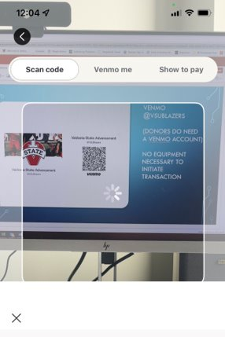
How does Payment work? Display QR Code on Foundation device From Donor's Venmo, Hit Scan

Slide 7
THE QR CODE then LINKS donor's VENMO TO THE @VSUBLAZERS VENMO
Select the “Pay”
Donor will enter $XX.00
Very Important – 5 digit fund number and a brief description of transaction
90005 Tickets
Why is this important??

Slide 8
Requirements:
Fund & brief Description
Source: Canned Venmo report

Slide 9
Venmo Fee’s: 1.9% +%0.10 per transaction
Sales Tax = 8.0%

Slide 10
Convenience
1. Taking a Jab at the Convenience
One of Venmo’s greatest perks is its convenience. Unfortunately, collecting your donors’ names and email addresses isn’t a built-in option with personal Venmo accounts. Because this information is crucial to your nonprofit, you’ll need to add extra steps to get your hands on it. Naturally, more steps equal less convenience, which counters the original purpose.
2. Tax Reporting Obstacles
For a platform to qualify for accepting online donations, it needs to be able to issue tax-compliant receipts. However, this feature isn’t available with personal Venmo accounts. Failure to issue tax-compliant receipts will result in revoking your nonprofit 501(c)(3) license.

Slide 11
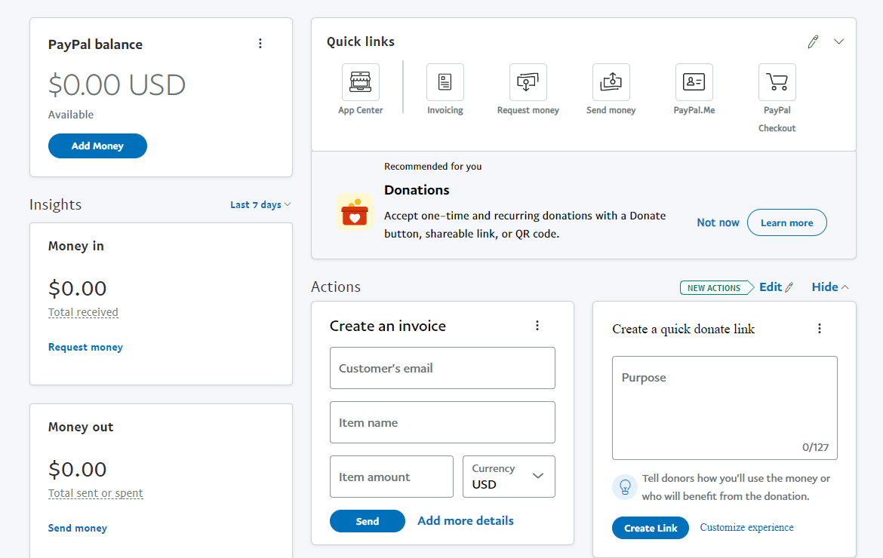
pAYPAL
Fee’s: VSUF is a registered charity, our account is receiving a discounted rate.
Your fee for online payments has been adjusted to 1.99% + $0.49 per transaction.
Donor pays $10.00 for tickets. (10.0)(0.0199) + 0.49 = 0.698 Fee
Net Revenue = $9.31

Slide 12
Methods of Payment for Donations
Preferred
NetCommunity Pages
Integrates with Raiser’s Edge and ability to link to constituent record
Checkout includes credit card, direct debit (routing number), Google Pay and Apple Pay
Other methods
MobilePay/Apple Pay (swipe/tap/insert) (include all contact and billing information)
Does not integrate with Raiser’s Edge and cannot be linked to constituent record if the contact information is not collected during the swipe
Give Campus Pages
Does not integrate with Raiser’s Edge, but can be linked to constituent record with IOM
Venmo
Does not integrate with Raiser’s Edge and does not include contact information for linking gift to constituent record
PayPal
Does not integrate with Raiser’s Edge, but can be linked to constituent record with IOM

Slide 13
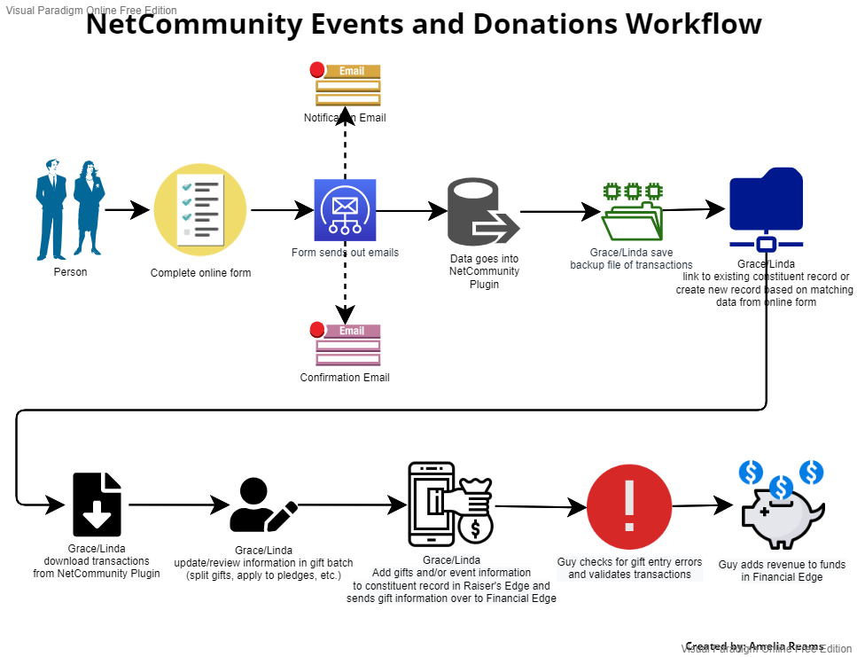

Slide 14
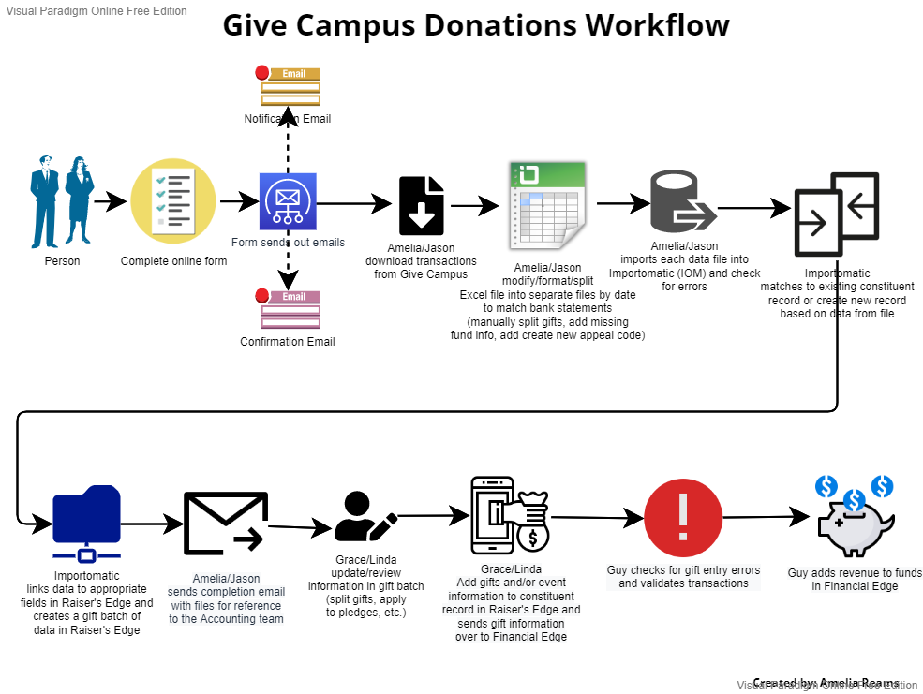

Slide 15
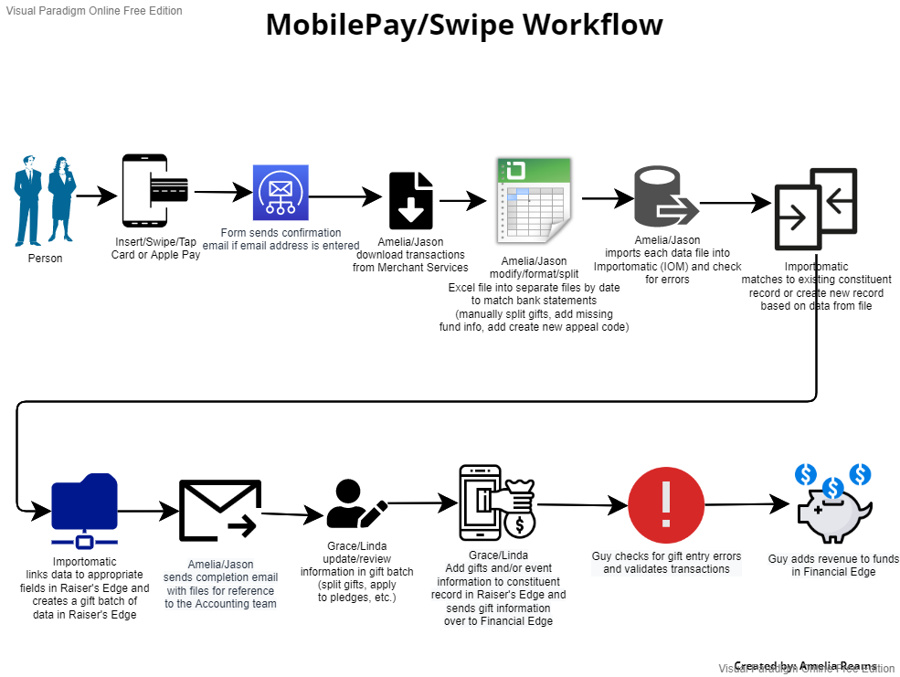

Slide 16
Summary
For all event registrations, use NetCommunity
For card not present donations, use NetCommunity or Give Campus general donation pages
For card present donations, use MobilePay/Swipe (ApplePay)

Slide 17
Advertising/Marketing Options
Mail QR Code
Flyer QR code
eBlast Link
Publish Link (Social Media)
Venmo QR code
PayPal.Me/VSUBlazers

Slide 18
Equipment needed for mobile swipe terminal
Equipment available upon reasonable timely request
Please see foundation reception to check out equipment and sign agreement

Slide 19
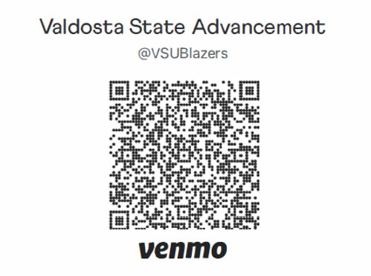
Venmo @VSUBlazers DOnors need a venmo account to give No Equipment necessary to initiate transaction

Slide 20
PayPal @VSUBlazers
DONORS NEED A PAYPAL ACCOUNT NO EQUIPMENT NECESSARY TO INITIATE TRANSACTION
https://paypal.me/VSUBlazers?country.x=US&locale.x=en_US

Slide 21
MobilePay Swipe Instructions For immediate assistance, refer to Help in the menu
Make sure the Wi-Fi is off and cellular is on (PCI compliance is cellular mode only)
Make sure Bluetooth is turned on (the swipe is Bluetooth)
Open MobilePay Terminal app
Enter Username and Password (Ask Aimee to reset pw in Merchant Services if needed)
Click done and click Login
Under Payment, Click Get started
Turn on swipe
To pair, select swipe id (Serial Number on back of swipe)
Click Settings
Account configuration: VSUF MobilePay
Skip Email subject lines (leave payments and refund acknowledgements blank)
Default comment should include event description and fund id/fund name
Enter Default input amount
Choose payment amount
Click collect payment
Name on card and email are required for all transactions
For donations all contact and billing information is required
Click continue
You are now Ready for payment
Swipe/insert/tap the card or use Apple Pay

Slide 22
Venmo & paypal @VSUBlazers
https://paypal.me/VSUBlazers?country.x=US&locale.x=en_US

Slide 23
Taking Cash payments
The person responsible for the cash should check out a receipt book and bank cash bag
Be sure to place cardboard behind carbon copies and press hard to transfer ink.
The white receipt goes to donor, use yellow carbon copy to verify cash received and the pink carbon copy is used by VSU Foundation
After all payments have been taken, detach the yellow carbon copies from the book and match each receipt with the individual payments by using a paper clip
The person responsible should check in the receipt book and bank cash bag and complete deposit sheet for cash deposits
Apon check-in, verify the total receipts with the total cash aside from the petty cash.
The petty cash total should equal the amount that was checked out. It is used for change ONLY

