Slide 1
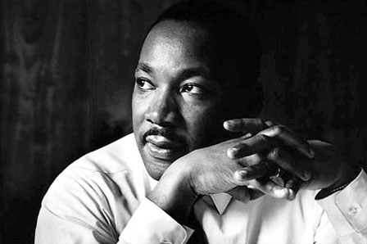
Dr. Martin Luther King, Jr. “Drum Major for Justice”
Celebrating His Life and Legacy
January 17, 2012
MLK National Holiday
“A Day on Not a Day Off

Slide 2
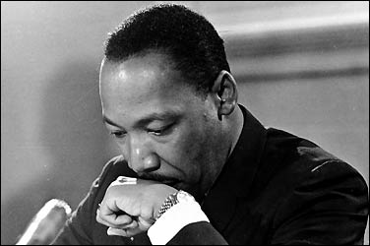
Dr. Martin Luther King, Jr. January 15, 1929 – April 4, 1968
Dr. Martin Luther King Jr. was an American Minister, Scholar, and Civil and Human Rights Activist.
He was the principal leader of the non-violent Civil Rights Movement in the U.S.
He not only began the Civil Rights Movement with the Montgomery Bus Boycott, he himself became an icon for the entire movement.
Famous for his oratory abilities, Dr. King is a American treasure and inspiration.

Slide 3
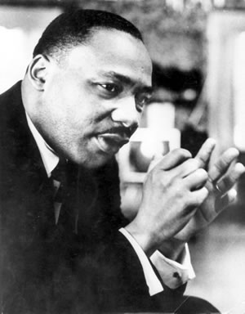
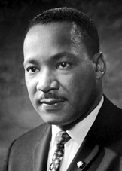
The Courage to Be Great
"I want you to say on that day, that I did try in my life . . . to love and serve humanity."
- Dr. Martin Luther King, Jr.

Slide 4
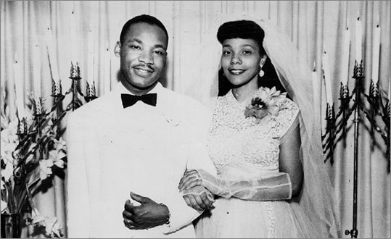
Martin Luther King Jr. National Holiday Monday, January 17, 2012 A Day On, Not a Day Off
The late Coretta Scott King embraced the King Day of Service as a meaningful way to celebrate and honor her husband's legacy.
She said, "The greatest birthday gift my husband could receive is if people of all racial and ethnic backgrounds celebrated the holiday by performing individual acts of kindness through service to others.“
For more information on the MLK Holiday, visit http://mlkday.gov/

Slide 5
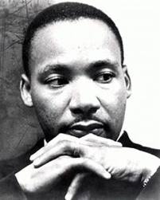
WHY SERVE?
During his lifetime, Dr. Martin Luther King, Jr. worked tirelessly toward a dream of equality. He believed in a nation of freedom and justice for all, and encouraged all citizens to live up to the purpose and potential of America by applying the principles of nonviolence to make this country a better place to live, creating the Beloved Community.
The King Day of Service is a way to transform Dr. Martin Luther King, Jr.’s life and teachings into community service that helps solve social problems. That service may meet a tangible need, such as fixing up a school or senior center, or it may meet a need of the spirit, such as building a sense of community or mutual responsibility. On this day, Americans of every age and background celebrate Dr. King through service projects that:
Strengthen Communities
Empower Individuals
Bridge Barriers

Slide 6
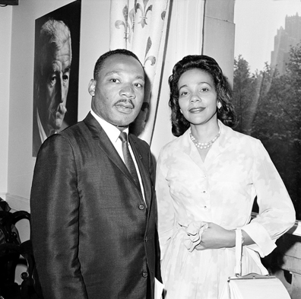
Strengthen Communities
Dr. King recognized the power of service to strengthen communities and achieve common goals.
Through his words and example, Dr. King challenged individuals to take action and lift up their neighbors and communities through service.

Slide 7
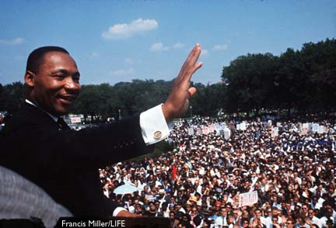
Empower Individuals
Dr. King believed each individual possessed the power to lift himself or herself up no matter what his or her circumstances – rich or poor, black or white, man or woman.
Whether teaching literacy skills, helping an older adult surf the Web, or helping an individual build the skills they need to acquire a job, acts of service can help others improve their own lives while doing so much for those who serve, as well.

Slide 8
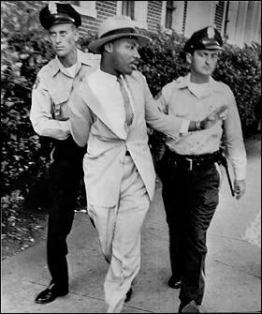
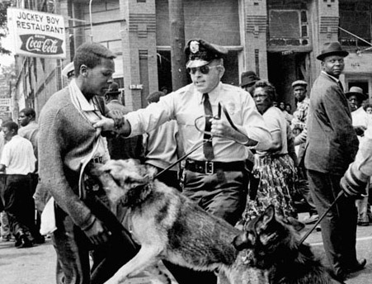
Bridging Barriers
In his fight for civil rights, Dr. King inspired Americans to think beyond themselves, look past differences, and work toward equality.
Serving side by side, community service bridges barriers between people and teaches us that in the end, we are more alike than we are different.

Slide 9
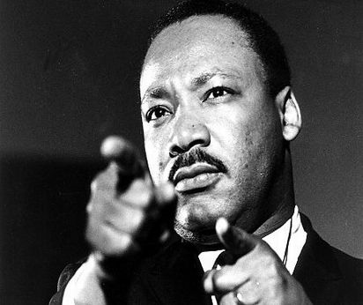
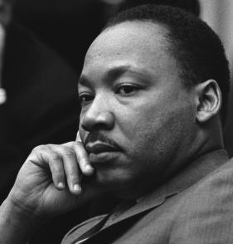
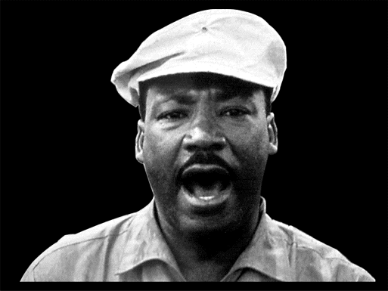
How to Serve?
You can join an organized service project in your area or help fill a need yourself—by tutoring a child, helping an elderly neighbor, serving in a homeless shelter, or volunteering at a school or community organization.
There are many ways to find service opportunities in your community on the King holiday and throughout the year.
Look for opportunities to serve within your local community. You don't have to wait for the MLK Day of Service to volunteer . . . visit www.volunteer.gov to find volunteer opportunities at home or abroad. Just enter geographic information, such as zip code or state, and your area of interest, and you can access service opportunities near your home or office, across the country or overseas.

Slide 10
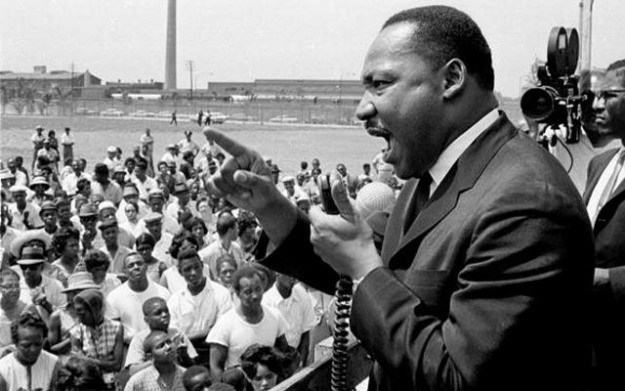
“The time is always right to do what is right.”
---Dr. Martin Luther King, Jr.

Slide 11
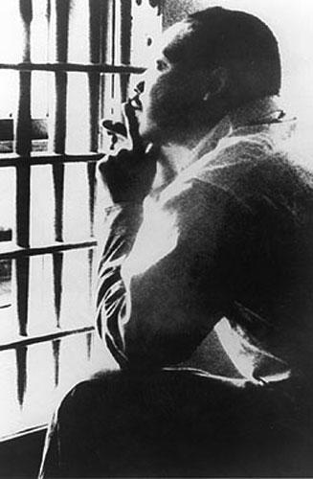
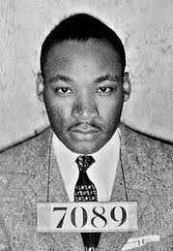
“Injustice anywhere is a threat to justice everywhere.”
-- "Letter from Birmingham Jail,“
16 April 1963

Slide 12
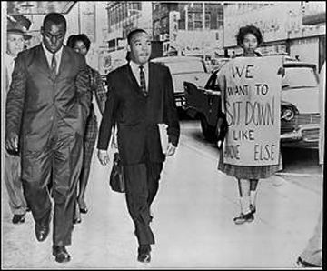
“We must learn to live together as brothers or perish together as fools.”
-- Martin Luther King, Jr.
Speech in St. Louis, Missouri
March 22, 1964

Slide 13
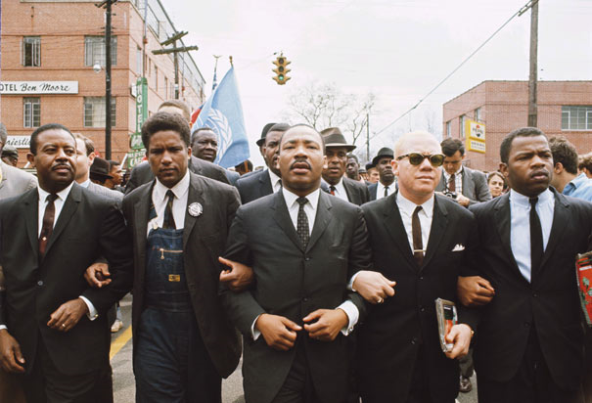
“The ultimate measure of a man is not where he stands in moments of comfort and convenience, but where he stands at times of challenge and controversy. The true neighbor will risk his position, his prestige and even his life for the welfare of others.”
-- Dr. Martin Luther King, Jr.
Strength to Love (1963)

Slide 14
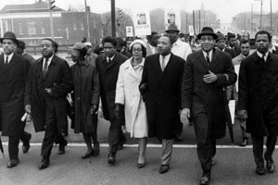
“I have a dream that one day on the red hills of Georgia the sons of former slaves and the sons of former slave owners will be able to sit down together at the table of brotherhood.”
-- Dr. Martin Luther King, Jr.
“I Have a Dream" Speech
August 28, 1963

Slide 15
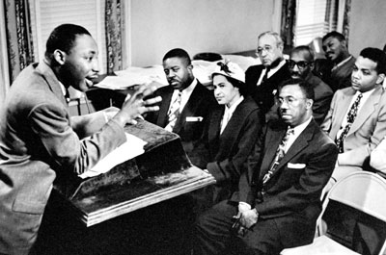
“If a man hasn't discovered something he will die for, he isn't fit to live.”
--- Dr. Martin Luther King, Jr.
Speech in Detroit, Michigan
June 23, 1963

Slide 16
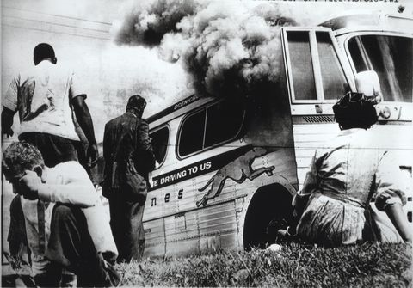
“We who engage in nonviolent direct action are not the creators of tension. We merely bring to the surface the hidden tension that is already alive.”
---Dr. Martin Luther King, Jr.
"Letter from Birmingham Jail"
April 16, 1963

Slide 17
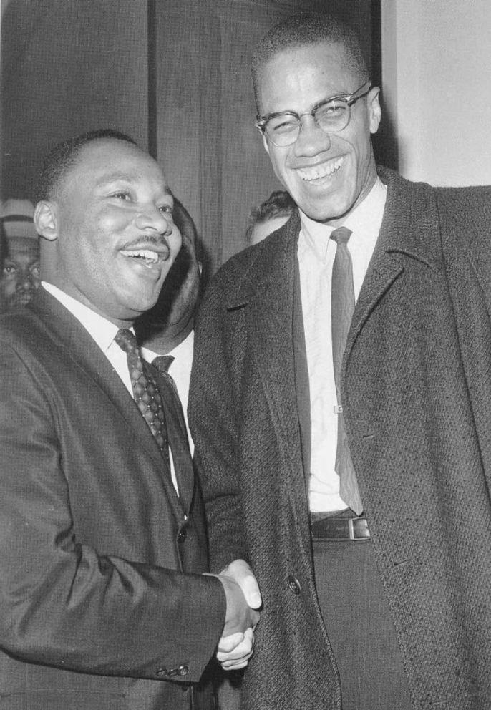
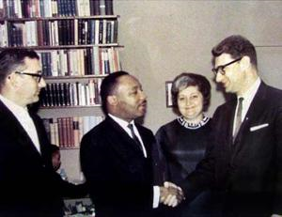
“When we let freedom ring, when we let it ring from every tenement and every hamlet, from every state and every city, we will be able to speed up that day when all of God's children, black men and white men, Jews and Gentiles, Protestants and Catholics, will be able to join hands and sing in the words of the old spiritual, "Free at last, free at last. Thank God Almighty, we are free at last.“
--- Dr. Martin Luther King, Jr.
"I Have a Dream" speech
August 28, 1963

Slide 18
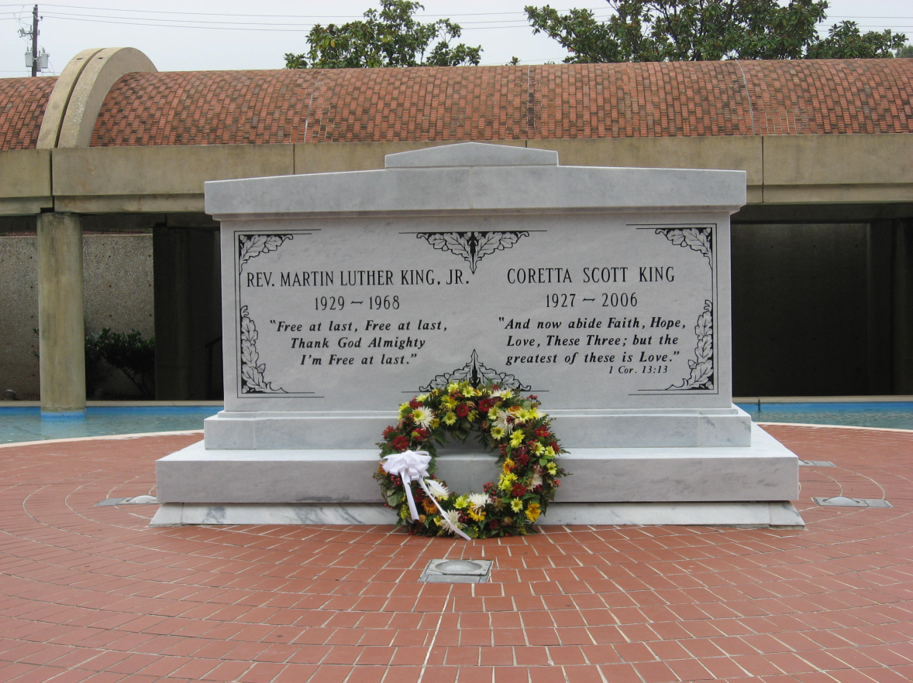
“I believe that unarmed truth and unconditional love will have the final word in reality. This is why right temporarily defeated is stronger than evil triumphant.”
--- Dr. Martin Luther King, Jr.
Nobel Prize Acceptance Speech
December 10, 1964
Online Exhibit Compiled and Created by:
Tamiko D. Lawrence, MSLS
Collection Development Librarian
January 2012

