Slide 1
Ice Cream Social
Cadiz, Spain Interest Meeting

Slide 3
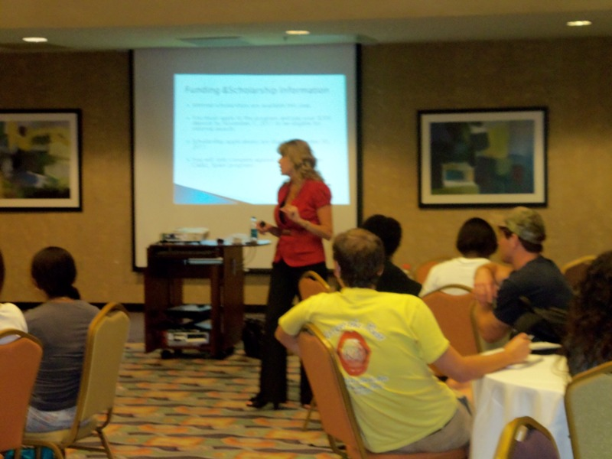

Slide 4
