Slide 1
Russia VECA
October 2022

Slide 2
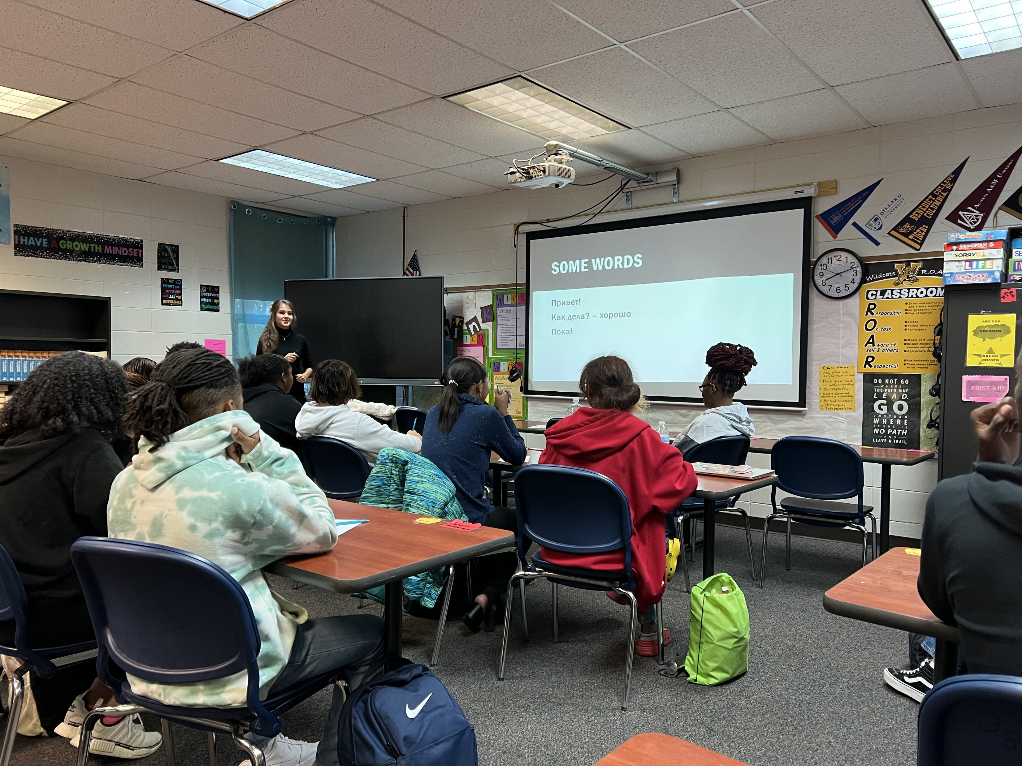

Slide 4
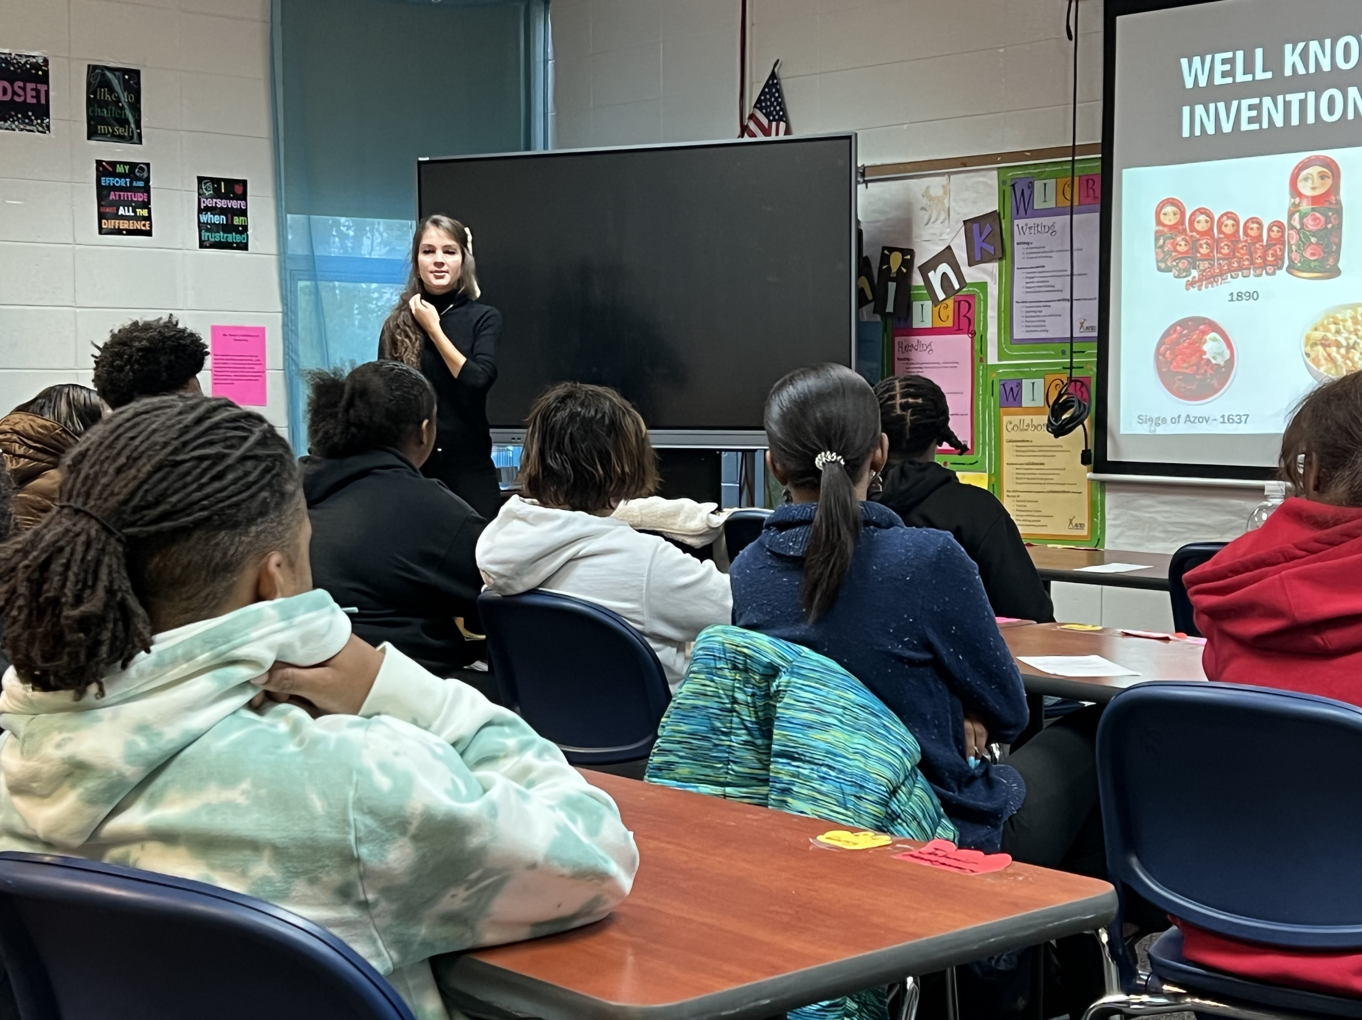

Slide 6
