Slide 1
CHINESE NEW YEAR
FEBRUARY 2022

Slide 2
What is Chinese New Year?
Chinese New Year is has been celebrated for thousands of years in China and it focuses on removing the old and the bad and welcoming the new and good. It also celebrates the beginning of a new year on the traditional Chinese lunisolar calendar.

Slide 3
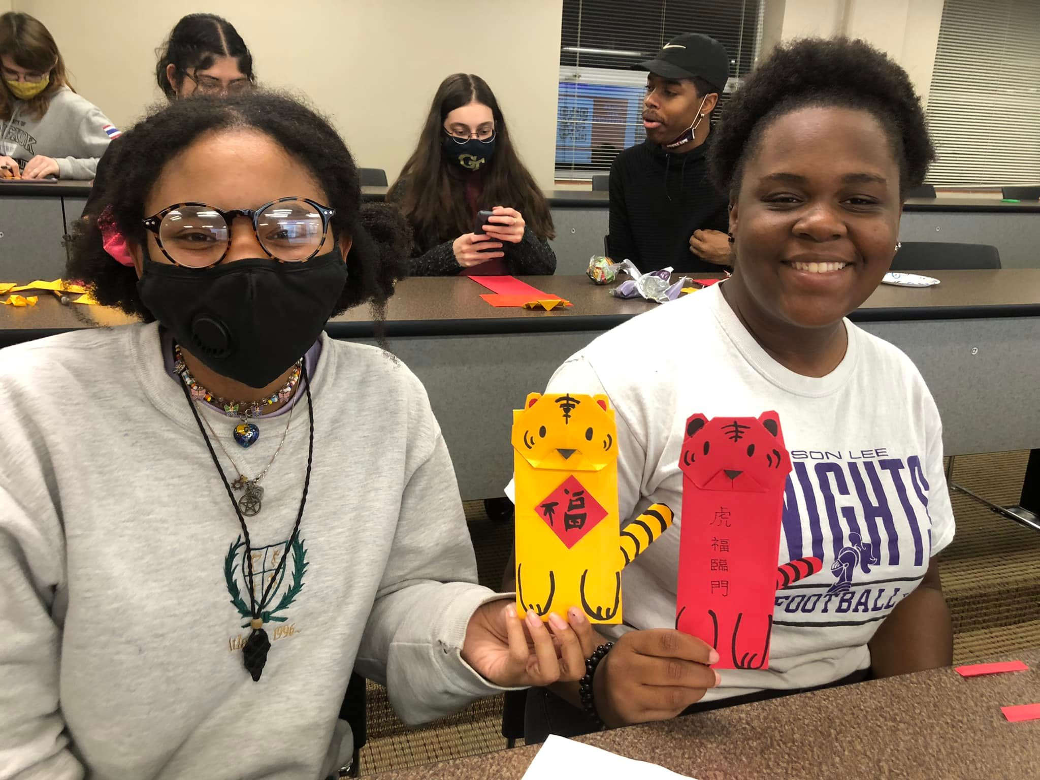

Slide 4
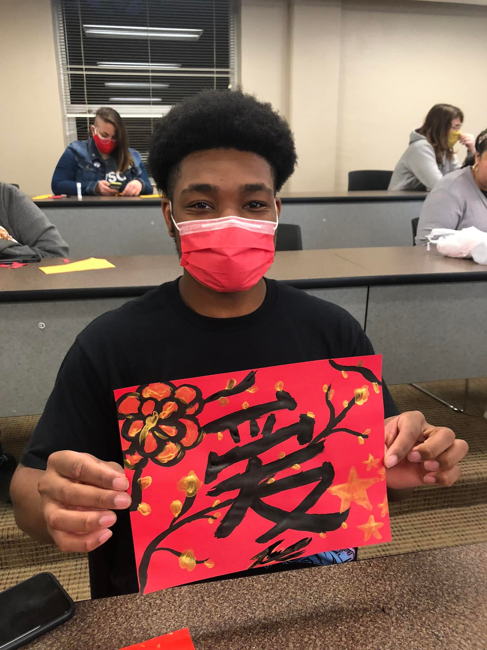
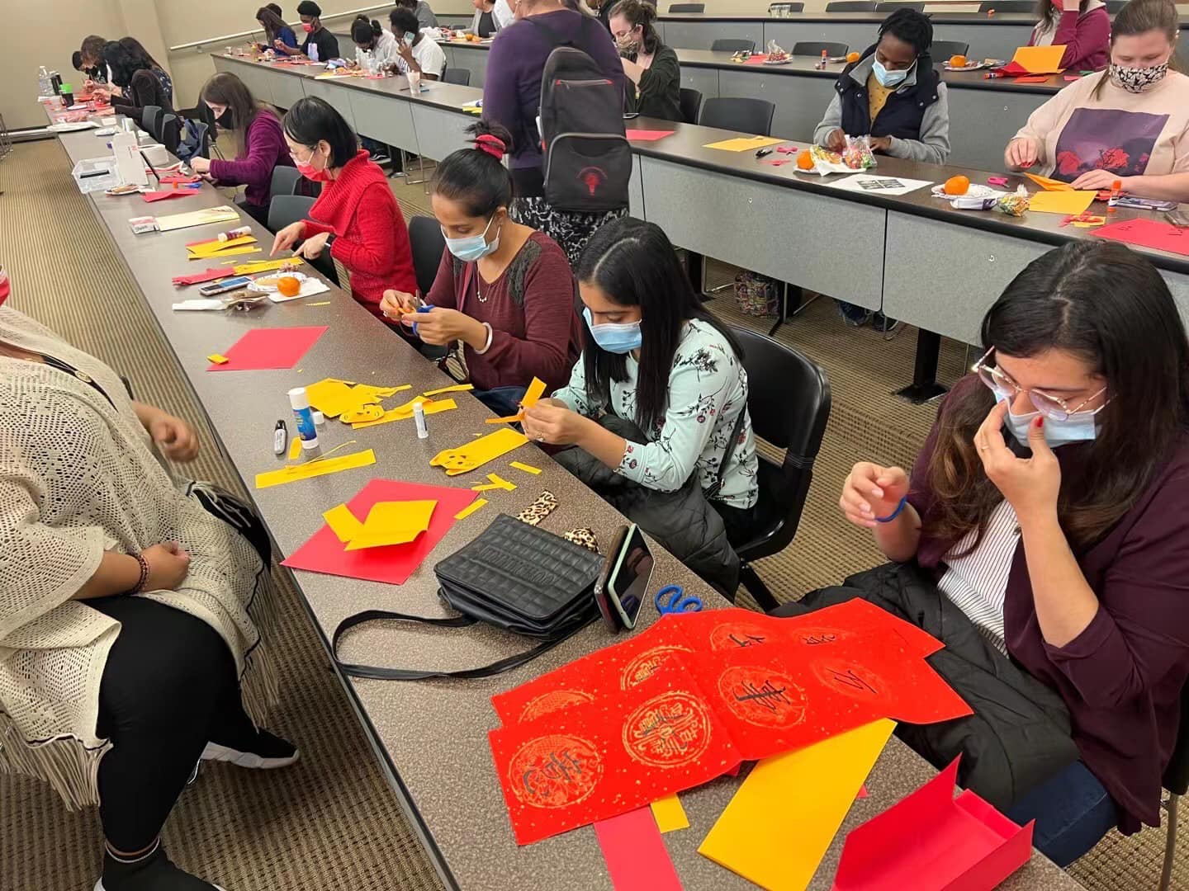

Slide 5
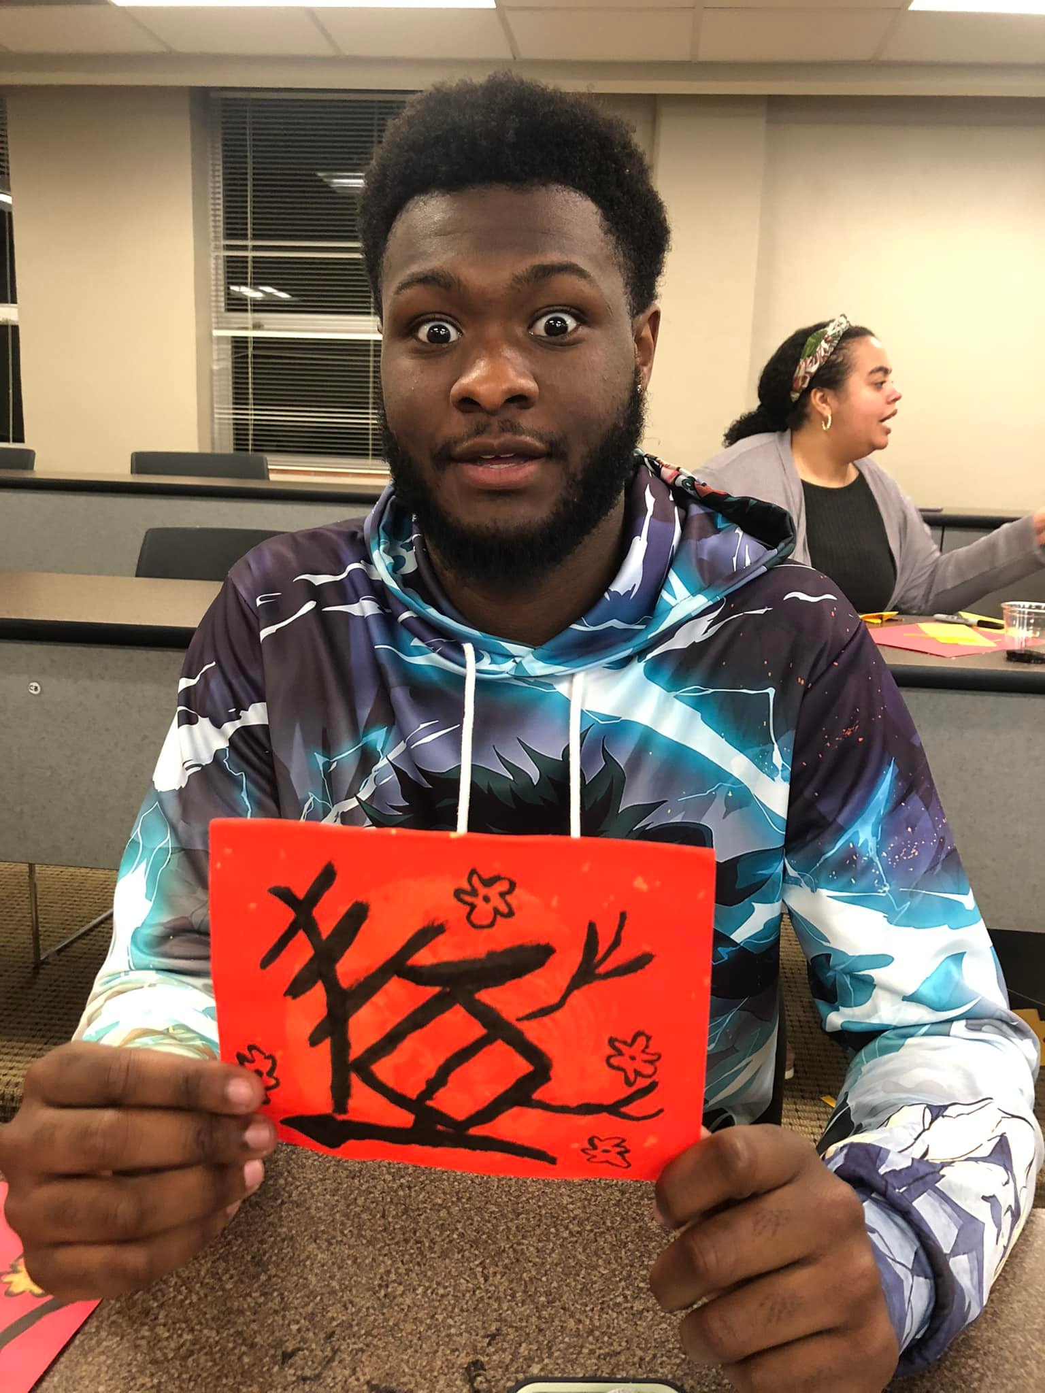
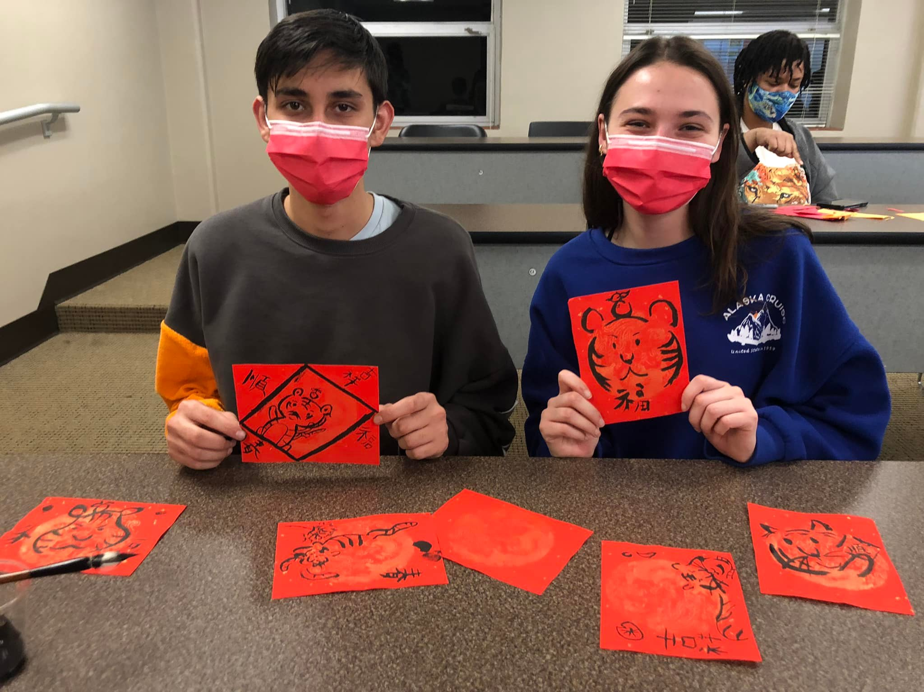

Slide 6
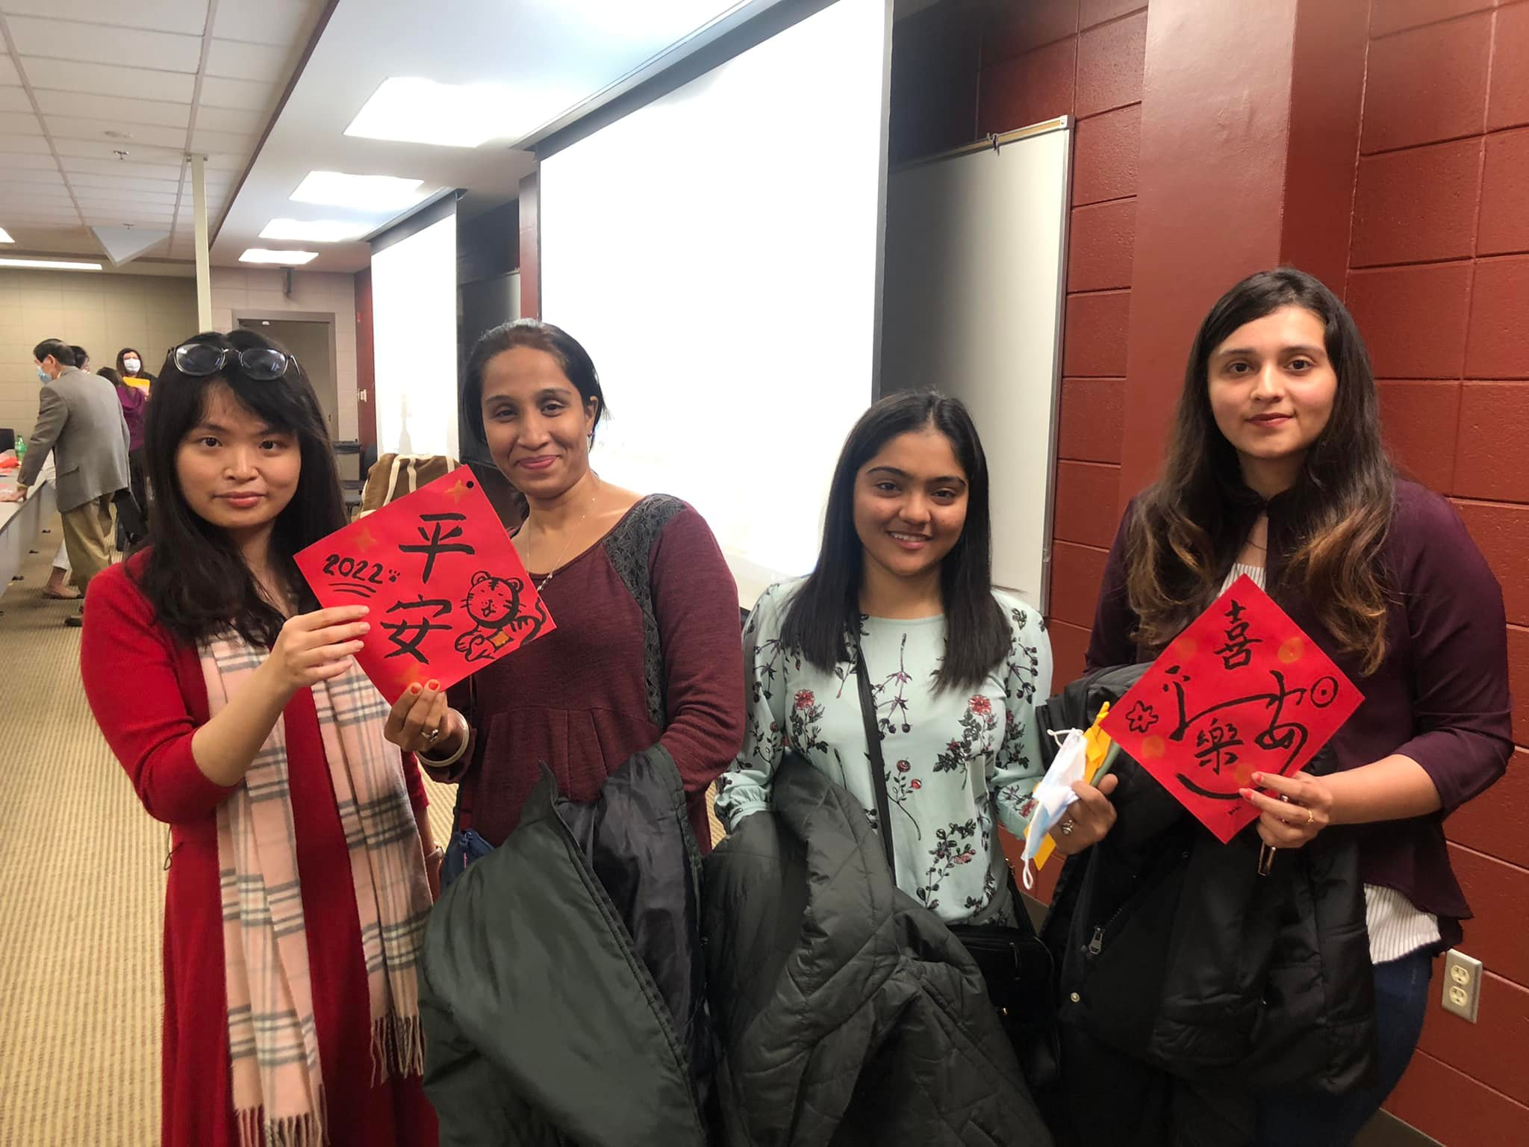

Slide 7
