Slide 1

AMAZIGH NEW YEAR
JANUARY 2022

Slide 2
What is Amazigh New Year?
Amazigh New Year, called Yennayer, is a Berber agricultural celebration. It is well known that this celebration is the first day of the Berber, or Amazigh, agricultural year. Amazigh people, or Imazighen,, celebrate it in January, but the date is decided based on the Julian calendar not the Gregorian calendar. The counting started when the Amazigh king Chiochink defeated the Roman emperor/Egyptian pharaoh Ramses III of Egypt, which was 2972 years ago

Slide 3
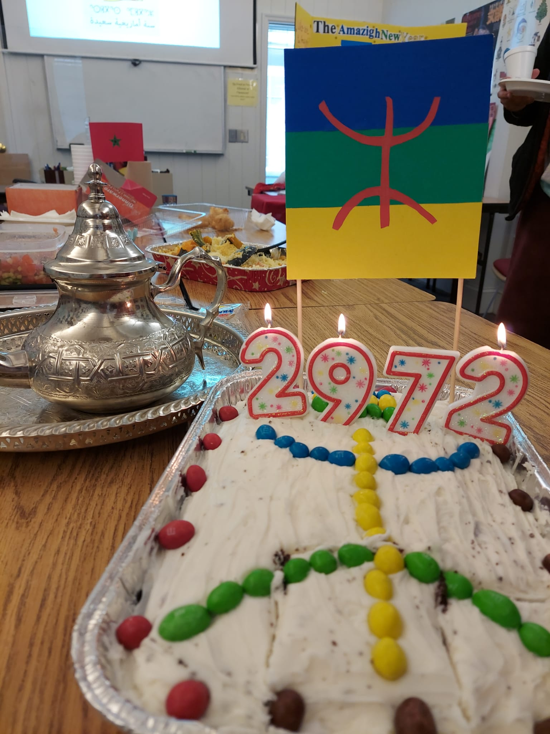


Slide 4

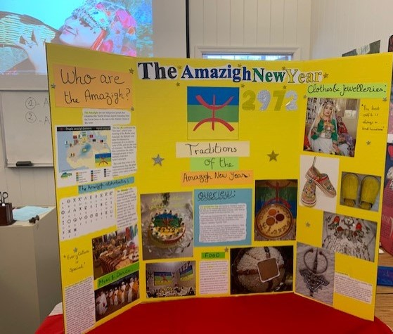

Slide 5
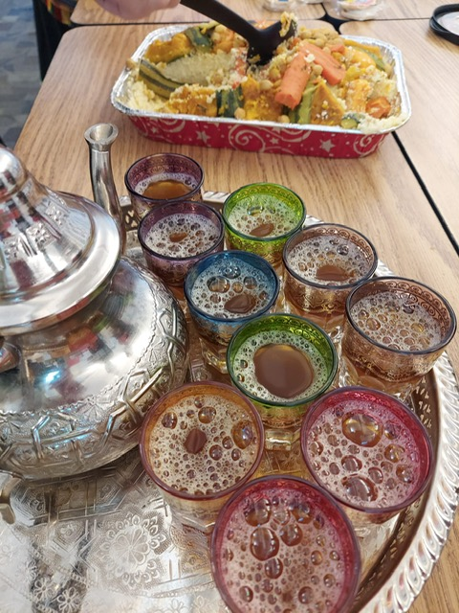
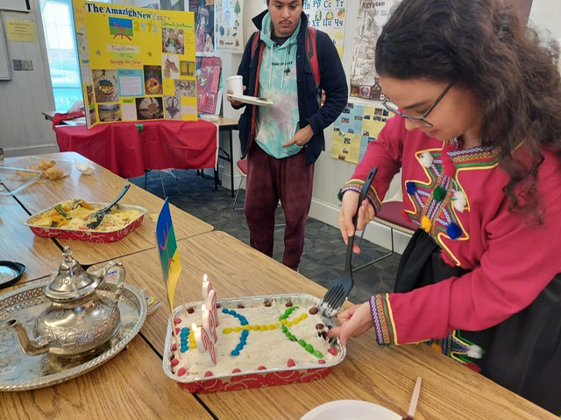

Slide 6

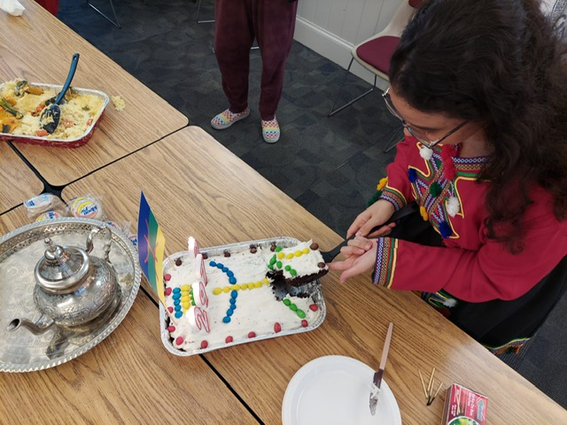

Slide 7

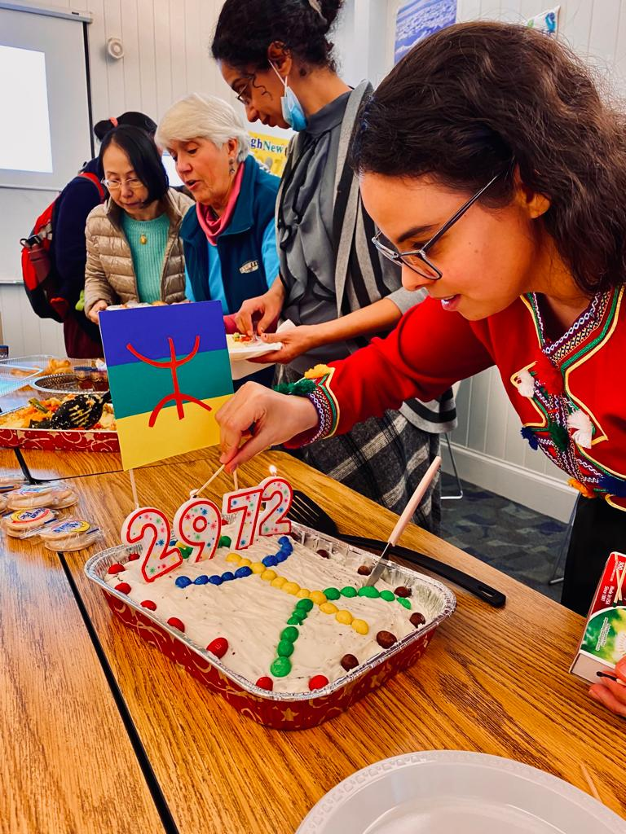

Slide 8


