Slide 1
Valdosta State University
Guidelines: Student Class Projects

Slide 2
http://www.hhs.gov/ohrp/humansubjects/guidance/45cfr46.101(b)
What is a Class Project?
Classroom Project or assignment involving human subjects are designed with the objective of providing students with training about and experience with research methods are not considered research. Therefore, the student is not required to submit an application on his/her project for IRB review.
Classroom Project or assignment involving systematic collection of data and for which the objective or design is to develop or contribute to generalizable knowledge are considered research and require IRB review.
However, there are certain regulatory conditions that DO NOT allow for exclusion from IRB review. These conditions are listed below:
No minors or vulnerable populations
No more than minimal risk
No deception
No publication and/or presentation
No audio or video recording
Nothing of a sensitive nature

Slide 3
Minors and Vulnerable Populations in Class Projects
Allowable only in an established educational setting that involves normal educational practices.
Conditions:
May not include intervention
May not include surveys
May not include interviews
May not include any interaction with the investigator
May not include audio and/or video recording
http://www.hhs.gov/ohrp/humansubjects/guidance/45cfr46.104 & 401

Slide 4
Any class project/assignment (including research) that includes interaction and/or intervention with minors can not be exempt from IRB review
http://www.hhs.gov/ohrp/humansubjects/guidance/45cfr46.104(d)(2)

Slide 5
Exempt – What does it Mean?
Although the 8 (7 & 8 do not apply to VSU) categories are called “exempt,” it still does require review and registration. The exempt registration process is much less rigorous than an expedited or full-committee review. The federally-defined exempt categories present the lowest amount of risk to potential subjects because they involve either collection of anonymous or publicly available data, or conduct the least potentially harmful experiments.
http://www.hhs.gov/ohrp/humansubjects/guidelines/45cfr46.104,1110,114,116

Slide 6
Who is required to receive training?
CITI IRB Basic training is required for the following:
IRB Administrator
IRB Committee Members
IRB Compliance Specialist
Researchers (PI & Co-PI)
Faculty/Staff Advisors for all student researchers/class projects
Student Researcher
Students conducting class projects involving human subjects (Students in Research Course–ONLY)
CITI training is valid for 3 years and faculty and/or student must score 80% or above in each module.

Slide 7
Even when a class project/assignment is “non-research” and not under the jurisdiction of the IRB, faculty members have an affirmative obligation to ensure that students understand their ethical obligations in carrying out their assignments. Instructors should provide guidance to students collecting information so as to minimize any unwitting or unintentional harms to other students or to individuals, especially if students will interact with or collect private information.

Slide 8
Class Project - Faculty Responsibilities
Faculty maintain current certification on the CITI IRB training to confirm their full understanding of ethical research practices.
Discuss the general principles of ethical research with human subjects with the class prior to the initiation of the project. Supplemented by the completion of the CITI IRB training module “Students in Research.”
Faculty discuss the above parameters with students before the class project begins.
Students must use their VSU student email when creating a CITI profile.
Review student class project plans and monitor those activities to ensure that human participants are protected.
Students conducting the project inform participants of the voluntary nature of participation and employ measures to confirm no personally identifiable information is collected.
When overseeing instructional assignments/class projects that do not fall under the definition of research, faculty or course instructor must have the students identify the project as a class assignment. No use of the word “research” or “IRB” is allowed.

Slide 9
Class Projects – Student Responsibilities
The student identifies himself/herself as a VSU student who is performing the activity to fulfill a course requirement.
The name and contact information for the faculty member or course instructor overseeing their project is included for participants to contact with any questions or concerns.
The students who have access to the individual data and/or summarized results are specified (instructor only, instructor and classmates only, etc.)
Participants are informed that their participation is completely voluntary, that they do not have to participate in the project if they do not wish to, and that they can stop participating at any time.
NO mention of the word research or IRB should be included.

Slide 10
Classroom Research Data
Identifying Participant information: Participant identifying information may not be included in the data collection. Students are required to destroy all data collected from human subject projects/assignments at the end of the semester upon receipt of final course grade.

Slide 11
http://www.hhs.gov/ohrp/humanssubjects/guidance/45cfr46.112
Future use of Student Classroom Project data
If a class project was conducted without IRB approval and resulted in unexpected but important findings or data, those findings or data cannot be presented at a conference or used in a future project or research study.

Slide 12
Course Assignment/Student Project Form
The Course Assigned Student Project form is a required document to be completed by the instructor and returned to OSPRA before students start a class project/assignment that involves human subjects.
Need link…………..

Slide 13
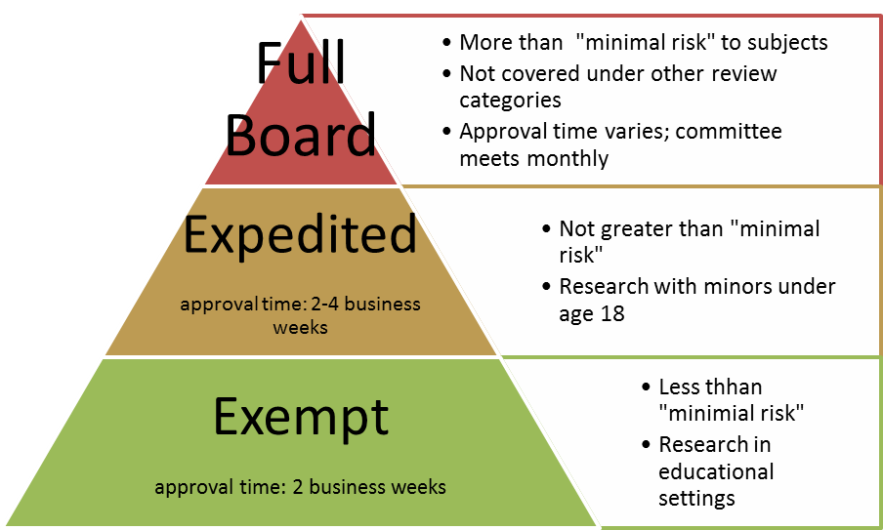
Which level of review are you?
Class project/assignment
No IRB review No minors or vulnerable populations
Minimal risk means that the probability and magnitude of harm or discomfort anticipated in the research are not greater in and of themselves than those ordinarily encountered in daily life or during the performance of routine physical or psychological examinations or tests.
Notes:
Add an exempt definition… “Do you qualify, if so go for exempt. Minmal risk might not be clear to some people. Perhaps give examples for exempt—VR
As a pyramid is this the order for the student to understand, perhaps maybe change it from a pyramid….consider a different type graph, if you are using a screen reader this wont be seen, student might think they are building up on the app---JM
Reduce full board and make it fit--MW
Ok with pyramid--LK

