Slide 1
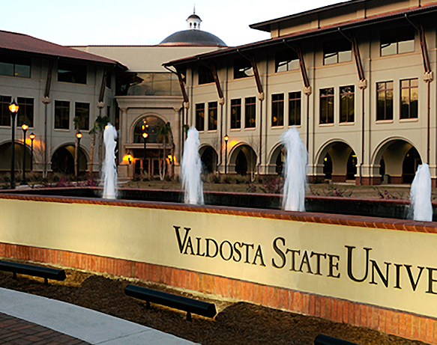
Graduate Assistant Supervisors
Policies and Procedures

Slide 2

Mission and Purpose
VSU’s graduate assistantships are designed to promote the research, teaching, and service responsibilities of the University and to provide students with valuable professional development opportunities while earning a graduate degree. Therefore, the graduate assistantship involves the dual responsibilities of maintaining a satisfactory academic performance and of successfully performing the assigned teaching, research, or other responsibilities.

Slide 3


Eligibility & Federal Regulations
The student must be accepted as a “Regular” admit in a degree granting graduate program at VSU. -- or “Probationary” in limited cases e.g.; international students. Students classified as “Non-Degree” are not eligible for assistantships.
Background Checks (for Position of Trust GA positions)
A student must verify lawful presence and complete hiring paperwork before any waiver of tuition will be applied to their account.
Maximum of 4 years.

Slide 4

Maintaining Eligibility
Maintain a 3.0 GPA
Register and Earn 6 semester hour credits every semester that they hold the assistantship (NO EXCEPTIONS)
Show satisfactory academic progress toward a degree
Flexible scheduling: Tier I GAs (14 hr/wk) must work 224 hours per semester, and Tier II GAs(19 hr/wk) must work 304 hours per semester.

Slide 5

Tuition Waiver & Fee Payment
The GA will be responsible for $38 and all student fees (SHIP and Housing) each semester (See Graduate Student Fee Schedule)
Tuition waivers cannot be applied until students have verified lawful presence and signed an appointment form each semester
The tuition waiver will apply to 15 credit hours in the fall and spring terms and 9 credit hours in the summer term

Slide 6

Types of GAs
Administrative Assistant
(Most common) Performs tasks important to daily office functions such as projects and other direct assistance to faculty, staff or students.
Teaching Assistant
Assigned instructional duties in a course(s) under the supervision of an experienced faculty member e.g., super-section GA
Lab Assistant
Aids with lab setup, proctoring, answering student questions, and helps with general function of Labs.
Research Assistant
Primarily responsible to work directly with faculty doing research-based tasks.
Instructor of Record
Fully responsible for own course(s) (teaching, lesson plans, assigning grades, etc.) Must have 18 hours at the graduate level in the discipline. Can teach up to 7 credit hours.

Slide 7

GA Supervisor Responsibilities
Do not promise, verbal or written, for a Graduate Assistant position to a prospective graduate student until the Supervisor has secured the Graduate Assistant position. Once a Graduate Assistant position is secured from your Dean or Vice President, a Letter of Intent can be issued. The letter must include the contingency of the prospective student’s acceptance into a graduate degree program.
Attend the Supervisor’s orientation.
Submit a performance review of the GA at the conclusion of the contractual period.
Approve the GA hours worked * The supervisor is the designated time approver. *GA must report actual hours worked in OneUSG.
Offer a valuable learning experience for the Graduate Assistant.
Complete the GA Exit Form once it is known the GA is resigning, is terminated, or has completed their contractual period and will not be returning to the GA position at a late date i.e. is graduating or leaving VSU.
Find this information and additional resources on the GA supervisor website.
Notes:
Note importance of scheduling hours with the GA to meet hours but not go significantly under or over the amount listed on the GA Appt Form

Slide 8

Supersection Allocation
Based on GA Allocation to the college.
Minimum enrollment number by class may vary by college.
The assigned position would be Teaching Assistants.

Slide 9

Hiring Process
ALTERNATIVE: Remote Hire packet
Supervisor
Secures funding or allocation from Dean or VP
Posts (or NOT) the position
Selects a Candidate
Submits GA Onboarding Request form
Graduate Assistant
Receives the next steps email (supervisor is copied).
Provides I-9 docs & completes Security Questionnaire (in person)
Signs Appointment Form in DocuSign (Supervisor is copied)
Completes Equifax for HR purposes
Receives HR Confirmation email (supervisor is copied)
* GA only begins work once receives email from HR.
Graduate School
Verifies the GA has been admitted into a Grad Program
Verifies that they are enrolled in a minimum of six credit hours
New Hire vs. Renewal vs. Re-Hire
Notes:
No longer have background check or the remote hire packet option for I9/Security Questionnaire

Slide 10
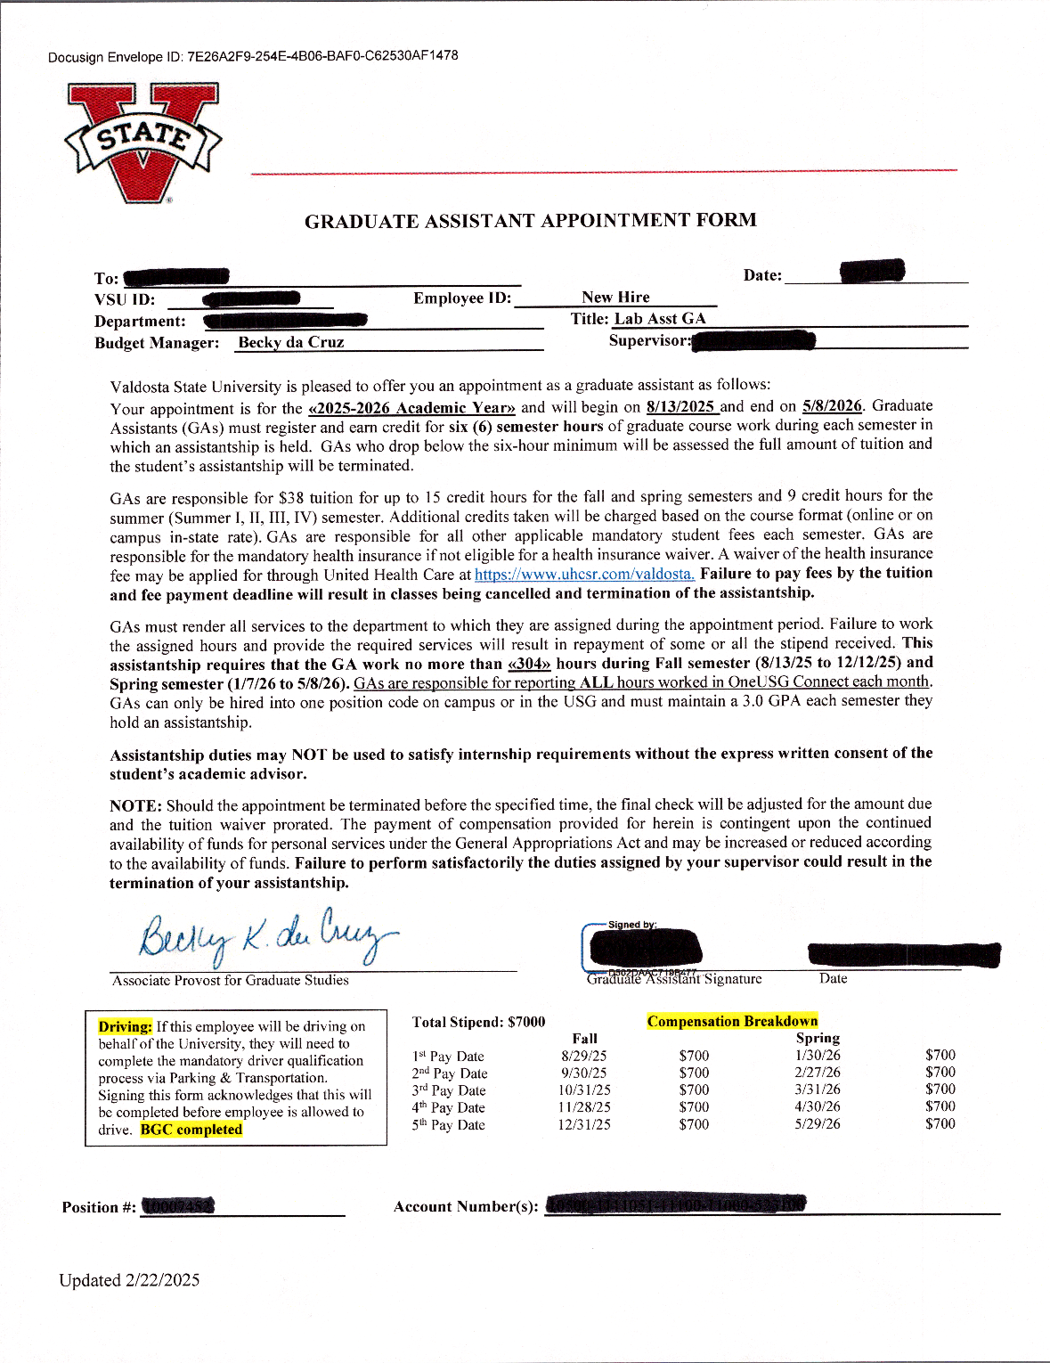
GA Appointment Form Example
Here is an example of a GA Appointment Form
Signed by the GA in DocuSign (Supervisors received signed copy via email)
Driving requirements listed on bottom lefthand corner

Slide 11
GA Recruitment & Hiring Timelines
Fall Semester Deadlines – For August 1st Start - Announce May 1st
November – June | Recruit & Hire GAs
May 15th | Deadline for postings to the GA Jobs Board
June 1st | Deadline to submit GA Onboarding Request Form for new GAs
June 15th | Deadline to submit GA Onboarding Request Form for returning GAs
July 15th | All documents must be submitted to Grad School i.e. I-9 & Security Questionnaire.
July 15th thru July 31st | HR processes i.e. Equifax, input to OneUSG, etc.
Wednesday before start of classes | New GA Orientation
1st day GA may begin work | GA will receive an email from HR when they are fully onboarded & permitted to begin work. Noted on GA’s Appointment Form

Slide 12
GA Recruitment & Hiring Timelines (Cont.)
Spring Semester Deadlines – For January 1st Start - Announce October 1st
September - November | Recruit & Hire GAs
October 15th | Deadline for postings to the GA Jobs Board
November 1st | Deadline to submit GA Onboarding Request Form for new GAs
November 15th | Deadline to submit GA Onboarding Request Form for returning GAs
December 1st | All documents must be submitted to Grad School i.e. I-9 & Security Questionnaire.
December 10th until campus closure | HR processes i.e. Equifax, input to OneUSG, etc.
Wednesday before start of classes | New GA Orientation
1st day GA may begin work | GA will receive an email from HR when they are fully onboarded & permitted to begin work. Noted on GA’s Appointment Form

Slide 13
GA Recruitment & Hiring Timelines (Cont.)
Summer Semester Deadlines – For May 1st Start – Announce February 1st
November-March | Recruit & Hire GAs
February 15th | Deadline for postings to the GA Jobs Board
March 1st | Deadline to submit GA Onboarding Request Form for new GAs
March 15th | Deadline to submit GA Onboarding Request Form for returning GAs
April 15th | All documents must be submitted to Grad School i.e. I-9 & Security Questionnaire.
April 15th thru April 30th | HR processes i.e. Equifax, input to OneUSG, etc.
As Needed | New GA Orientation
1st day GA may begin work | GA will receive an email from HR when they are fully onboarded & permitted to begin work. Noted on GA’s Appointment Form

Slide 14

International Students
Additional potential timeline delays
VISA appt - set as soon as admission is received (Letter of Intent)
SSN – in the US for 10 days before can apply
SSN required for GA onboarding
Must check in with International Programs regarding I20
Notes:
Any courses taken for credit outside of the US – the student must have the transcript evaluated by an Educational credentials service – NO EXCEPTIONS
Students can receive a letter outlining their funds for a GA, but only after they are accepted to the program – they must be able to show that they can fund their education
TOEFL/IELTS - ELS Language Centers Level 109, or completion of level 6 at VSU's English Language Institute – Applicants whose first language is not English (based on country of citizenship) must submit one of
the above. International applicants whose first language is not English but who have earned a bachelor’s degree or higher from a U.S. institution may be exempt from the language proficiency requirement.
Know which tests – some programs will NOT accept the IELTS
Timeline – Athletics Cheat Sheet
Financial Preparation – Financial Waivers may NOT be in place prior to student’s fee deadline

Slide 15


Appointment Forms
FLSA & ACA
Working Hours and Minimum Wage
ACA and Reporting Hours
Number of Hours
Contract with Student
Internships/GA Positions

Slide 16



Holidays/School Closing
Graduate Assistants are required to work the 224 or 304 hours each semester. If the University is closed for holidays, inclement weather, fall & spring break, please work with your GA to ensure they work all assigned hours.
Missed Work
Follow the same principle for hours missed due to illness or other absences.

Slide 17
Supplemental Pay for GAs is the exception – not the norm.
Must meet following criteria for Graduate School approval:
1. Make request prior to GA beginning the work.
2. Explain how the work outside of or in addition to the GAs regular GA duties.
How is hourly load accommodating GA hours?
Provide a brief description of GA duties & how these duties are different from the proposed additional work.
Provide the pay amount and hours to be worked for the supplemental pay.
Provide support that the additional work cannot be accomplished within the GA contractual hours/terms.
Supplemental Pay

Slide 18
Budget – GA Stipends
Remaining allocations from FY25
Additional $100,000 in GA allocations FY25 to increase GA stipends
Minimum GA stipends will be increasing FY27
Allocations will be reduced if funds remain

Slide 19
Please share this information with your VP or Dean.

Slide 20

Q & A

