Slide 1
Presentation about Algeria at LIR
SEPTEMBER 2022

Slide 2
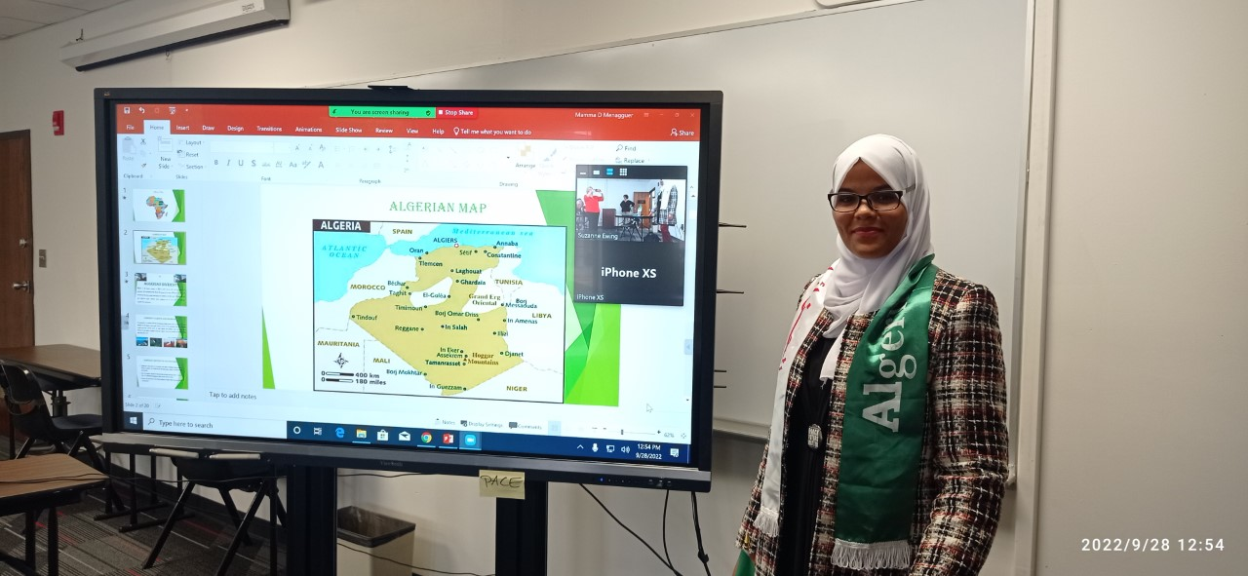

Slide 3
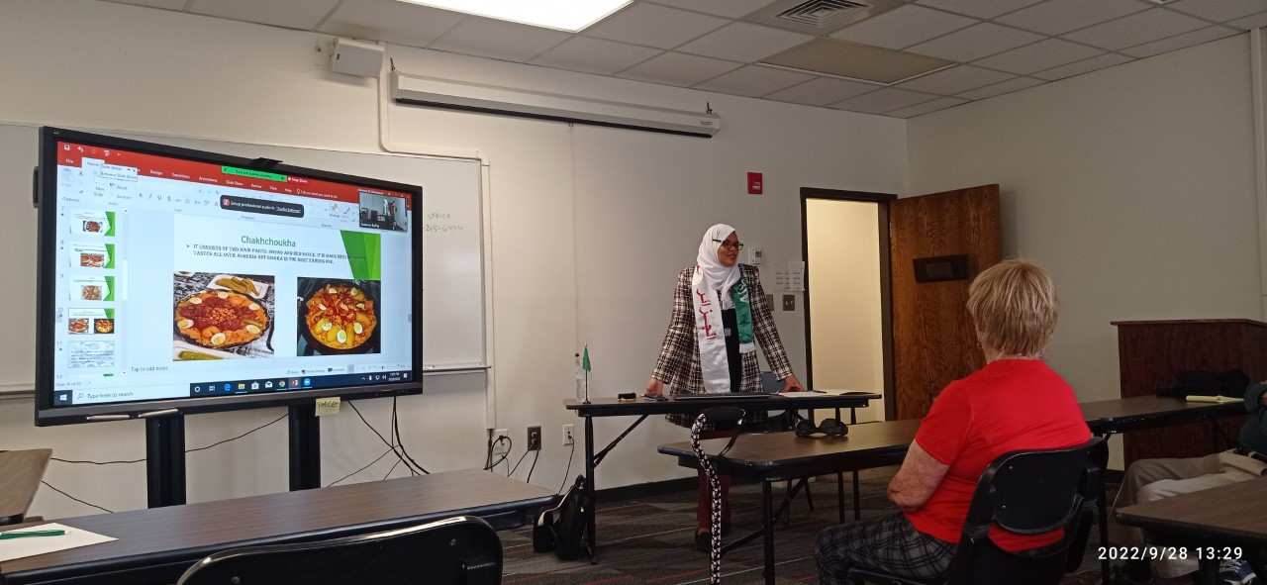

Slide 4
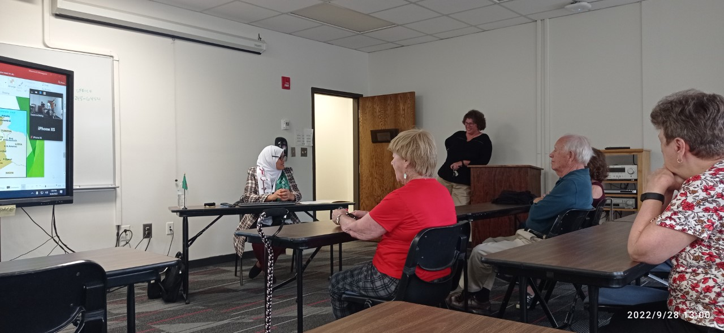

Slide 5
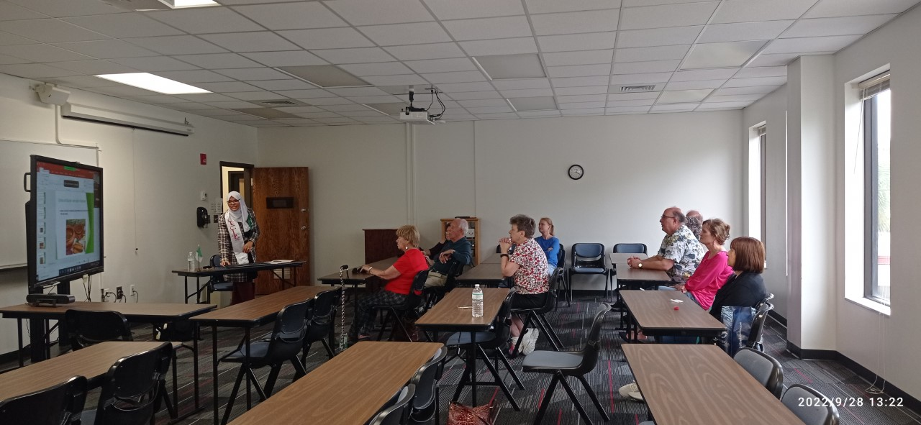

Slide 6
