Slide 1
WOMEN’S HEALTH
VSU Student Health
By Kim Rasmussen, RN

Slide 2
Good health starts with a healthy life style.
Getting enough sleep
Eating healthy
Exercising
Managing stress
Enjoying life without alcohol and drugs
Getting vaccinations: Flu, Tetanus, HPV, Meningitis, Hep B
Having an annual physical
Doing monthly self breast examinations
Beginning at age 40, mammograms should be done annually or earlier if you have a family history of breast cancer

Slide 3
ANNUAL EXAMINATION
Once you become sexually active you should start
having a Pap every year or if you are over age 20,
even if you are not sexually active.
If you are sexually active you should also have
STD testing done at least annually.
Many STD’s have no symptoms.

Slide 4
MENSTRUAL CYCLES
Vary from woman to woman
Change at different stages in life
A cycle is the period of time, starting with your first day of vaginal bleeding (usually monthly) until the 1st day it begins again.
An average cycle is 25-40 days

Slide 5
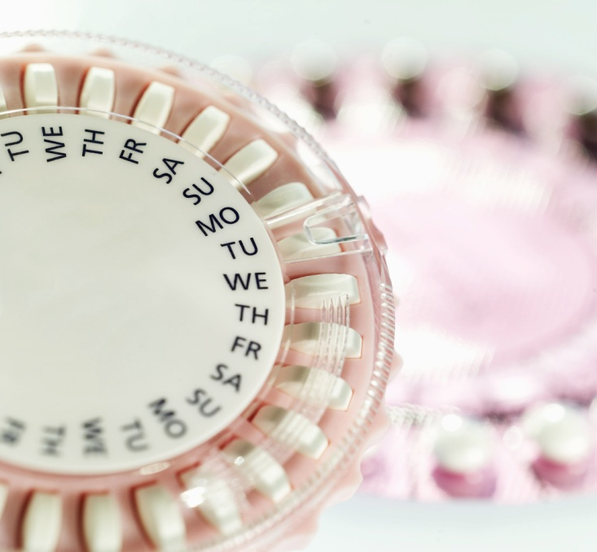
Many things can lead to changes in menstrual cycles.
Taking birth control pills usually results in a more regular schedule unless a pill is missed.
Living with other women
Stress
Illness, cold, flu
Medications
Infections, STDs
Changes in weight
Surgery

Slide 6
Vaginal secretions often vary throughout the menstrual cycle.
When the egg is being released (ovulation) the discharge is more like raw egg whites, clear and slippery.
Just after your period the discharge is often thicker and white.
When you are sexually aroused, secretions increase.
Secretions should not smell bad, they may have a mild odor but not fishy.
It is not normal to have yellow or green discharge.
You should not have vaginal burning or itching.

Slide 7
PELVIC EXAMINATION
Vaginal examination with a speculum
During the vaginal examination the following may be done: Pap, STD testing, and/or a wet prep.
If you come into a clinic with a vaginal discharge sometimes a “wet prep” is done to see if there is an infection present but this does not necessarily mean that an STD check was done. The “wet prep” can not tell you if you have Chlamydia or Gonorrhea. The “wet prep“ can diagnose: bacterial vaginosis, yeast infections, and trich.

Slide 8
WHAT IS A PAP SMEAR
It is named after the man who developed the test, Dr George N. Papanicolau.
The test involves taking a few cervical cells, to detect precancerous cells and other abnormal cells.
An instrument called a speculum is inserted into the vagina and then opened so that the cervix is visible. A brush is then used to obtain the cells.
Do not use any douches, vaginal creams or have intercourse within 48 hours prior to the exam.
If you are coming to Student Health for your exam, you will need to make sure you state that you want an appt. for a Pap as a longer time is needed than is used for a regular visit.

Slide 9
What is HPV
HPV (human papillomavirus) is a virus with over 100 different types.
Many types of HPV can be passed by close physical contact during sex.
Some types of HPV can cause warts in the genital area. Others cause no symptoms
HPV is easy to transmit because:
  HPV lives in the skin and is found on skin surfaces
  People can have HPV without knowing it

Slide 10
What are the symptoms of HPV
No symptoms. Most people with HPV don’t ever know they have it. They never have symptoms or other problems. Currently there is no test for HPV in Men.
Genital Warts. Some people with HPV get warts. These are small, flat or round bumps on, around or inside the sex organs of both men and women.
Cell changes. HPV can cause cell changes in the cervix, penis or anus. Sometimes these cell changes lead to cancer.
No one can say who will have symptoms or problems and who will not.

Slide 11
Reduce your risk of HPV
You can take steps to help protect yourself from HPV. If you have HPV, you can still prevent cancer.
Don’t have sex. This includes any genital touching. This will eliminate your risk. Experts believe that over 50% of people who have had sex have HPV.
Use condoms every time you have sex. Male or female condoms may reduce your risk. (But if the condom doesn’t cover skin that contains the virus, you can still get HPV.)
Have sex with only one partner who only has sex with you. The more partners you have sex with, the higher your risk of getting HPV.
A vaccine can help protect you from many types of HPV. Ask your health care provider if it’s right for you.

Slide 12
What is the HPV Vaccine
There is a vaccine for women that protects against most types of HPV that cause cervical cancer and genital warts.
The vaccine is given in 3 shots over a 6-month period. Females between ages 9 and 26 can safely receive the shots.
The vaccine works best before a woman begins to have sex. But it can also protect someone who has already had sex.
Even if a woman gets the vaccine, she should still have regular Pap tests.

Slide 13
SEX
The only safe sex is NO SEX!!
If you are sexually active use protection!!
Condoms, if used properly are: 98% effective to prevent pregnancy, decrease the risk of HIV, Hepatitis, Chlamydia, Gonorrhea and cervical/throat HPV
Condoms will not prevent herpes, genital warts, MRSA and crabs.
Oral sex is still sex and can spread STDs.

Slide 14
SEXUAL RESPONSIBILITY
Know your partner well before you ever have sex and get tested. Remember that some diseases can take months to appear and some like genital warts, if only on the outer genitalia, will not show up on tests.
Every time you sleep with someone you are also exposed to every disease that any of their previous partners may have had.
People are not always honest about their past number of sexual partners.
Before you have sex, ask yourself: are they worth risking my life for, are they worth risking the ability to have children later or a possible pregnancy at this time.

Slide 15
VIRGINITY
Is something to be proud of. Few people regret maintaining their virginity but many regret losing it.
If you want to stay a virgin until marriage or a committed relationship, communicate this to potential partners so that your feelings on this subject are clear.
Refrain from drinking alcohol excessively as it is easier to be taken advantage of when impaired.
Hang out with people that have similar values as it will be easier to maintain yours.
It may seem that every one else is “doing it” but there are many that aren’t and they will respect your decision.

Slide 16
Breast Cancer Facts
Anyone can get breast cancer
Although men are at a much lower risk, it is possible for them to get breast cancer
Currently, White women have a higher incidence of breast cancer than Black women

Slide 17
You may be at increased risk for breast cancer because of your family history. Women who have more than one blood relative with breast cancer are at increased risk
Over 50% of breast cancer occurs in women age 65 and older
Excluding skin cancer, breast cancer is the most common cancer among women

Slide 18
Birth control pills can increase your risk for breast cancer if they contain estrogen
Breast cancer found in the early stages is often treated successfully
Because of early detection and advances in treatment, breast cancer death rates are falling

Slide 19
Early Detection is the Key
  There is no way at present to prevent breast cancer, but a healthy lifestyle can help
  Beginning at the age of 20, monthly self breast exams should be performed

Slide 20
Beginning at age 40, mammograms should be done annually
Mammograms are capable of detecting lumps as small as the size of a pea, often long before it can be felt

Slide 21
How to perform SBE
Follow an up and down pattern or circular pattern for each breast
Self breast exams can be done in the shower or lying down
It is important to look in the mirror for a general inspection of the breasts also:
breast shape changes
dimpling, puckering or flattening
skin color or texture changes

Slide 22
Remember that not all breast lumps are cancerous
If your do find a lump, consult your healthcare provider

Slide 23

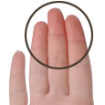
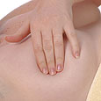
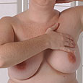
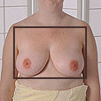
Self Breast Exam
1. Use of soap/lotion
2. Use 3 fingers
3. Pressure needed
Use soap or a lotion if you want. It may be easier to feel your breast using soap or lotion.
Use your three middle fingers together.
Use firm but gentle pressure.
4. Compare both breasts
5. Check the whole breast area
Check both breasts. You should feel the same or similar things in each breast.
Make sure you check the entire breast area, including under your arms and up to your collarbone.

Slide 24
Inflammatory Breast Cancer
Rare and aggressive form of breast cancer
Sudden onset of symptoms may include:
*Redness and increased heat
*Swelling
*Tenderness
*Possible dimpling
Presents without a detectable lump
Commonly misdiagnosed as an infection

Slide 25
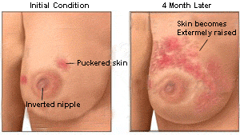
Inflammatory Breast Cancer

Slide 26
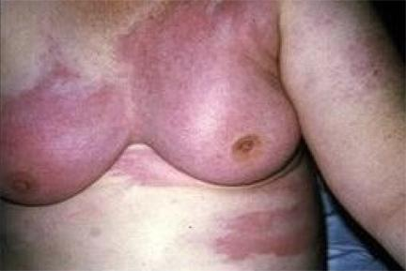
Inflammatory Breast Cancer
A patient with inflammatory breast cancer generally presents with a tender, firm and enlarged breast, rather than a discernable mass. This patient was diagnosed with acute mastitis carcinomatosa involving the entire breast.

Slide 27
Source
Cooley, B. & Fellner, J. (2007) ETR Associates. www.etr.org.

