Slide 1
MRSA
METHICILLIN-RESISTANT STAPHYLOCOCCUS AUREUS
Created by Kim Rasmussen, RN
VSU – Student Health Center
11/8/10

Slide 2
WHAT IS STAPHYLOCOCCUS AUREUS?
It is commonly called staph and it is one of the bacteria frequently responsible for skin infections.
Staph is often found on the skin and in the noses of healthy people.
Most Staph infections are minor (pimples and boils).
Staph can also be more serious in surgical wounds and pneumonia.

Slide 3
WHAT IS MRSA
MRSA is a type of Staph infection that is resistant to certain antibiotics.
Because MRSA can be harder to treat it can lead to more serious blood or bone infections.

Slide 4
WHAT DOES MRSA LOOK LIKE?
At first it may look like an insect bite.
As the infection grows it becomes red, swollen, warm, and tender to touch.
Sometimes the boil like lesions will rupture or form abscesses.

Slide 5
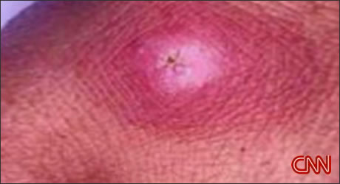

Slide 6
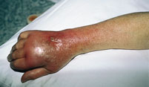

Slide 7
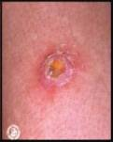

Slide 8
HOW IS MRSA SPREAD?
MRSA can be transmitted by skin to skin contact.
It can live on surfaces for 24 hours or more.
Commonly used objects such as workout equipment, desks, towels and sheets.
MRSA is more common in people that use gyms, are in school, or incarcerated.

Slide 9
HOW CAN I PREVENT MRSA?
Always wash hands well and shower daily.
Eat a healthy diet, exercise, quit smoking and avoid stress.
Keep open wounds covered.
Avoid contact with other peoples wounds.
Avoid sharing personal items like razors, towels, uniforms and sports equipment that directly touches your skin.
Clean and disinfect gym equipment, tanning beds and any other items that touch your skin directly.
Wash dirty clothes, linens and towels with hot water, detergent and bleach when possible.
Use antibiotics only prescribed for you, take on correct schedule and finish the entire bottle!!!

Slide 10
HOW IS MRSA DIAGNOSED AND TREATED?
A health care provider swabs the wound and the specimen is sent to a laboratory for a test called a culture and sensitivity.
The test results are usually back in 2-3 days. The test will show if the infection is resistant to certain antibiotics. If the infection can not be killed with standard antibiotics it is then referred to as MRSA.
The culture will show what antibiotics will treat the infection.

Slide 11
Source
Holt, K. (2008) Journeyworks Publishing, Santa Cruz, CA. www.journeyworks.com.

