Slide 1

Internal Controls
“They Are Everyone’s Business”

Slide 2
Presentation Overview
Understand Internal Controls
Identify Control Weaknesses
Fraud
Best Practices
Notes:
Importance of IC
COSO model
Best practices

Slide 3
Internal Controls
How did this happen?
When did you know about it?
Why didn’t you prevent it?
Notes:
Imagine this: your division is running well, you seem to be making all good decisions and no one’s complaining. Things appear to be going well for you. You’re “in the zone” so to speak. Your boss asks you to meet him in the conference room at 3:00 p.m. You’re thinking, “finally – I’m getting that promotion and the raise that goes with it”. You are so excited!
When 3:00 o’clock finally gets here, you open the conference room door with much anticipation and wait – what is this. There’s the President, the Controller. All the VP’s - Some people from the system – the Vice Chancellor of finance and oh, no, the auditors are here. Everyone is dressed in black and no one is smiling.
What’s going on? What’s happening?
That’s exactly what they want to know. What is happening?
“How did this happen?” “Why didn’t you prevent it?” “When did you know about it?”
This was the scene in the GPC boardroom

Slide 4
Question #1
Internal control is a process designed to provide reasonable assurance regarding the achievement of which objective?
Effectiveness and efficiency of operations
Reliability of financial reporting
Compliance with applicable laws and regulations
All of the above
Notes:
Answer: D Effectiveness relates to the ability of the entity to accomplish its goals. Efficiency is concerned with maximizing the best use of resources. Reliability of financial reporting includes the accuracy of financial statement balances and adequate and complete disclosure. Compliance with applicable laws and regulations refers to all laws and regulations that apply to the entity.

Slide 5
Internal Controls
Internal
Controls
YOU
Peace of Mind
Notes:
Interestingly, one of the core principles of best business practices can prevent scenarios like the one at GPC from playing out. That principle is the concept of internal controls, yet it remains an area that gets little attention until something goes wrong.
There are many instances of businesses losing vast sums of money and employees winding up in jail as a result of weak internal controls. Time and again, studies cite lack of adequate internal controls as the single most common reason that frauds can occur. Yet time and again some businesses, managers, and employees take chances, ignore the law, or remain ignorant of inherent risks – especially in their own department. “That can’t happen to me,” isn’t true. The fact is employees from line to senior management get caught in the lax environment of weak internal controls and the subsequent consequences. The good news is there is something you can do about it.
It is much less expensive to implement sound internal controls than it is to investigate and prosecute fraud or to recover from the bad publicity surrounding a fraud. From the famous Bernie Madoff and Enron headlines. In June of 2012, the former CEO of Archbold Hospital in Thomasville was sentenced to two years in prison for medicaid fraud. Lack of controls or override of controls can be cited as a cause for allowing the frauds to happen in the first place.
Here at VSU, we are still responding to the consequences of a p-card fraud at Georgia Tech several years ago. Two other recent system wide audits were painful for many: lawful presence and admissions requirements.
And Georgia Perimeter had consequences for all the institutions – additional quarterly financial reporting, loss of reputation, loss of trust. Many people lost their jobs. Most of them good employees, doing their jobs.

Slide 6
What are Internal Controls?
Systems and processes designed to provide management with reasonable but not absolute assurance that the goals and objectives it believes important to the entity will be met.
Internal controls should be a part of HOW you do your job, not just “added” to what you already do.
Notes:
Effective internal controls are one method that can be employed to assist the USG in achieving its mission.
Part of the USG ethics policy: Internal controls are the processes employed at all levels to help ensure that USG business is carried out in accordance with BOR policies and procedures, institutional policies and procedures, applicable laws and regulations and sound business practices. Good internal controls promote efficient operations, accurate financial reporting, safeguarding of assets and responsible fiscal management

Slide 7

What’s the Purpose of Internal Controls?
Achieve goals
Carry out management directives
Reduce surprises
Increase reliability of information
Promote efficiency and effectiveness
Safe guard assets
Comply with rules and regulations
Notes:
When thinking of internal controls think of your department and lets see how we can relate these few examples to what you are accountable for?

Slide 8
Question #2
Who is responsible for internal controls?
  Upper management
  Accountants and Auditors
  Supervisors
  All employees
Notes:
Answer: D Internal controls are effected by “People”. It is not just manuals and policies but the people at all levels of the organization.

Slide 9
Responsibility and Accountability
Deans, department heads, chairpersons and directors are primarily responsible for identifying the financial and compliance risks and internal controls for their operations.
Individual employees have responsibility for evaluating, establishing and/or improving, and monitoring internal controls for their areas of responsibility and accountability
Notes:
When thinking of internal controls think of your department and lets see how we can relate these few examples to what you are accountable for?

Slide 10
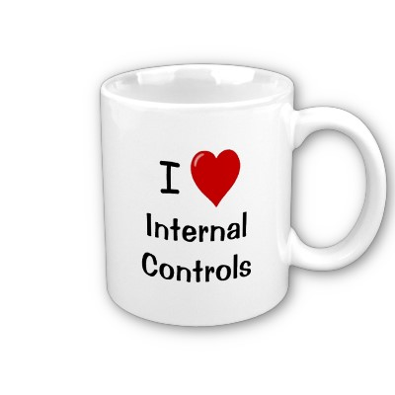
WHY Are Controls Important?
Management viewpoint
Transactions are recorded (complete)
Profitability and reporting accuracy
Assets are secure and existent
Compliance with laws and regulations
Notes:
Examples of internal controls in a budgetary context include processes and procedures designed to:
• Assign responsibility for budget development and execution;
• Monitor budget performance;
• Ensure that resources are available to meet planned expenses;
• Validate and approve expenditures against a valid budget;
• Ensure that budgets submitted to the Board of Regents are congruent with the financial resources
of the college and that they are properly reflected in the financial system; and,
• Provide early warning of financial or other risks as reflected in budget performance.

Slide 11
WHY Are Controls Important?
Worker’s standpoint
Reduce errors
Protection and evidence of no wrongdoing
Simplify
Notes:
One control we cite frequently is separation of duties – another is dual controls. We see this frequently in cash handling, but the same is true for inventory or any other asset. There should be a record of when responsibility for the asset is transferred.
If you don’t have this accountability, and $ is missing, you will be suspect.

Slide 12
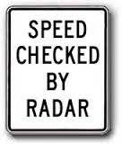


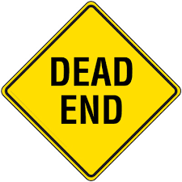
Controlling Opportunity
Prevent Control Monitor Deter
Notes:
To ensure that you will reach your department goals and mitigate risks – first you want to try and prevent major risks from happening, so you will implement controls, to include monitoring, which will deter the honest workers from fraud, and help to reduce errors, etc.

Slide 13

What do internal
controls look like?
Notes:
Reconciling bank statements
Counting your change
Reading expiration date before you drink that milk.
Counting inventory
Lock your doors
ASK THE PARTICIPANTS FOR EXAMPLES OF WHAT THEY DO. AND WRITE ON THE BOARD

Slide 14
Question #3
Control activities can be defined as:
A means to an end
Authorized procedures
The particular category in which a control is placed
The actions of people to help ensure that management directives necessary to address risks are carried out
Notes:
Answer: D The COSO definition of control activities recognizes that internal control is affected by people at every level of the organization. Control activities are more than a means to an end, and are not limited to authorized procedures. Control activities are often in overlapping categories

Slide 15
What can IC protect against?
Conflicts of Interest
Purchasing Schemes / Turnaround Sales
Bribery & Incentives
Kickbacks
Billing Schemes
Shell Companies
Non-Accomplice Vendors / Personal Purchases
Expense Reimbursements
Fictitious Expenses
Multiple Reimbursements
Notes:
Internal controls can protect against these types of schemes.
Relate this back to the audience. Do you think you could ever be the victim of any of these schemes?
A local example of fraud is Lowndes County YMCA former executive director Nicky Tampas and his co-conspirator Wayman Lee Patrick Jr. Among other dishonest acts these two performed, Mr. Patrick was awarded the landscaping and renovation contracts for the YMCA by Tampas, then kicked back a portion of the money to Tampas. In 2006, Mr. Tampas was sentenced to 97 months in prison, with $1.4 million in restitution; Mr. Patrick was sentenced to 65 months in prison.

Slide 16

Why Should I Care?
Protect yourself
Protect your assets
Help you do your job
Help deter fraud
Management directive

Slide 17
What If We Don’t Have Controls
Control deficiency:
  The design or operation of a control does not allow management or employees, in the normal course of performing their assigned functions, to prevent or detect misstatements on a timely basis.
Notes:
So, someone may THINK they have a control in place, but by design it is not a control. For example – police evidence room. The officer gives the evidence to the custodian who securely locks it in the evidence room. Maybe he even watches the custodian log it in the evidence book. But wait, the evidence receipts are not numbered and when the officer leaves, the custodian removes the unnumbered receipt and destroys it. Now he is free to pocket the evidence. And when it’s time to produce the evidence, there is no record of it. What happened to it? Did it ever exist? Did the officer lose it or steal it? What about the custodian? Is he under suspicion?
How would you improve this?

Slide 18

Control Deficiencies Can Result In:
Break-ins (doors not locked; access from outside not controlled)
ID theft
Wrong prisoners released
Assets misappropriated (stolen)
Laws broken
Misstated financial statements
Inefficiencies resulting in higher costs

Slide 19
Example 1 of Control Deficiencies
GA Tech professor shaking down students
http://www.ajc.com/news/news/breaking-news/georgia-tech-professor-accused-taking-20k-students/nd734/

Slide 20
Example 2 of Control Deficiencies
Three employees under investigation by the FBI for suspected fraud of $1.5 million at Georgia Tech
http://www.wsbtv.com/news/news/local/audit-uncovers-suspected-fraud-georgia-tech/nbz5K/

Slide 21
Evaluating Your Work Environment and Identifying Deficiencies

Slide 22
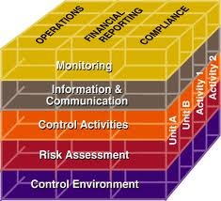
COSO Model
Notes:
One tool to evaluate an organization’s internal controls is the COSO model. This FRAMEWORK is important – it formalizes a set of conditions that can be commonly understood and accepted by all parties and that will foster good controls.
COSO is The Committee of Sponsoring Organizations formed in 1985 to sponsor the National Commission on Fraudulent Financial Reporting known as the Treadway Commission, continues to be dedicated to enhancing the quality of financial reporting.
COSO developed a common definition of internal controls that provides a standard against which all organizations can assess their controls.
“Systems and processes, effected by the entity’s board, management and other personnel, designed to provide management with reasonable but not absolute assurance that the goals and objectives it believes important to the entity will be met”
Mission
COSO’s mission is to strengthen internal control and deter fraud. If this cube represents VSU, each column would be your department or unit.

Slide 23
How does COSO apply to you?
Operations
Financial Reporting
Compliance
Notes:
The Framework provides a control structure for all aspects of the organization.
Think of your job in the context of these 3 areas:
Operations
Financial Reporting
Compliance

Slide 24
Good Internal Controls Help to Ensure:
Effective and Efficient Operations: For example:
A university has multi-million dollar endowment that is invested in a wide range of traditional and nontraditional investment vehicles to maximize its investment return and spread risk.
An institution is beginning an aggressive capital campaign and will be assessing its resource requirements (e.g. people, systems) to effectively manage it.
An institution is implementing a new payroll system and wants to ensure that the implementation will be within budget and that the resulting system will meet its desired business objectives.
In each of these examples, good internal controls give the stakeholders (i.e., benefactors, donors, students, parents, IT users) more faith in the institution’s ability to manage its operations effectively and efficiently so it can fulfill its missions of education, research and community service.
Notes:
So what are internal controls?
Internal controls mean “different things to different people”, which can create confusion and lead to miscommunication.

Slide 25
Good Internal Controls Help to Ensure:
Reliable Financial Reports. For example:
A state legislator uses a report that has been reconciled to a public university system’s annual audited financial statement. The legislator wants to get a sense of how the institution has administered the prior year’s appropriations.
University department heads and chairs monitor financial reports each month that compare their department’s budgeted expenses to their actual expenses to assess whether they are on target to meet their budget.
The National Science Foundation (NSF) reviews financial status report from university to track its use if NSF grants and contracts.
In each of these examples, good internal controls give the users of financial reports (i.e., the legislator, department heads and chairs, and NSF) greater confidence in the reliability of the financial report.

Slide 26
Good Internal Controls Help to Ensure:
Compliance with Laws and Regulations. For example:
A college files its Form 990 with the IRS on a timely basis, and the tax return evidences that the institution complies with IRS rules and regulations.
A university undergoes a self-assessment of its faculty effort reporting policies and controls to ensure it is in compliance with federal research sponsors rules and regulations.
A regents asks the CBO about compliance with the institution’s conflict of interest policy.
In each of these examples, good internal controls give the stakeholders (e.g., IRS, federal sponsors, regents) more confidence that the institution and its employees have complied with laws and regulations.

Slide 27
COSO Model: Environment
Good control environment
  Competent people
  Understand responsibilities
  Knowledgeable, mindful, committed
  Policies, procedures, ethics
Notes:
The environment sets the tone of an organization. It is the foundation for all other components of internal control, providing discipline and structure.
The “Tone at the top” is often mentioned. This is the message you convey to your reporting structure and how you communicate acceptable behavior. Consider a supervisor who arrives late, leaves early, and takes long lunches and the message that this behavior conveys to their employees.
Another example is what happened at Penn State. Egregious behavior was condoned, resulting in significant loss of reputation to the entire institution.
Albany State Financial Aid

Slide 28
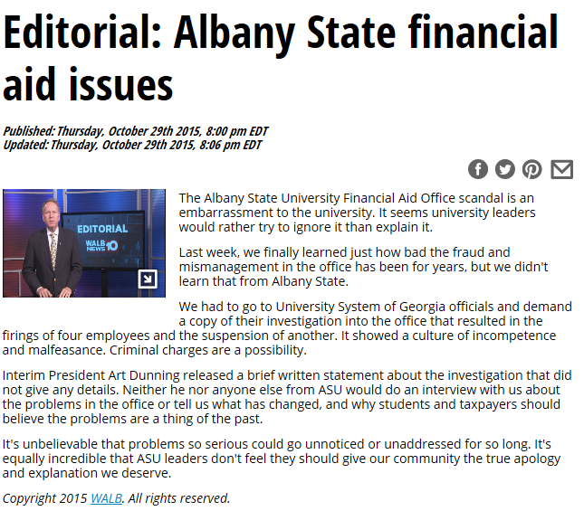
COSO Model: (Not So Good) Control Environment
Notes:
The environment sets the tone of an organization. It is the foundation for all other components of internal control, providing discipline and structure.
The “Tone at the top” is often mentioned. This is the message you convey to your reporting structure and how you communicate acceptable behavior. Consider a supervisor who arrives late, leaves early, and takes long lunches and the message that this behavior conveys to their employees.
Another example is what happened at Penn State. Egregious behavior was condoned, resulting in significant loss of reputation to the entire institution.
Albany State Financial Aid – a culture of incompetence and malfeasance; reputational damage; no confidence that these issues are a thing of the past

Slide 29
COSO Model: Risk assessment
Categories
  Error
  Omission
  Delay
  Fraud
Balance between the impact of the event or action, and the cost of implementing a control
Notes:
So, thinking about your own department:
What are your Goals and Objectives. Do you have a mission statement?
What would prevent your goals and objectives from being achieved? Internal mistakes and errors, external events, decisions.
What is necessary to manage those risks?
The easiest way to start is to think about a single process, we usually use a visual aid such as a flowchart. Think about what can go wrong, then consider how to prevent it. A guiding principle is that internal controls should be proactive, value-added, cost- effective and address exposure to risk.
Area Department Risks:
HR – Federal Workstudy – e.g., Students recorded work hours in ADP match the hours reported in student timesheets; compliance requirements
Access –
International Programs -
Creative Designs -
Grants -
Police -
FAID -
College of Education -
Institutional Effectiveness -
Student Services -
Budgets -

Slide 30
Question #4
Your department has been struggling to implement the monitoring component of the COSO framework. Which of the following is NOT correct in how the department can implement the monitoring component?
Monitoring can be an ongoing process.
Monitoring can be conducted as a separate evaluation.
An adequate internal audit staff can reduce external audit costs.
The independent auditor can serve as part of the control environment.
Notes:
Answer: D – Management is responsible for establishing and maintaining the entity’s internal control, and an independent auditor cannot perform management functions. Monitoring can be an ongoing process or be conducted as a separate evaluation. For many larger entities, internal audit departments are essential for effective monitoring. In fact, internal auditors can have an effect on the external auditor’s evidence accumulation, provided the internal audit function is performed by staff independent of both the operating and accounting departments and reports either to top management or the audit committee.

Slide 31
COSO Model: Control Activities
  1. Preventive controls
    Written policies and procedures
      Employees know what is expected of them
      Reference material
      Training material
      Consistency & continuity
    Segregation of duties
    Physical control of assets
    Transactions are authorized and approved
    Supporting documentation
Notes:
Controls fall in to two categories
1. Preventive Controls - Designed to prevent an error or exception from occurring

Slide 32
COSO Model: Activities
  2. Detective
    Inventory counts
    Reconciliations
      Correct
      Routine
      Timely
      Reviewed by a person outside of the process
    Monitoring that policies are being followed
Notes:
And 2. Detective Controls - Detective controls are designed to identify an error or exception after it has occurred.
By a show of hands, which type of control is more effective? Preventive or Detective?
Answer is that an ounce of prevention is better than a pound of cure.

Slide 33
Types of Controls
Identify as either Preventive or Detective
Give example from your area
Approvals and Authorizations
Verification
Reconciliation
Reviews of Performance
Security of Assets
Segregation of Duties
Controls over Information Systems
  General (access, passwords)
  Application
Notes:
ASK AUDIENCE TO ANSWER THE QUESTIONS AND GIVE EXAMPLES FROM THEIR JOBS.
Approvals, Authorizations and Verifications – Preventive
Reconciliations – Detective
Reviews of Performance – Detective – Identify unexpected results or unusual conditions that require follow-up.
Security of Assets – Preventive (access controls) Detective – (counts and reconciliations)
Segregation of Duties – Preventive – responsibilities for authorizing transactions, recording transactions (accounting), and handling the related asset (custody) are divided.
Controls over Information Systems – Preventive and Detective – Controls over information systems are grouped into two broad categories – general controls and application controls. General controls commonly include controls over data center operations, system software acquisition and maintenance, access security and application system development and maintenance. Application controls such as computer matching and edit checks are programmed steps within application software; they are designed to help ensure the completeness and accuracy of transaction processing, authorization and validity. General controls are needed to support the functioning of application controls; both are needed to ensure complete and accurate information processing.

Slide 34
COSO Model: Communication
Who does your department communicate to?
Who provides information to your department?
Consider:
  Faculty
  Students
  Customers
  Suppliers
  Regulators
  Other departments
Notes:
Quality and Effective communication must occur in a broader sense, flowing down, across, and up the organization.
Internally, communication should flow down from management to staff, across from one department to another and up from staff to management.
Information must also be Reliable and Relevant and Timely and Accessible
Are you getting the information you need to do your job?
The right information must be identified, collected and communicated so employees can carry out their responsibilities as intended.
Communication tools can be as informal as one-to-one conversations and as formal as policy manuals.
For example:
If an institution wants to increase its undergraduate enrollment, then it must be able to manage an increasing number of student applications and admissions. When the new students arrive, the institution must have sufficient housing as well as the capacity to register, advise, and teach a greater number of them. In short, an institution's strategy to increase its enrollment will affect nearly every administrative and academic process. Managing and controlling the flow of information about the new strategy across the campus – and ensuring that there is clarity around the policies and processes that support and facilitate the flow of information with respect to this specific strategy – will be critical to the institution’s success.

Slide 35
COSO Model: Monitoring
What do you do to make sure that everyone is doing their job well and that all these controls are working properly?
You can have the best internal controls in place but if you never check to see that the controls are operating right chances are they are NOT.
Notes:
Just as control activities help to ensure that actions to manage risks are carried out, monitoring helps to ensure that the control activities are functioning as expected.
Ongoing monitoring activities include
management and supervision
self-assessments
internal audits
The use of spot checks of transactions or basic sampling techniques can provide a reasonable level of confidence that the controls are functioning as intended.
For the supervisors in the room, consider how you monitor your employees, and employees should consider how/who monitors you.
Example of a monitoring control:
A CBO’s review of a report that compares budget-to-actual unrestricted and restricted revenue as well as expense activity by school over a given period. An effective monitoring control includes not only the review, but also the specific follow-up inquiries that result in corrective budgetary actions.

Slide 36
Consequences of Poor Monitoring
Loss of reputation/Front page test
Unable to meet financial obligations
Sanctions for non-compliance
Additional rules and regulations
Notes:
Front Page Test – Would you want it reported in the Valdosta Daily Times or Atlanta Journal Constitution?
Fin Obligations: GPC - Cash balance declined until they could not meet the payroll
Burden of additional rules: KSU – One student was incorrectly allowed to pay in-state tuition and EVERY student admitted had to be tested.
NCAA violations – Academic fraud at UNC-CH. Dept of African American studies had courses of “low academic rigor” to boost GPA of student athletes.
Ethical – Penn State; Sandusky; Paterno was complicit

Slide 37
How does COSO apply to you?
Monitoring
Information and Communication
Control Activities
Risk Assessment
Control Environment
Notes:
The three objectives concern operations, financial reporting and compliance
The five components – monitoring, information and communication, control activities, risk assessment and control environment – MUST be in place in order for a control to be effective.
Monitoring:
What is done to make sure that everyone is doing their job well?
Information and Communication:
What IT do you use on your job?
Do these systems work well?
Who do you communicate with?
Do you get the information you need?
Control Activities:
Approval for purchases (supplies, equipment, inventory, travel)?
Are duties segregated so that one person is not doing everything?
Are reports reviewed before they are released to outside parties?
Do you know where all of the equipment is located at all times and who is responsible for what?
Risk Assessment
What are the risks that something will go wrong in your area?
What are the risks if your project/work is not completed on time?
Are you doing anything to try and reduce the risks in your area?
Control Environment
Do people know how to do their job?
Do you have written policies (What to Do) and procedures (How to do them)?
Is your area organized in a way that allows things to run smoothly and operate in the best manner?

Slide 38
COSO Model
Notes:
Referring back to the COSO model,
Each department/area/unit is a column
Operations, Financial Reporting, and Compliance cross over departments
Within each department, there are the layers of internal control
Foundation of control environment
Risk assessment
Control Activities
Information and Communication
Topped off with Monitoring activities
Simply put: Internal controls mean that you’re paying attention.

Slide 39
Test your Observation https://youtu.be/8-hapS2SPz4
Notes:
short video
https://youtu.be/8-hapS2SPz4

Slide 40
Correcting Control Deficiencies
When business controls contain weaknesses we must choose between the following alternatives:
Increase supervision and monitoring
Institute additional or compensating controls and/or
Accept the inherent risks with the control weakness (assuming management approval)
Notes:
The cost of control should never outweigh the benefit derived from the control.
Inherent risk – Probability of loss arising out of circumstances or existing in an environment
Compensating controls - Are used to "counterbalance" the effects of an internal control weakness (see below for examples)
Compensating Controls
Compensating controls are less desirable than the separation of duties internal control because compensating controls generally occur after the transaction is complete (post audit). Also, it takes more resources to investigate and correct errors and to recover losses than it does to prevent them in the first place. However, in some circumstances, Organizational Units do not have the staff resources to establish adequate separation of duties. In these instances, it is important for management to implement internal controls that compensate for this increased risk. Following is a list of compensating controls used at the university. An Organizational Unit must implement at least one of these when an adequate separation of duties is not present.
For the Finance System:
Review Reports of Detail Transactions Charged to the Responsibility Unit
At a minimum, Fiscal Managers having Fiscal Staff who can perform all aspects of a key activities grouping should be doing a monthly review of their departmental Detail of Budget, Revenue, Expenses and Transfers Report and the Balance Sheet Transaction Report for their department to identify, investigate, and correct improper charges. An adequate review will take into consideration the transaction date, vendor where applicable, description, dollar amount, and account. Keep in mind that this review of the Detail Report cannot be delegated; such delegation would defeat the effectiveness of this compensating control.
OR
Pull a Sample of Transactions Initiated by the Person with Incompatible Access
A manager periodically can pull and review the supporting documents for a transaction sample selected from transactions initiated by the person with incompatible access and charged to her or his Responsibility Unit. A sample can be generated by using detail reports, the central information warehouse, or one of the IRM web queries. An adequate review would consider the transaction date, description, vendor (where applicable), dollar amount, and account.
Attachment A provides an in-depth look at the Pull a Sample of Transactions Initiated by the Person with Incompatible Access compensating control.
For HRMS:
Job Data Compensation Change Audit
This audit report lists all compensation changes made to an employee’s job record, including the addition of new jobs and the deletion of any rows, whether the actions are done in add, update/display, or correction mode. No system-generated updates, e.g., mass salary increases, are included. This report is available in HR Production, but at present is limited by operator security to the campus HR offices. Step-by-Step Guides for this report are in development, and when these are completed, more widespread training on the Job Data Compensation Change Audits report will begin.
Time Collection Compensation Override Audit
This audit report lists all rate changes from the amount specified in Job Data (for example hourly override amounts) and flat amounts that are paid to an employee through time collection. This report does not include earnings codes that do not represent pay to the employee (for example BEX, which just increases an employee’s taxable gross income). This report is available in HR Production, but at present is limited by operator security to the campus HR offices. Step-by-Step Guides for this report are in development, and when these are completed, more widespread training on the Time Collection Compensation Override Audit report will begin.
If an organizational unit wants to strengthen further its internal controls, it can also implement the following compensating control.
Prepare Budget Analysis and Cost Trends: Investigate Discrepancies
Preparing and/or reviewing budgets, and also doing a trend analysis of expenses, can be a way to identify problem areas where further and more detailed review needs to take place.

Slide 41
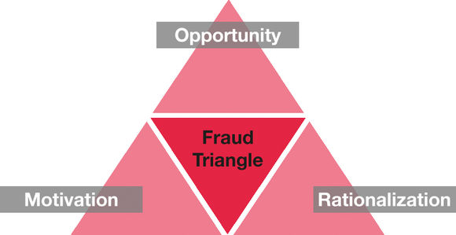
What If We Don’t Have Controls
We open the door for FRAUD:
Notes:
Whether you are a fraud professional or you are just curious about the various types of financial fraud, there is one concept that is important to grasp before anything else makes sense: this concept is the Fraud Triangle.
What is the Fraud Triangle?
The fraud triangle seeks to explain what must be present for fraud to occur. There are three basic things that must be present in order for fraud to occur: opportunity, motivation, and the ability to rationalize. Without these three things, fraud is unlikely to occur.

Slide 42

Fraud Triangle: Opportunity
Opportunity facilitates the ability to commit fraud
  Weak internal control environment
  Poor management oversight
  Misuse of position or authority
Notes:
Fraud Triangle Point #1: Opportunity
Opportunity in the fraud triangle is simple. In order for fraud to occur, there has to be an ability to commit fraud. For instance, a cashier can steal money out of the cash register because it is there. If the cashier was required to drop all cash in to an underground safe to which he did not know the combination, opportunity would not exist.

Slide 43
Fraud Triangle: Opportunity
This is the individual who sets the
TONE
Which in turn provides the
OPPORTUNITY
For fraud to occur
Notes:
http://www.wsbtv.com/news/local/audit-uncovers-suspected-fraud-georgia-tech/241975839

Slide 44
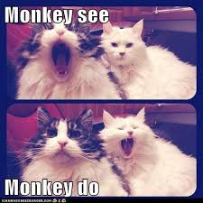
Fraud Triangle: Opportunity
The Big Monkey Theory
  Monkey See
  Monkey Do
  Does not matter what’s on paper
  It’s what the BIG Monkey DOES the Little Monkey will DO!!!
Notes:
http://www.wsbtv.com/news/local/audit-uncovers-suspected-fraud-georgia-tech/241975839

Slide 45

Fraud Triangle: Motivation
Most pressure comes from a significant financial need or problem
  Family situation
  Medical bills
  Expensive tastes
  Addiction problem
  Greed
Notes:
Fraud Triangle Point #2: Incentive (Pressure) / Motivation
In order for someone to perpetrate fraud, there has to be an incentive. Take the same cashier example. Say he is able to access the cash in the cash register. Will the cashier gain anything by taking the cash? He may be late on his electric bill or wants a new expensive watch that he saw at the mall. These needs and wants could be motivating factors.

Slide 46

Fraud Triangle: Rationalization
Rationalization involves a person reconciling his/her fraudulent behavior
  Fraud is justified to save a family member or loved one
  Person believes they will lose everything
  Person believes no help is available
  Job dissatisfaction factors (salaries, work environment, treatment by management) person believes something is owed to him/her
  Person labels the theft as “borrowing”
Notes:
Fraud Triangle Point #3: Rationalization
Rationalization is the grayest area in the fraud triangle. Opportunity and motive exist or don’t exist. However, rationalization depends on the individual and the circumstances they are facing. If the cashier feels he is underpaid, he/she could rationalize stealing money by feeling that it is owed to them. On the other hand, the store owner could be like family to the cashier in which case stealing the money would feel wrong. In that case, the cashier would not likely steal from the cash register.
Understanding the fraud triangle is essential to evaluating financial fraud. Once you grasp the basic concept of the fraud triangle you will be able to better understand financial frauds, how they occur, why they occur, and what you can do to stop them.

Slide 47
Typical Fraudster?
Male
36 to 45 years old
Has not been previously charged or convicted for a fraud-related offense
Senior management position
University degree
Living beyond one’s means (financial difficulties)
Employed by company 1-5 years
Notes:
According to 2016 Report to the Nations on Occupational Fraud and Abuse

Slide 48

What about trust?
Notes:
Trust is not a recognized internal control

Slide 49
Situations That May Contribute to Fraudulent Activities
Ineffective internal controls
Insufficient supervision
High personnel turnover
Low employee morale

Slide 50
BEST PRACTICES

Slide 51

Value your Signature
Know what you are signing
Ask if it is a wise use of taxpayer or student funds?
You are responsible for what you have signed.
Don’t use a rubber stamp
Don’t include your signature in your email
Don’t sign blank forms
Don’t let other folks sign your name or initials
Notes:
The President at GPC said he had never seen the audited financial statements. Yet, there was signature proof that he had seen them. In this instance, either scenario was unacceptable.
A good state employee – she realized that it was “her” taxpayer money being spent and she was a good steward.

Slide 52

Protect your Password
Don’t share your password with anybody. EVER!
Don’t let anyone watch you enter your password.
Use a strong password that you don’t have to write down.

Slide 53
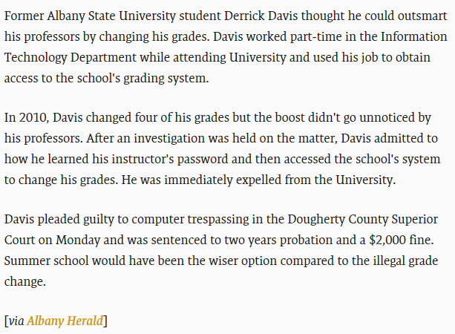
Protect your Password
Student Admits To Hacking Into University's Computer System To Change Grades

Slide 54
Develop Written Procedures
Resource for current employees
Training tool for new employees
Promote consistency and efficiencies
Manage expectations – everyone knows what is expected of them.

Slide 55
Segregation of Duties
No one should control any process start to finish.
No one can approve their own expenditures.
Each transaction should have at least 2 people involved: an initiator and an approver.
Reduces the possibility of errors
Separate persons should approve and record transactions and have custody of the asset
If not feasible – have compensating controls in place

Slide 56
Financial and Other Reports
Review budget reports
Review reports showing who accessed computer files
P-cards
Accounts Payable
Accounts Receivable
Payroll
Investigate unusual transactions

Slide 57
PCards
GA Tech
https://www.youtube.com/watch?v=Buuen1pwJdo

Slide 58

Cash
Deposit all cash and checks at the Bursary daily
Keep cash locked up
Dual controls
Accountability: Sign-off each time cash changes hands

Slide 59
Example:
Cash (contd):
  What are some controls:
    Segregate receiving, depositing, recording and reconciling
    Regular reconciliations
    Accountability, including sign-offs and receipts
    Pre-numbered receipts
    Daily deposits
    Receipt books
Notes:
Control is most effective when only one person is responsible for the given task.
You never want someone to be doing too many tasks (Collecting cash, recording cash and depositing cash..these duties should be segregated)
Prenumbered documents and all documents should be accounted for (ex. Deposit receipts, invoices)
Reconciliations on all cash accounts should be prepared monthly and
Reviews of all reconciliations and reconciling items monthly by someone other than the preparer of the reconciliation ,along with supervisor sign off

Slide 60
Example:
Review your cash transactions:
  What are the risks:
    Misappropriations
    Diversion of funds
    Posting to wrong client account

Slide 61
We’ve Always Done It That Way
Review your processes on a continuous basis
Improve inefficiencies and duplications of effort
Ask yourself WHY you are doing what you’re doing and be sure you understand the purpose

Slide 62

Approvals
Document:
What?
Why?
Notes:
Be sure all expenditures have a clear business purpose.
The business purpose for all expenditures should be clearly documented but ESPECIALLY if the purchase could be construed as personal

Slide 63
Prevent & Detect Fraud
Trust your instincts
Be open to concerns from your staff
Insist policies and procedures are followed:
  Prevent fraud
  Protect employees from accusation of fraud
  Protect employees from temptation
Not everything that looks suspicious is a fraud, but every fraud looks suspicious. If it looks suspicious, follow up on it.

Slide 64
Question #5
In a university setting what area is most likely to have weak internal controls where fraud could occur?
  A. Accounting
  B. Operations
  C. Information Technology
  D. Human Resources
Notes:
Clicker: Answer A
According to 2016 Report to the Nations on Occupational Fraud and Abuse
Accounting 16.6%
Operations 14.9%
IT 2.8%
HR 1.2%

Slide 65
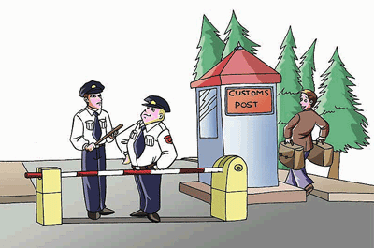
DO NOT CIRCUMVENT INTERNAL CONTROLS

Slide 66
Accountability
For yourself
For others
For doing the right thing

Slide 67
Where is Your Department?
Unreliable
Control activities are not designed or in place. The environment is unpredictable.
Informal
Control activities are designed and in place but they are not adequately documented.
Standardized
Control activities are designed, in place and adequately documented.
Monitored
Controls are standardized. There is periodic testing for effective design and operation with reporting to management.
Optimized
Controls are integrated. There is real-time monitoring by management and continuous improvement.
Internal Control Maturity Model
Notes:
Internal Control Maturity – keep moving rightward
Where is your department?

Slide 68
Accountability
UGA – Financial Wrongdoing
http://www.wsbtv.com/news/local/channel-2-investigation-exposes-financial-wrongdoi/26909704

Slide 69
Resources
VSU Internal Audit – Heidi Cox 245-2491
VSU Legal Office – Tony Thomas 333-5351
VSU Hotline - 877-516-3470
USG OIAC – 404-962-3034

Slide 70
Comments and Questions?

